Slide 1
Water Source to Conway Garden
Presentation by the District 1 Community Council for the Garden of Feed’em

Slide 2
Garden of Feed’em
Second of two community gardens in District 1
Located in a city park surrounded by apartments and single family homes
Diverse group of gardeners
Community plot that feeds home-bound seniors and supplies the local foodshelf
Additional science plots by University of St. Thomas

Slide 3
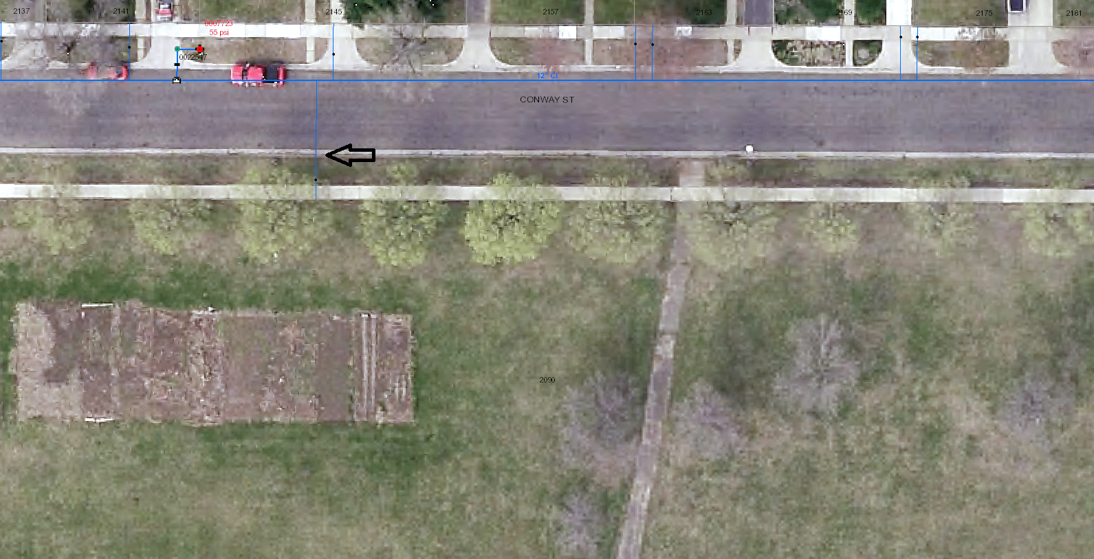
The Current Situation

Slide 4
The Solution
Working with Parks since last fall
Proposal to connect to the water main
Does a stub-in already exist?
What is the cost of a connect to the Conway center?
Allows for greater participation, greater productivity

Slide 5
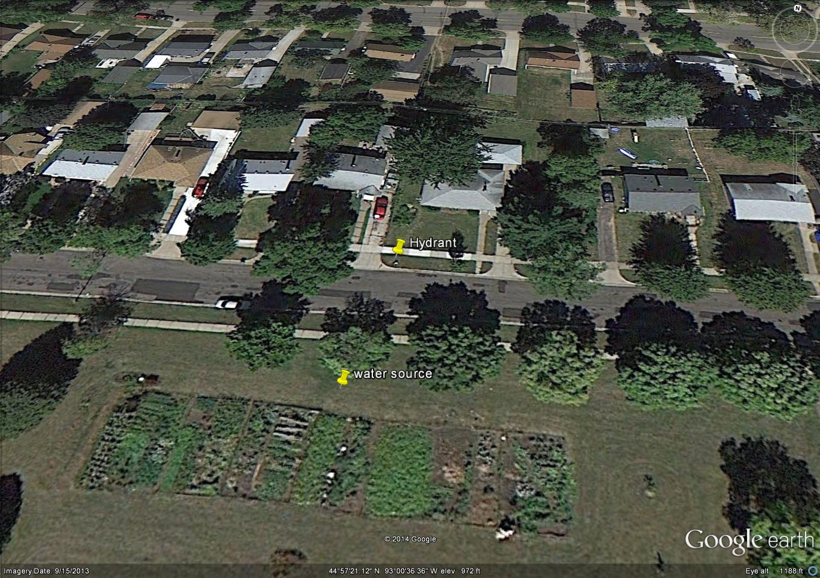
The Proposal

Slide 6
Benefits
Creates an asset for area that is seeing increasing use by increasingly diverse group
Increases safety concerns with use of hoses across the street
Community gardeners and University of St. Thomas are in support
Currently gardeners are not paying for water use – a meter would be installed

Slide 7
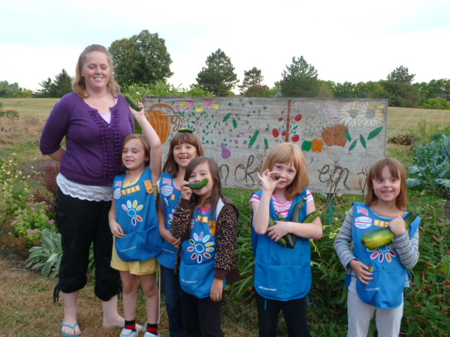
The wider community benefits!

Slide 8
THANK YOU!!

