Slide 1

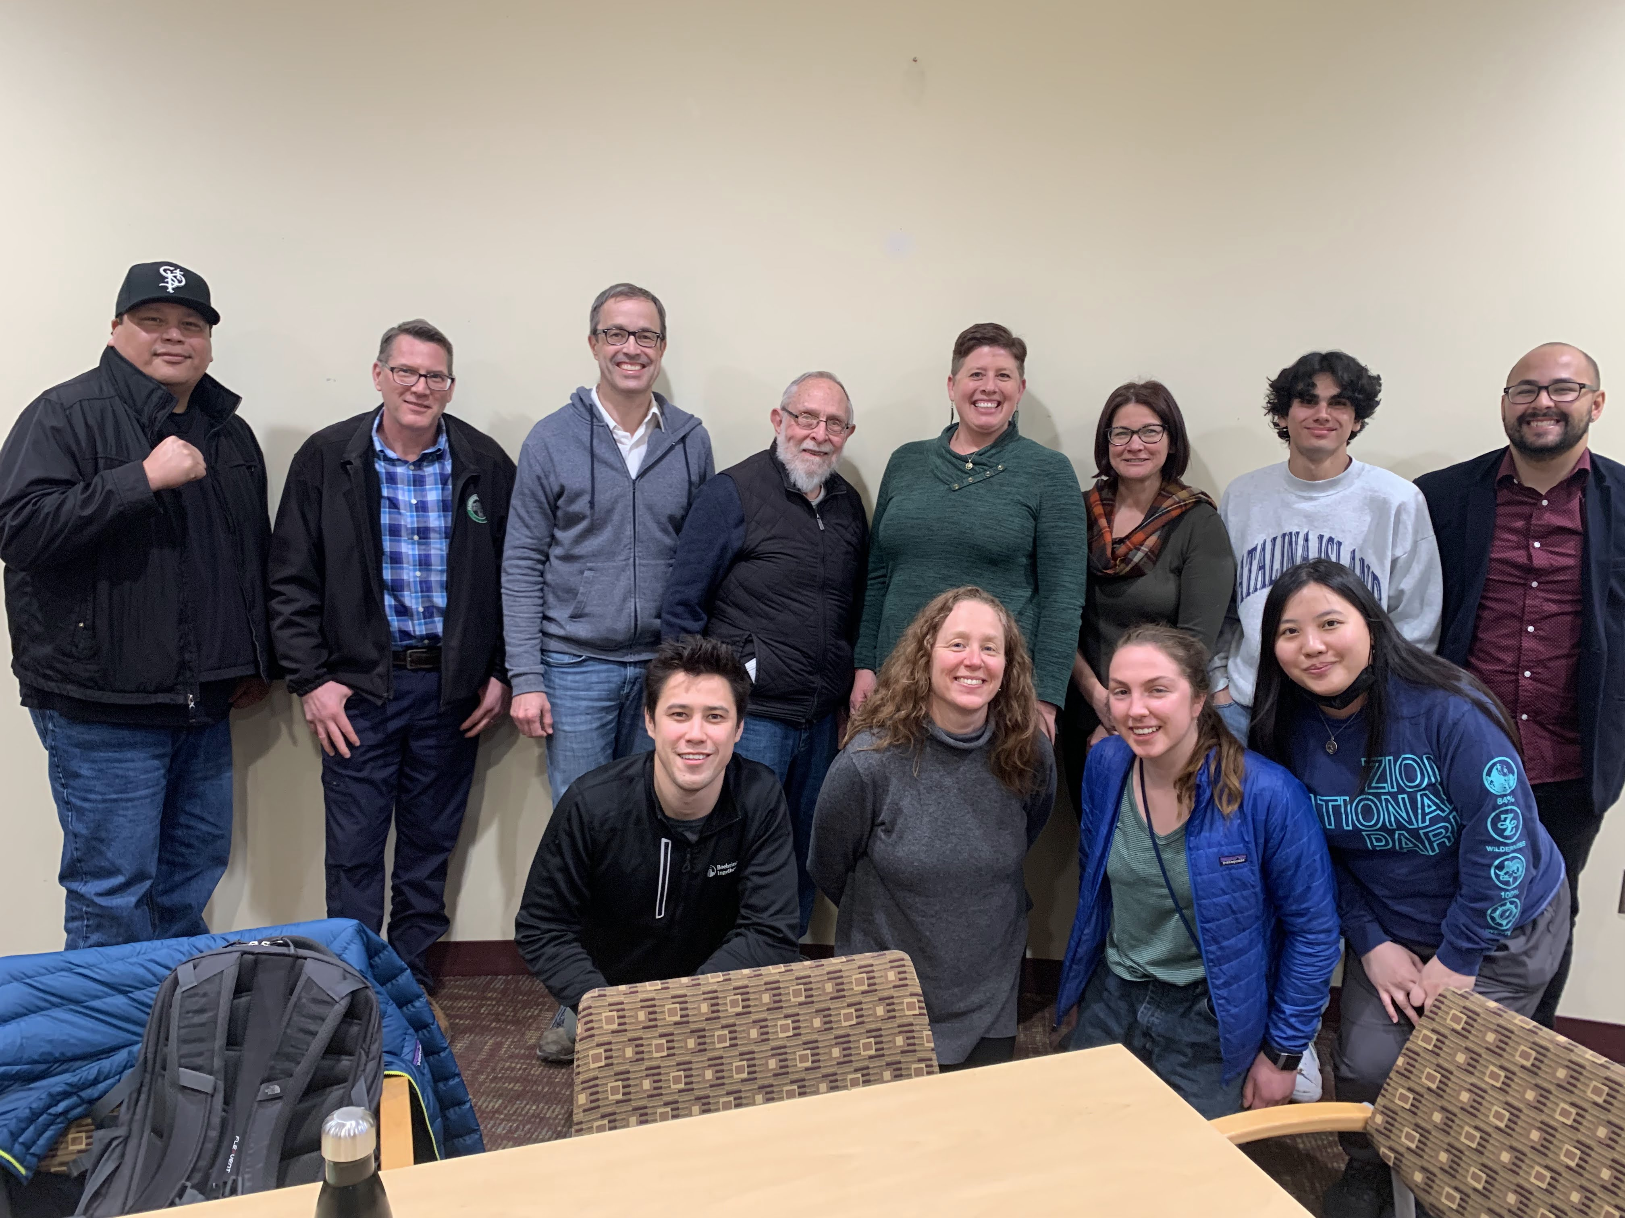
Climate Justice Advisory Board (CJAB)

Slide 2

Introduction of CJAB Members
Notes:
EVERYONE
Slide
Thank you Council President Brendmoen and Council Members.
Hello and thank you for inviting us to share an overview of our first year as St. Paul’s inaugural Climate Justice Advisory Board. I am (name, ward, why you are invested in the City of St. Paul, why you believe climate change is a critical issue for St. Paul)

Slide 3
Thank You!
January 2021
Unanimously established CJAB on January 20, 2021
Declared a climate emergency in Saint Paul, Minnesota on January 19, 2022. Issued joint climate action with cities and counties across the state
January 2022
Notes:
Kristen
Slide
We’d like to start by thanking you for demonstrating your commitment to the climate crisis by declaring a unanimously declaring a Climate Emergency in January- demonstrating leadership and solidarity with other cities and counties across Minnesota. Strong leadership and aggressive reduction of greenhouse gas emissions is critical. We’re proud that St. Paul recognizes this and in addition recognizes that this work must be done justly and equitably through the resolution that established our Board.

Slide 4
Climate Justice Advisory Board (CJAB)
CJAB will advise the Mayor and City Council on the development of policies and programs related to the City of Saint Paul’s Climate Action and Resilience Plan (CARP). The CJAB’s focus will be to ensure that the costs and benefits of new programs in clean energy, energy efficiency, the reduction of greenhouse gas emissions, and climate resilience and adaptation, are equitably distributed and address the challenges faced by our most vulnerable populations and neighborhoods.
Notes:
Kristen
Our Charter is to advise the Mayor and City Council on the development of policies and programs related to the City of Saint Paul’s Climate Action and Resilience Plan (CARP). The CJAB’s focus will be to ensure that the costs and benefits of new programs in clean energy, energy efficiency, the reduction of greenhouse gas emissions, and climate resilience and adaptation, are equitably distributed and address the challenges faced by our most vulnerable populations and neighborhoods. CJAB-50% or more BIPOC, 1 person from each ward, youth representatives
The City of Saint Paul has committed to reducing greenhouse gas emissions community-wide 50% by 2030 and down to net zero by 2050. The City recognizes that policies and programs could have negative impacts on BIPOC (Black, Indigenous, and People of Color) communities and under-resourced residents
if the needs of and challenges faced by these groups are not explicitly addressed. The transition to cleaner energy and reduced greenhouse gas emissions will require significant investment in our communities, and the CJAB will help to ensure that Saint Paul’s most vulnerable residents benefit as much or more from these changes as the City’s less vulnerable populations.
The CARP also identifies strategies for building climate resilience, and the CJAB will advise the Mayor and Council on the design of policies and programs in this area as well. In this context, climate resilience refers to natural, physical, and social infrastructure that makes our community less vulnerable to negative effects of changes in our climate, such as extreme heat and increased flooding.

Slide 5
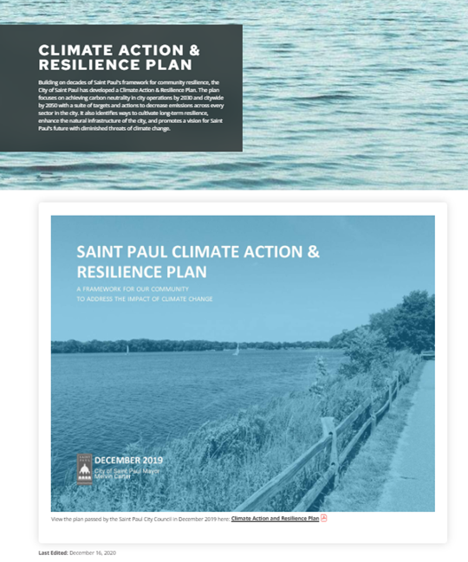
Year 1: Got grounded in CARP & current initiatives
Laid groundwork to more pro-actively help the City prioritize and maximize the impact of new climate justice initiatives
We know we need to do a lot! But that we can only do so much
Notes:
Kristen
Today we are excited to share a bit more about who we are, what we have worked on to date, and where we would like to focus in the future. I think if there is any takeaway from today – I hope you see that we take our role as a climate justice advisory board seriously- we have thought deliberately about what each of those words climate, justice, advisory, and board mean as St. Paulites and collaboratively defined them. We have looked to the CARP to ground us in the climate mitigation and adaptation needs of St. Paul, and discussed how we equitably and justly address those needs so that they take all St. Paulites- especially those that are impacted first and worst by climate change- into account. There is so much to do and as a volunteer board, supported by Russ- only one, very capable staff person-we know that we need to prioritize.

Slide 6
Our connections with the Council
CJAB has connected with the Council twice in the past year:
  Daunte Wright curfew
  Line 3
These interactions allow us to continue thoughtful conversations on the role of CJAB and the intersection of climate change and social justice.
Notes:
Kristen
CJAB has connected with the Council twice this year as we were determining our role and the actions we could take. It has been clarified that we were not within the boundaries of our role entirely. We do hope that the unanimous concern expressed by CJAB about the impact of the Duante Wright curfew and Line 3’s impact on our St. Paul communities- especially on our most vulnerable populations and neighborhoods offers clear examples of how we understand climate change as intersectional and that climate justice is racial justice.

Slide 7
First Year Accomplishments
Board Structure
Climate Jusice Definition
Community building
Defining our role
Notes:
May
Our first year we have laid the groundwork for the board and our work moving forward by establishing a structure that reflects our work, a climate justice definition to guide us, connecting with our CJAB community and the greater St. Paul community, and defining and clarifying our role.

Slide 8
Board Structure
Shared Leadership including Co-chairs, Chair Designate, Secretary, and a youth leader
Diverse and representative leadership including youth and Saint Paul community advocates
Staggered terms to support leadership development
Rotating leadership: New chair every 6 months
Notes:
May
Our board structure is intentional and developed to reflect the communities we serve and the type of structure that is need form just and equitable decisionmaking.
July 2022: Kristen on, elect new designate, Secretary, and youth leader
January 2023: Melissa cycle off, new designate co-chair join, elect new designate

Slide 9
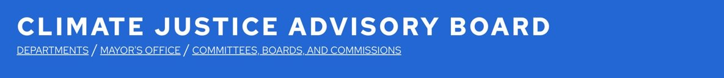
Defining Climate Justice
Climate Justice Definition
To achieve equitable and just outcomes, we must ensure equity & inclusion are centered in decision-making & utilize a climate justice lens. Climate Justice aims to establish a world where everyone has dignity & can thrive. Climate Justice is realized when the residents & communities that experience the most harm from unhealthful air & water, the urban heat island effect, fewer trees & less access to greenspace, & other inequities related to environmental racism, are prioritized with investments that lead to cleaner air, water, more energy-efficient and healthful homes & businesses, equal access to greenspace, & accelerated economic opportunity.
A Climate Just Saint Paul looks like a community in which there are equitable & sustainable systems so that everyone has dignity & can thrive by having access to clean air, water, greenspace & natural areas, economic stability & mobility, healthy food, affordable & safe housing and neighborhoods, & safe and quality education.
Notes:
May
It took a few iterations to get to an agreement, but our Climate Justice definition is important to us as we think about what is important and how we look at the opportunities to make changes.
READ

Slide 10
Community Building
Building the CJAB community
Developed our Climate Justice Definition
Established board structure
Hosted outdoor Summer Meet Up
Started visioning for Year 2
Getting to know our city's community
Mayor attended meeting for discussion after Daunte Wright's death
IRP-PUC role
EV Spot Network and EV Carshare
Presentation on Truth in Sale of Housing Energy Disclosure proposal
Low-income energy efficiency & weatherization presentation
Youth Commission
Notes:
May
Getting to know each other and others doing climate and energy work to support the CARP in St. Paul was important this year. Together we were able to work through the things I already mentioned, as well as actually meet up in person last summer and start developing a vision for next year in a recent meeting. We had visits from a number of guests to provide their expertise and information on work they are doing to support the CARP. Some of those guests are featured here. We were excited to be joined by Mayor Carter early last year to discuss the intersection of cliamte and racial justice, and opportunities ahead.

Slide 11
What are CJAB Members most proud of in their first year?
Notes:
Kathleen
We spent some time talking about what were most proud of in our first year and Members answers really fell into two categories.

Slide 12
Building a Caring Community
"Our collaborative approach to defining climate justice was very memorable. It spoke to our ability to be thoughtful in this important work."
"The courage of our members to use their voice to advocate for climate justice. It's powerful when a diverse group of strangers share a unified purpose."
"How passionate people are and motivated to improve the lives of our community members and Saint Paul."
Notes:
Kathleen

Slide 13
Learning
"I think before joining the CJAB and reading the CARP and all the different maps of the city really showed the challenges and inequities we have in Saint Paul without any words."
"The most memorable part about CJAB in the first year was learning about the different programs in energy the City of Saint Paul offer and presenters for taking their time to talk with us."
"The conversation with Mayor Carter. To be able to talk about the CJAB and our role."
Notes:
Kathleen

Slide 14
Looking Ahead
Identified Priorities:
Transportation
Energy burden
    Green workforce development and inclusion
Emergency preparedness
Communication/education with community
Notes:
Melissa
Recently we met to discuss what concrete actions we might be able to take in the year ahead after this year of building a foundation and learning about the opportunities in St. Paul. There was interest in focusing more specifically on these topics and thinking about how we might establish working committees.

Slide 15

Transportation
Gas-powered automobiles are greenhouse gas contributor, local pollution impact
Inequitable access to transit options
Car-ownership is expensive
Lack of cars in a car-centric community results in time-consuming transit
Extreme weather events could greatly impact car-less households
Notes:
Melissa

Slide 16

Energy Burden
We all want healthy homes and energy efficiency. How should the city prioritize these efforts in the short-term?
Funding from the American Rescue Plan could provide support to those who are the most burdened
Notes:
Melissa
The CARP details that Saint Paul is committed to 50% reduction of GHG by 2030 which will take significant investment across sectors- one of which is in energy efficiency and renewables. An estimated 38,000 Saint Paul Households live below 50% of the area median income. A baseline analysis of household income and average energy costs show that 12 census tracts within the city have a median energy burden above 4%, with the highest at 12%. These 12 tracts contain over 10,000 households. How do we lower the energy burden so that no Saint Paul household spends more than 4% of household income on energy costs?

Slide 17
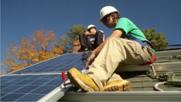
Green Workforce Development and Inclusion
What opportunities should the city advise on? How will the city support a "Building Green Saint Paul"?
How can Saint Paul position itself as a leader when it comes to today’s workforce and the workforce of the future?
Notes:
Melissa
While not specifically outlined in the CARP- the transition that needs to happen involves a new set of skills and workforce. Both youth and adults need to have access to high quality education and training that connects to a green career pathway.

Slide 18

Emergency Preparedness
How can we ensure residents are better prepared and educated?
Where can the "American Rescue Plan" support?
Notes:
Melissa
Unfortunately we know that focusing on just mitigation is no longer an option- especially for our most vulnerable communities. Advising on how we can ensure our residents are better prepared and more educated is critical with increasing heat, flooding, and extreme weather events.

Slide 19

Communication & Education with Community
CJAB will advise on elements of new virtual Climate Action Dashboard
What opportunities are there for CJAB/the city to better share and educate residents on the importance of just climate action and already implemented solutions?
How can the cities support schools on climate justice?
How can the youth council and CJAB work together?
Are there other voices we (and the city) should be connecting with?
Notes:
Patty
There is a real opportunity to do more in the realm of education and engagement. In MSP metro 76% believe that cc is happening- yet only 38% report that they talk about it occasionally. 58% think local officials should do more to address cc.

Slide 20
An Invitation!
We'd love for you to join a meeting and are always available for consultation on related issues!
Notes:
Patty

Slide 21
Questions?
Notes:
Patty

