Slide 1
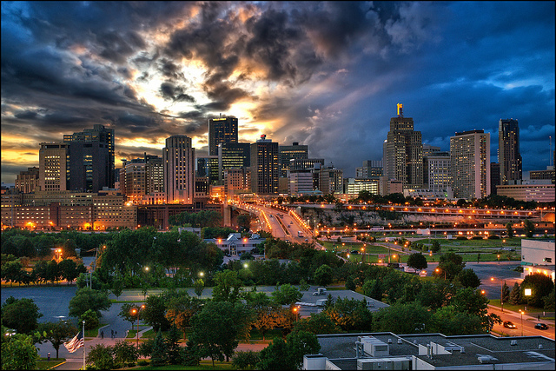
CITY OF SAINT PAUL
CLIMATE DASHBOARD

Slide 2
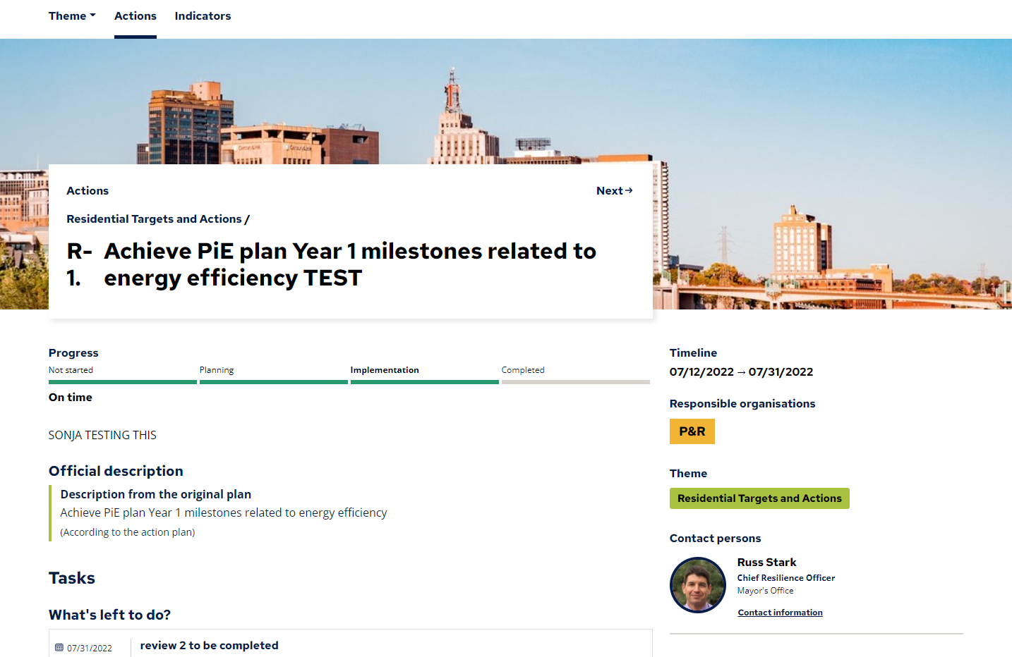

Slide 3
CJAB Priority Areas
Transportation
Energy Burden
Green Workforce Development and Inclusion
Emergency Preparedness

Slide 4
Defining the Priorities
Small Groups: 15 min

Slide 5
Small Group Work: 15 min
Discuss and take notes in your small groups for your assigned priority area:
What is our desired outcome: what change do we need to see as a result of our actions?
What actions should the city take to achieve this (or what is the city currently doing, if known)?
How will we know we are successful: what metrics should we be tracking?

Slide 6
Transportation
Gas-powered automobiles are greenhouse gas contributor, local pollution impact
Inequitable access to transit options
Car-ownership is expensive
Lack of cars in a car-centric community results in time-consuming transit
Extreme weather events could greatly impact car-less households
Notes:
Melissa

Slide 7
Energy Burden
We all want healthy homes and energy efficiency. How should the city prioritize these efforts in the short-term?
Funding from the American Rescue Plan could provide support to those who are the most burdened
Notes:
Melissa
The CARP details that Saint Paul is committed to 50% reduction of GHG by 2030 which will take significant investment across sectors- one of which is in energy efficiency and renewables. An estimated 38,000 Saint Paul Households live below 50% of the area median income. A baseline analysis of household income and average energy costs show that 12 census tracts within the city have a median energy burden above 4%, with the highest at 12%. These 12 tracts contain over 10,000 households. How do we lower the energy burden so that no Saint Paul household spends more than 4% of household income on energy costs?

Slide 8
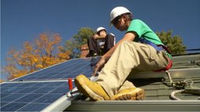
Green Workforce Development and Inclusion
What opportunities should the city advise on? How will the city support a "Building Green Saint Paul"?
How can Saint Paul position itself as a leader when it comes to today’s workforce and the workforce of the future?
Notes:
Melissa
While not specifically outlined in the CARP- the transition that needs to happen involves a new set of skills and workforce. Both youth and adults need to have access to high quality education and training that connects to a green career pathway.

Slide 9
Emergency Preparedness
How can we ensure residents are better prepared and educated?
Where can the "American Rescue Plan" support?
Notes:
Melissa
Unfortunately we know that focusing on just mitigation is no longer an option- especially for our most vulnerable communities. Advising on how we can ensure our residents are better prepared and more educated is critical with increasing heat, flooding, and extreme weather events.

