Slide 1
2019 Proposed Budget Presentation to the City Council
September 19, 2018
Saint Paul Parks and Recreation - Recreation Focused
- Como Campus
- Recreation
- Special Services
Notes:
Delete [Department Name] and add your department

Slide 2
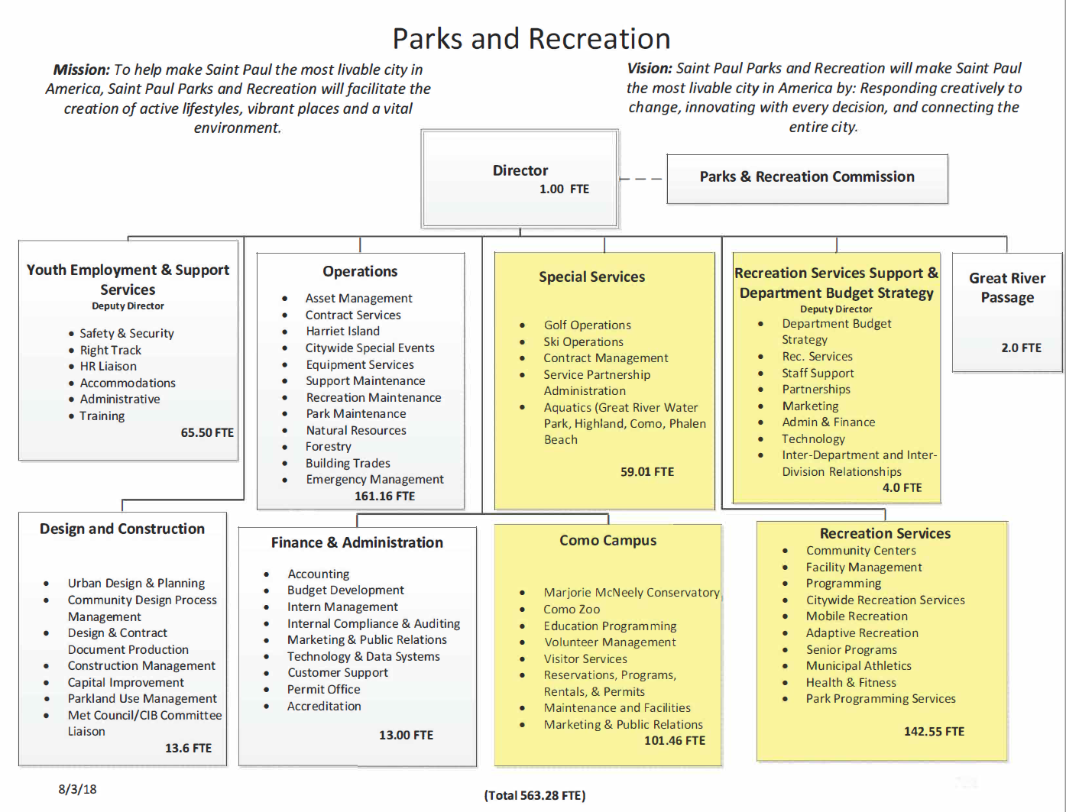

Slide 3
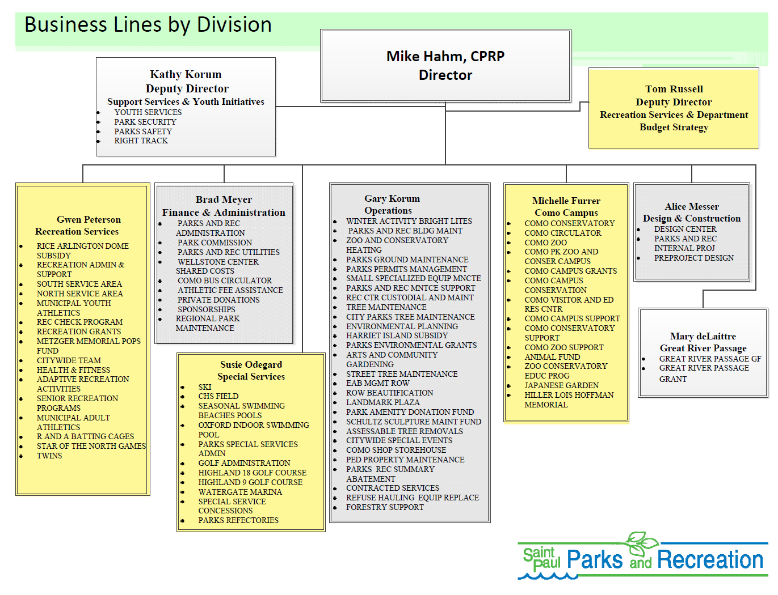

Slide 4
Parks and Recreation Business Line Portfolio for General and Special Funds
Notes:
Spending Budgets by Division and separated by General Fund and Special Fund

Slide 5
Financial Summary
 | 2018 Adopted | 2019 Current | % Change | FTEs
General Fund | $34,906,856 | $38,512,977 | 10.3 | 354.25
Special Funds | $25,900,815 | $25,147,413 | -2.9 | 209.03
Total: | $60,807,671 | $63,660,390 | 4.7% | 563.28
Significant General Fund Changes in Previous Budgets
2018 | Right Track – One-time resource to supplement loss of state funding for YJ1 youth wages | $200,000
2018 | Capital Projects – One-time predesign funding for staff to work on planning for specific capital projects outlined by City Council | $100,000
2017 | Additional Recreation Services Programming | $158,167
2017 | Right Track (one time in 2017, made ongoing in 2018) | $125,000
*Redirected to Street Maintenance
Notes:
[slide from The Mayor’s budget submission template]
Fill out financial summary table with the relevant financial data.
Assume “Special Funds” means all non-General Fund funds combined, unless your budget analyst specifies differently.
FTEs should be the current 2019amount.
List any major General Fund investments in the previous two budget years.
Work with your budget analyst if you need examples of what type of investments to list here.
If additional rows are needed place cursor in one of the table cells and right click. Select “insert” and then select “insert row above” or “insert row below.” Do this as many times as necessary.

Slide 6
Financial Summary – Grants
 | Duration | Total Amount | 2019 Amount | FTEs
DNR 2018 EAB Grant | 1/1/18 – 12/31/18 | $1,455,000 | $0 | 0.0
MN Legacy Grant - Como | 7/1/17 – 6/30/19 | $2,646,000 | $661,500 | 2.3
MN Deed Right Track | 7/1/18 – 6/30/19 | $400,000 | $200,000 | 16.2
Total: |  | $4,501,000 | $861,500 | 22.3
Significant Changes to Grants in 2019
Description | Amount | City Match | Term
Forestry DNR Grant | $1,455,000 | $0 | 1/1/18 – 12/31/18
Deed Supplemental Grant (Right Track) | $202,970 | $0 | 1/1/18 – 12/31/18
Notes:
From Mayor’s Slides
Fill out financial summary table with the relevant financial data.
FTEs should be the current 2019 amount.
List any major grants that ended in 2018.
Work with your budget analyst if you need examples of what to list here.
If additional rows are needed place cursor in one of the table cells and right click. Select “insert” and then select “insert row above” or “insert row below.” Do this as many times as necessary.

Slide 7
Previous City Council Investments
City Council Investments in Previous Cycles
2018 | Predesign for Capital Projects | $100,000
2017 | Additional Recreation Services Programming | $158,167
2017 | Right Track | $125,000
Describe how that funding has been used and results to date?
The pre-design funding for the Rice Rec. Center, Highland 9, Eastview Tennis Courts and future park at Weyerhaeuser Development projects has them all at various design phases. The additional recreation services programming funding has helped add Saturday hours to Eastview and Dayton’s Bluff, add additional community youth worker and mobile recreation staffing and dedicate $22k in GF support towards Equity Matters classes. The Right Track investment has helped ensure continued executive level leadership along with adding project management, technical, and clerical support to meet program hiring goals.
Notes:
Slide for City Council
Question to answer in space below:
If the Council allocated additional funding in 2018 to your department, please describe how that funding has been used and results you have to date. What is the department’s 2019 proposed use for these funds, any changes to the program?

Slide 8
Summary of 2019 Budget Changes
Program | 2019 $ Change | Total 2019 Budget
Frogtown Community Center – Partial year operations | $283,862 | $417,389
Seal & Sea Lion Habitat – Partial year operations | $23,949 | $23,949
Re-Establish Services at Highwood Hills Recreation Center | $200,000 | $200,000
Recreation Center Hours – Equity Matters Facilities | $50,000 | $50,000
Youth Recreation Programming – Equity Matters | $200,000 | $304,572
Youth Program Quality Assessment – Dedicated specialist | $81,102 | $81,102
Youth Transportation – Funding to purchase vans and provide transportation to programming | $66,000 | $66,000
Rice Recreation Center – Design | $500,000 | $500,000
EAB – loss of 2018 State DNR grant and increase in 2019 GF support for EAB (Net) | -$8,222 | $2,539,948
Notes:
Slide for City Council
QUESTION: Please summarize the 2019 budget, include major spending and financing changes (positive and negative).
New Column, asking for the total budget, for example, Right Track Funding is increasing $200,000 (this would be the 2019 change) and the total Budget is $1,230,900

Slide 9
More Access – More Programs
Recreation Center Programming
9
Notes:
Header slide – do not edit.

Slide 10
Notes:
If applicable, use this slide to provide any additional analysis that supports this proposed budget change.

Slide 11
Recreation Services Budget
Recreation Services
  434 Employees (146.55 FTE’s)
  $8,953,240 GF
    97% Salaries
    2% Rec. Check
    1% Fee Equity
  $2,905,056 SF
    Fee supported Programming
    All Other Non-Staff Support for Programming
Notes:
Recreation General Fund Budget Supports
90% - Staff
Rec. Check
Fee Programs
Recreation Special Fund Budget Supports
All other non-staff support for programming (materials/supplies/etc)

Slide 12
Strategic Objectives
Recreation Center Programming
Notes:
Header slide – do not edit.

Slide 13
Notes:
If applicable, use this slide to provide any additional analysis that supports this proposed budget change.

Slide 14
Budget Proposals
Notes:
Header slide – do not edit.

Slide 15
Frogtown Community Center
Fiscal Impact |  |  |  | FTEs | Funding
General Fund |  | Special Fund |  | Additional (if applicable) | One-time (yes/no)
Spending | Revenue | Spending | Revenue | 3.49 | no
$283,862
Description
The new Frogtown Community Center will open in Summer/Fall 2019 and replace the existing Scheffer Recreation Center. The proposed budget includes additional building operations and programming funding for this new building with expanded square footage (6,000 to 24,000), hours, amenities, and programming for all ages, abilities, and backgrounds.
Which of the Mayor’s strategic objectives does this proposal support?
Economic Justice | Lifelong Learning | Community-first Public Safety
 | X | X
Department Strategic Objective | Improve access to programming and facilities
Notes:
Delete ‘[Proposed Budget Change]’ and add a title.
Provide the estimated costs, FTE changes, and whether this proposal is for one-time or ongoing funding. If you have a more detailed breakdown of these costs, please send that information to your budget analyst.
Provide a brief summary of the proposed change, including reference to what problem this change is trying to solve.

Slide 16
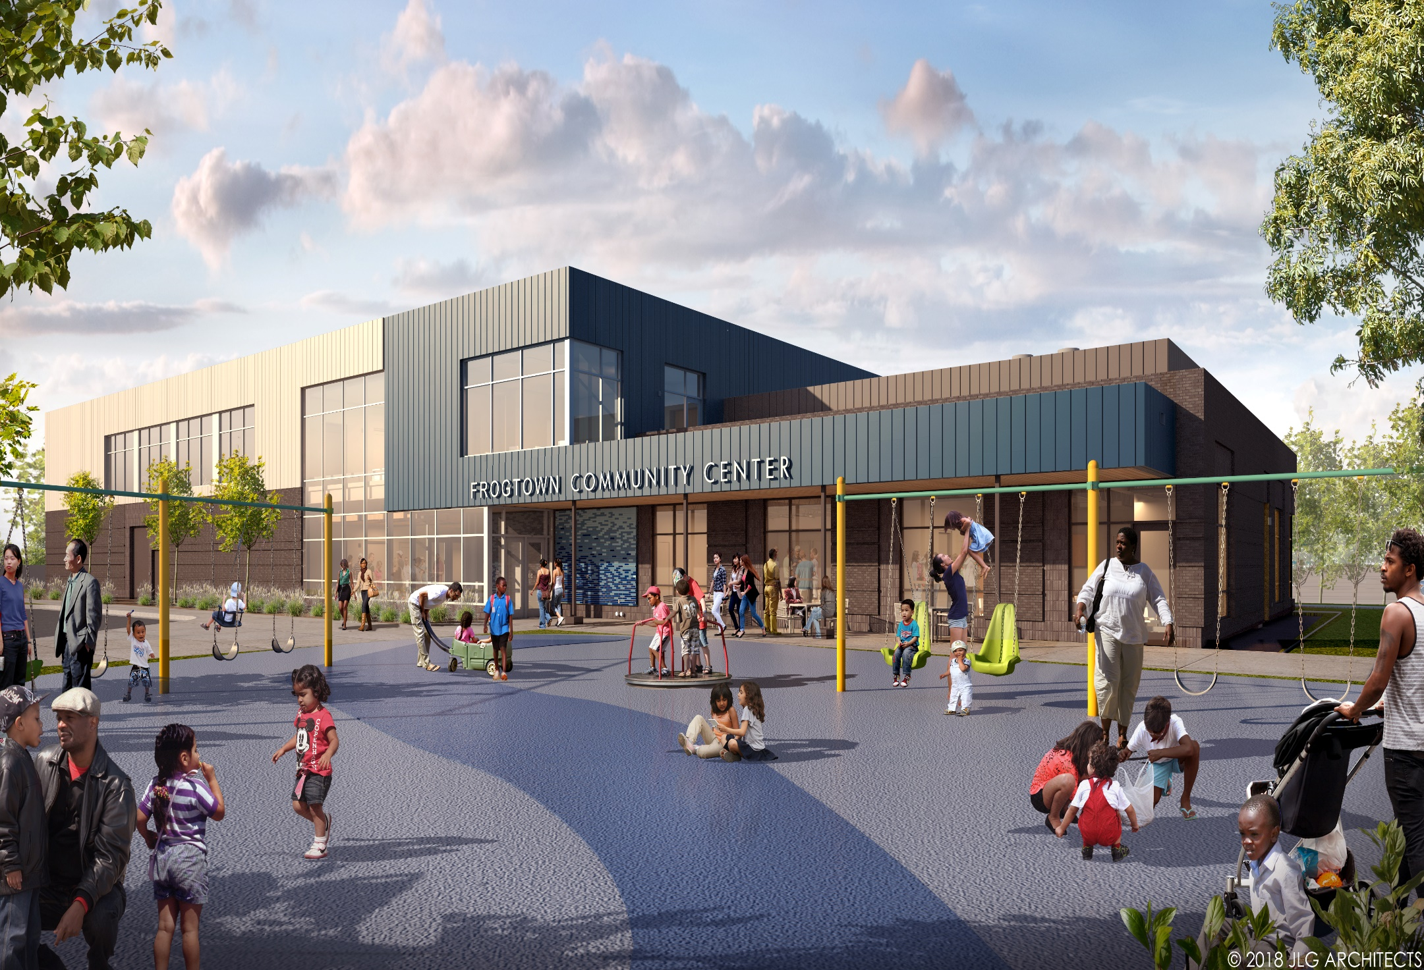

Slide 17
Seals and Sea Lions Habitat (Como Harbor)
Fiscal Impact |  |  |  | FTEs | Funding
General Fund |  | Special Fund |  | Additional (if applicable) | One-time (yes/no)
Spending | Revenue | Spending | Revenue | 0.16 | no
$23,949
Description
The new seals and seas lion habitat (now named “Como Harbor”) will open at Como Park Zoo and Conservatory in late 2019. The new space will allow for one habitat year-round, instead of the current set up which requires several locations and winter closure. The 2019 proposed budget includes partial-year funding for utilities and programming for this new exhibit.
Which of the Mayor’s strategic objectives does this proposal support?
Economic Justice | Lifelong Learning | Community-first Public Safety
 | X | X
Department Strategic Objective | Improve access to programming and facilities
Notes:
Delete ‘[Proposed Budget Change]’ and add a title.
Provide the estimated costs, FTE changes, and whether this proposal is for one-time or ongoing funding. If you have a more detailed breakdown of these costs, please send that information to your budget analyst.
Provide a brief summary of the proposed change, including reference to what problem this change is trying to solve.

Slide 18
Highwood Hills
Fiscal Impact |  |  |  | FTEs | Funding
General Fund |  | Special Fund |  | Additional (if applicable) | One-time (yes/no)
Spending | Revenue | Spending | Revenue | 2.83 | no
$200,000
Description
The 2019 proposed budget includes funding to re-establish programming at Highwood Hills Recreation Center, with hours similar to the existing 17 afternoon/evening sites across the city: M-Th 3-9pm, F 3-6pm. The Department will partner with SPPS and local East African Community Organizations to work on community engagement and implementation of site programming.
Which of the Mayor’s strategic objectives does this proposal support?
Economic Justice | Lifelong Learning | Community-first Public Safety
 | X | X
Department Strategic Objective | Improve access to programming and facilities
Notes:
Delete ‘[Proposed Budget Change]’ and add a title.
Provide the estimated costs, FTE changes, and whether this proposal is for one-time or ongoing funding. If you have a more detailed breakdown of these costs, please send that information to your budget analyst.
Provide a brief summary of the proposed change, including reference to what problem this change is trying to solve.

Slide 19
Highwood Hills (cont’d)
How does this proposal reform or improve current operations/services?
Services would be re-established at Highwood Hills which would allow for increased activities and programs at the site.
What is the community benefit and how have/will they been engaged?
Programming at Highwood Hills would provide the surrounding community with an increase in consistent recreational opportunities. The Department will gather community input by working in coordination with SPPS and local East African Community Organizations and Community Leaders on facilitating a coordinated community engagement process.
How does the proposal advance equity in the City of Saint Paul
Reestablishing services at Highwood Hills would help provide additional access and programming in an ACP50 area, and an area of the city that is in need of additional recreational opportunities.
Notes:
Additional slide.

Slide 20
Recreation Center Hours
Fiscal Impact |  |  |  | FTEs | Funding
General Fund |  | Special Fund |  | Additional (if applicable) | One-time (yes/no)
Spending | Revenue | Spending | Revenue | 0.86 | no
$50,000
Description
2019 proposed budget provides resources for additional 500 total open hours per year at other Saint Paul recreation centers. The sites and number of hours will be based on community driven program needs with priority being shaped by the Recreation Services Community Engagement Plan. The Engagement Plan will prioritize sites located in ACP50 areas to use these total open hours to expand access to Equity Matters Programming.
Which of the Mayor’s strategic objectives does this proposal support?
Economic Justice | Lifelong Learning | Community-first Public Safety
 | X | X
Department Strategic Objective | Improve access to programming and facilities
Notes:
Delete ‘[Proposed Budget Change]’ and add a title.
Provide the estimated costs, FTE changes, and whether this proposal is for one-time or ongoing funding. If you have a more detailed breakdown of these costs, please send that information to your budget analyst.
Provide a brief summary of the proposed change, including reference to what problem this change is trying to solve.

Slide 21
Recreation Center Hours (cont’d)
How does this proposal reform or improve current operations/services?
This proposal adds 500 total to recreation centers in ACP50 areas based on community driven programming needs with priority being shaped by the Recreation Services Community Engagement Plan.
What is the community benefit and how have/will they been engaged?
Opportunity to plan programming around when the community is available to participate, not just when the building is available. Community Recreation Directors will engage the community within ACP50 areas
How does the proposal advance equity in the City of Saint Paul
The additional facility hours would address a key recommendation from the fee equity innovation project, and will help expand programming opportunities in ACP50 areas based on when the community is available, as opposed to when a facility is currently open.
Notes:
Additional slide.

Slide 22
Youth Recreation Programming
Fiscal Impact |  |  |  | FTEs | Funding
General Fund |  | Special Fund |  | Additional (if applicable) | One-time (yes/no)
Spending | Revenue | Spending | Revenue | 2.3 | no
$200,000
Description
The 2019 proposed budget includes resources to offer additional Equity Matters free recreation classes for youth in Saint Paul, and to expand the Recreation for Preschoolers (RPS) program to additional sites. This will nearly triple the investment in the Equity Matters initiative to expand programming in areas of poverty where 50% or more residents are people of color (ACP50).
Which of the Mayor’s strategic objectives does this proposal support?
Economic Justice | Lifelong Learning | Community-first Public Safety
 | X | X
Department Strategic Objective | Improve access to programming and facilities
Notes:
Delete ‘[Proposed Budget Change]’ and add a title.
Provide the estimated costs, FTE changes, and whether this proposal is for one-time or ongoing funding. If you have a more detailed breakdown of these costs, please send that information to your budget analyst.
Provide a brief summary of the proposed change, including reference to what problem this change is trying to solve.

Slide 23
Youth Recreation Programming (cont’d)
How does this proposal reform or improve current operations/services?
This proposal expands the free Equity Matters classes in ACP50 areas and adds a free preschool program that is typically fee based, to targeted recreation centers in areas of highest need. This proposal would add 125-165 Equity Matters classes, and 2-4 new preschool program locations.
What is the community benefit and how have/will they been engaged?
This proposal will ensure underserved areas of the community are able to experience access to high quality youth programs, and not just those that are able to afford it. The community is engaged prior, during, and following programming to ensure the programs are meeting their needs.
How does the proposal advance equity in the City of Saint Paul
This proposal would address a key recommendation from the fee equity innovation project and expand programming opportunities in ACP50 areas
Notes:
Additional slide.

Slide 24
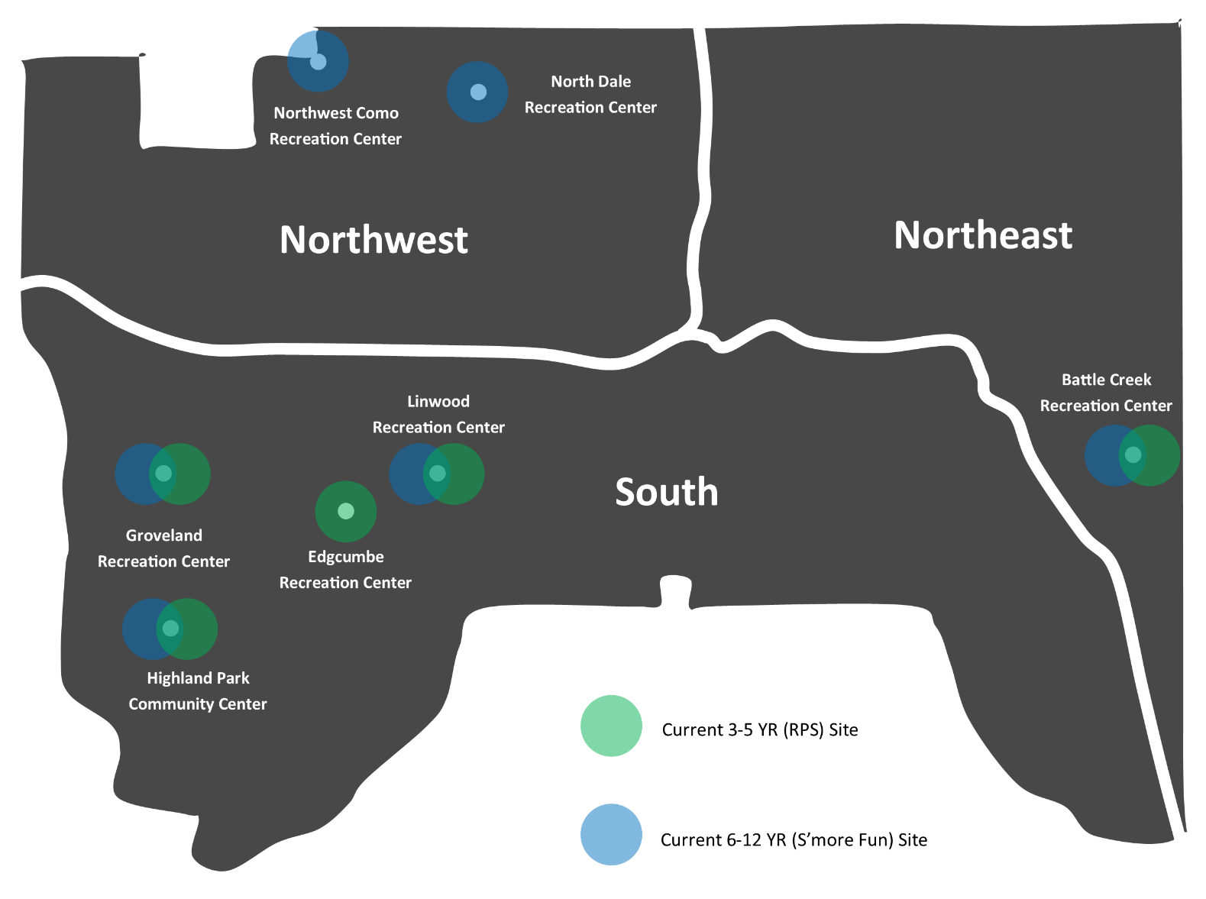
Current RPS & S'more Fun Sites
Notes:
If applicable, use this slide to provide any additional analysis that supports this proposed budget change.

Slide 25
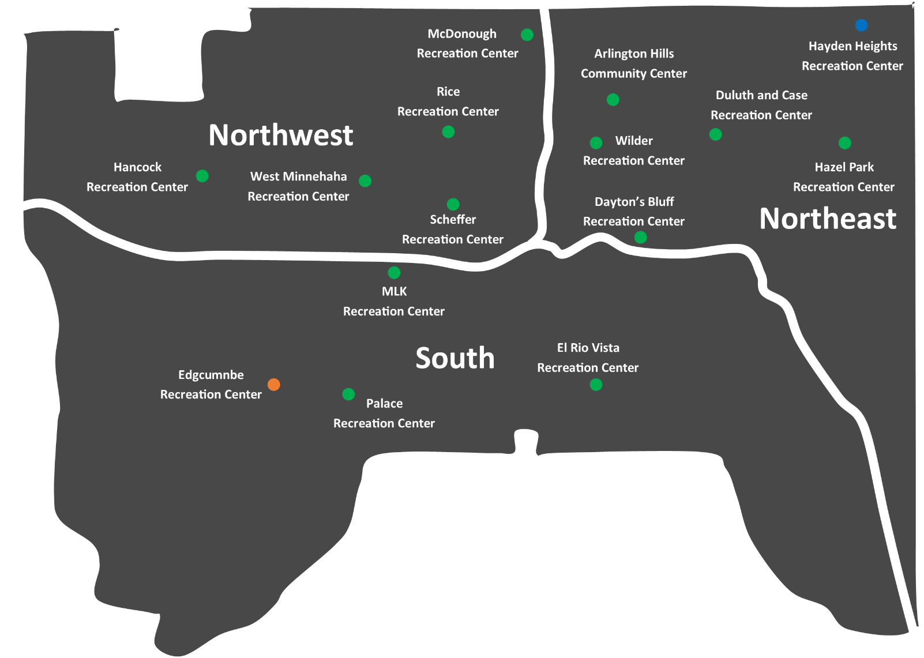


Current Equity Matters Sites
Notes:
If applicable, use this slide to provide any additional analysis that supports this proposed budget change.

Slide 26
Youth Program Quality Assessment
Fiscal Impact |  |  |  | FTEs | Funding
General Fund |  | Special Fund |  | Additional (if applicable) | One-time (yes/no)
Spending | Revenue | Spending | Revenue | 1.0 | no
$81,102
Description
In 2019, the Department will add a Youth Program Quality Assessment (YPQA) Specialist that will be the first dedicated staff person assigned to ensuring programs are meeting the needs of participants, and identifying ways to continuously improve the quality of youth programming system-wide.
Which of the Mayor’s strategic objectives does this proposal support?
Economic Justice | Lifelong Learning | Community-first Public Safety
 | X | X
Department Strategic Objective | Improve access to programming and facilities
Notes:
Delete ‘[Proposed Budget Change]’ and add a title.
Provide the estimated costs, FTE changes, and whether this proposal is for one-time or ongoing funding. If you have a more detailed breakdown of these costs, please send that information to your budget analyst.
Provide a brief summary of the proposed change, including reference to what problem this change is trying to solve.

Slide 27
Youth Program Quality Assessment (cont’d)
How does this proposal reform or improve current operations/services?
Ensuring programs are meeting the needs of participants in terms of quality, especially the new equity matters classes, is a priority that requires dedicated support. This proposal would add the first dedicated YPQA specialist to the Department, which will help start meeting the need for program quality assessment across the system.
What is the community benefit and how have/will they been engaged?
The community will see higher quality programs. Offering high quality programming is a key piece of feedback that is continually received from the community
How does the proposal advance equity in the City of Saint Paul
This proposal would address a key recommendation from the fee equity innovation project and start ensuring current and planned programming opportunities in ACP50 areas are meeting quality standards and YPQA criteria.
Notes:
Additional slide.

Slide 28
Youth Transportation
Fiscal Impact |  |  |  | FTEs | Funding
General Fund |  | Special Fund |  | Additional (if applicable) | One-time (yes/no)
Spending | Revenue | Spending | Revenue | - | Yes/No
$66,000 | $54,000
Description
The 2019 proposed budget includes one-time and ongoing funding to provide dedicated transportation services (2 new 15-passenger vans) for youth to attend programs and events at various locations and facilities. This proposal is consistent with the new fleet program and allocating adequate resources towards future capital replacement.
Which of the Mayor’s strategic objectives does this proposal support?
Economic Justice | Lifelong Learning | Community-first Public Safety
 | X | X
Department Strategic Objective | Improve access to programming and facilities
Notes:
Delete ‘[Proposed Budget Change]’ and add a title.
Provide the estimated costs, FTE changes, and whether this proposal is for one-time or ongoing funding. If you have a more detailed breakdown of these costs, please send that information to your budget analyst.
Provide a brief summary of the proposed change, including reference to what problem this change is trying to solve.

Slide 29
Youth Transportation
How does this proposal reform or improve current operations/services?
Getting youth to attend events and programs at off-site locations is very challenging without dedicated transportation. This proposal will purchase 2 dedicated vans for use in ACP50 area recreation centers, which will allow for the expansion of Equity Matters programing to opportunities not currently available on-site.
What is the community benefit and how have/will they been engaged?
Funding would provide ACP50 communities the opportunity to participate in recreational programming they normally might not be able to due lack of transportation. Community Recreation Directors will engage ACP50 communities, particularly youth within those communities, on the types of recreational activities not readily accessible available to them.
How does the proposal advance equity in the City of Saint Paul
This proposal would address a key recommendation from the fee equity innovation project and would allow for the expansion of the types of Equity Matters Programming available to communities in ACP50 areas by removing transportation barriers for participation
Notes:
Additional slide.

Slide 30
Considerations/Next Steps
Timing
  Would need a minimum of 2-4 months to implement various budget proposals once approved/given go ahead
September 26, 10 a.m.
  Operations/Parks Presentation
Notes:
Add any final words/implementation notes related to the 2019 budget. Or DELETE

