Slide 1


Professionalism, Attitude, and Enthusiasm
Notes:
Presenter to youth: This slide will be a brief introduction to youth about how to be successful in their positions through good attitude, appropriate appearance and attire, and maintaining perseverance through challenges in a positive manner. These are all critical factors in being successful at work as they help you build good rapport with colleagues and supervisors, allow you to work towards long time goals within the company/organization, may lead to promotions, and essentially makes the position more enjoyable!
Feel free to use some of our handouts on our webpage to better help you present yourself positively. https://righttrack.stpaul.gov/professional-development-training-material/

Slide 2

Cell Phones
Keep phones in your bag or pockets.
Professionalism starts now.
Notes:
Presenter to youth: First thing about professionalism is knowing when and where to use your cell phones. It’s best to put away your phones when you are in a meeting and in class. It is rude, disrespectful and sends an, “I don’t care” message to the people around you when you have your phone out during professional settings. If you have a hard time not looking at your phone, turn it off, leave it in your bag or put it on airplane mode before going into a professional setting.
Professional settings can include: Meetings, lectures, class, interviews, work, networking events and presentations.

Slide 3
Agenda
Ice Breaker
How to present yourself
Strategies to be successful
Uncomfortable situations – What to do
Feedback
What makes a great leader?
Notes:
Information for Presenter: After introductions, have students participate in a fun ice breaker. Some ideas: https://funattic.com/41-youth-group-icebreakers/
After the Ice breaker, give a quick breakdown regarding what will be covered in this presentation- Presenting yourself, strategies to be successful, dealing with uncomfortable situations, Feedback from youth, and the characteristics of a great leader.

Slide 4

Presentation of Self
https://www.youtube.com/watch?v=F-ecFkZ5saU
Notes:
Presenter to youth: Did you know that within the first 3 minutes of meeting someone new, they already have hundreds of judgements about you? First impressions tend to last a lifetime and may be the only impression you get to make on someone. That is why it is crucial to present yourself appropriately to gain a higher chance of being successful. By presenting yourself successfully, we mean appropriate dress attire, posture, facial cues and body language. Watch this quick and engaging YouTube video to gain tips on how to present yourself successfully. Please keep in mind that although the speaker addresses males in his video, the lesson he teaches can pertain to all genders.

Slide 5


A Good Handshake Includes:
Firm but not too firm
Web to web contact
Eye contact
A Good Introduction Includes:
A smile/eye contact
Your (full) name + your title/context
A handshake
Repeat their name
“Nice to meet you/see you”
Notes:
Presenter to youth: Does a simple handshake matter that much? Yes! A good handshake is one of the non-verbal cues that people will judge you on. We have heard stories of people getting hired just because they knew how to properly introduce themselves and give a good handshake. Be aware that handshakes are acceptable in western culture but is not the norm in all countries. For example, in Thailand, instead of a handshake, a person will put their hands together and bow their head slightly while greeting the other person. Being aware of this, professional introductions in western culture is a handshake. Take 3 minutes to practice shaking hands and introducing yourself to someone close to you. This can be with a family member, friend, teacher, or mentor.

Slide 6
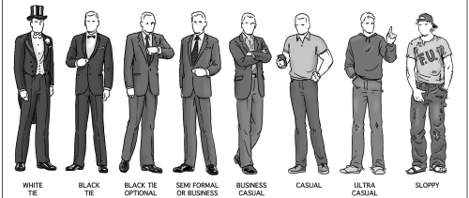
Present Yourself Successfully
Notes:
Presenter to youth: It is important to understand dress codes to prevent going to work unprepared. This picture displays the different levels of professional dress going from ballroom style to “sloppy”. When going to work or an event, always try and figure out what is appropriate.

Slide 7
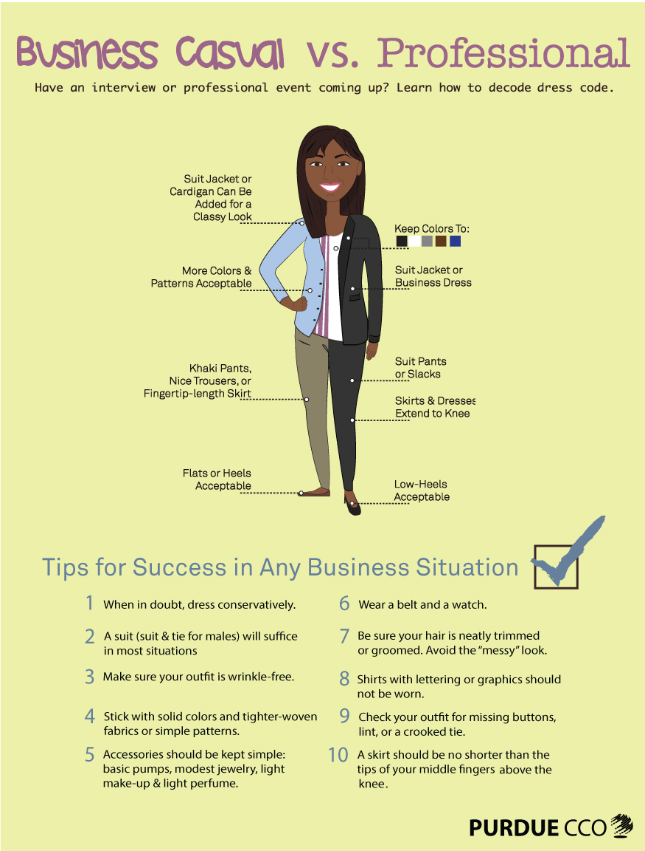
Notes:
Presenter to youth: Business casual is less formal than professional but not completely informal. Professional ware is more corporate and usually means wearing some type of suit. The poster above gives excellent tips on how to dress business casual vs. professional.
Information for Presenter: Ask youth what they notice about the differences between Business casual and Professional in the photo.

Slide 8
How should I be dressed?
Notes:
Information to Presenter: Please refer to the worksheet located under the https://righttrack.stpaul.gov/wp-content/uploads/2017/01/What-to-wear-to-an-interview-or-work.docx tab.
The information in the worksheet discusses cleanliness, what NOT to wear, what to do when in doubt, and advice on tattoos.

Slide 9
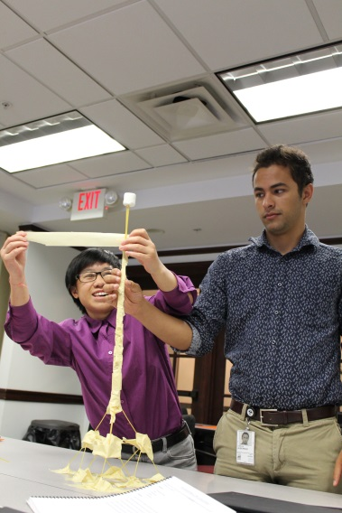
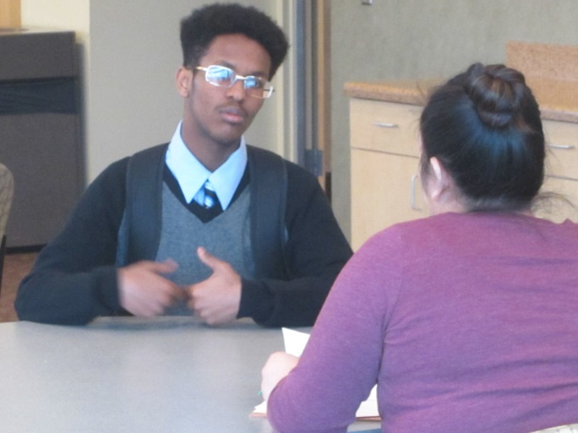
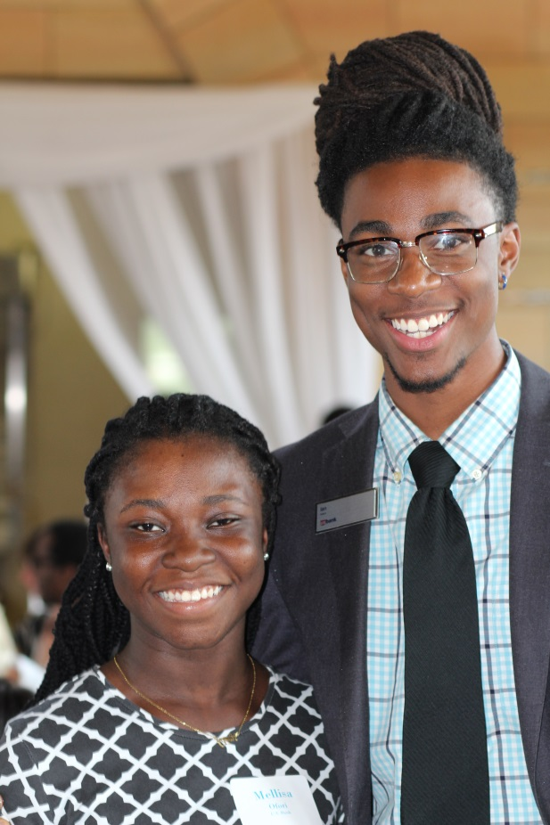
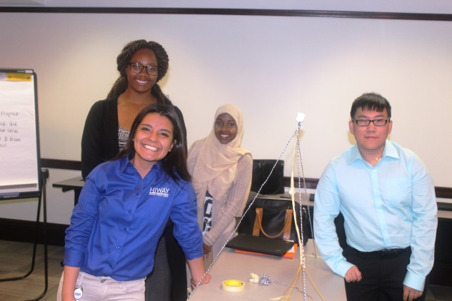
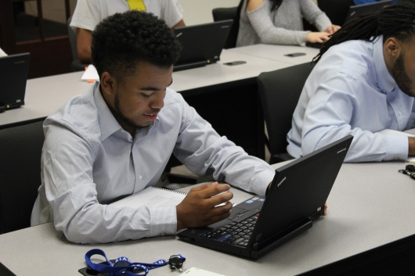
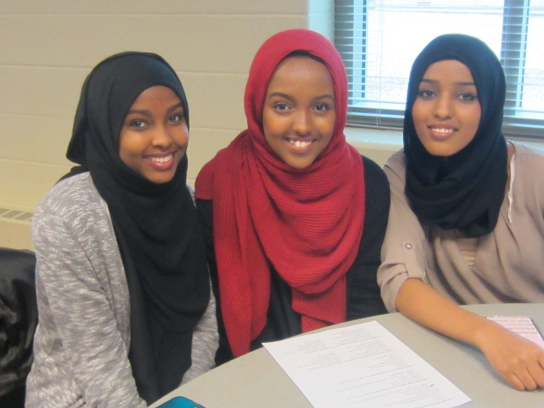
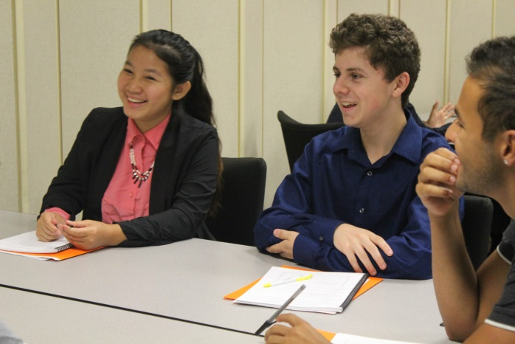
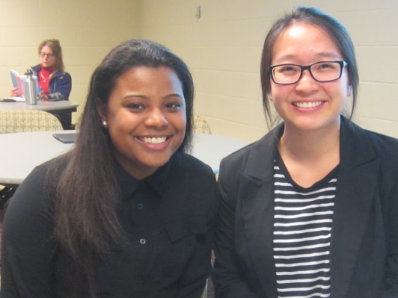
Notes:
Right Track interns are a great example of how youth can dress professionally.

Slide 10
Where would you wear these?
Notes:
Information for presenter: The next few slides will showcase people in different outfits. To the right are some locations. Test yourself and circle where you think the person can wear their outfit.

Slide 11
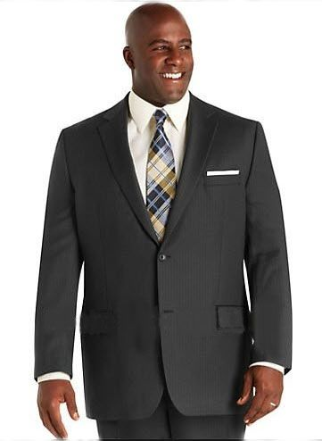
Interview
Corporate office
Farming job
Retail job at Walmart
Working with kids/youth

Slide 12
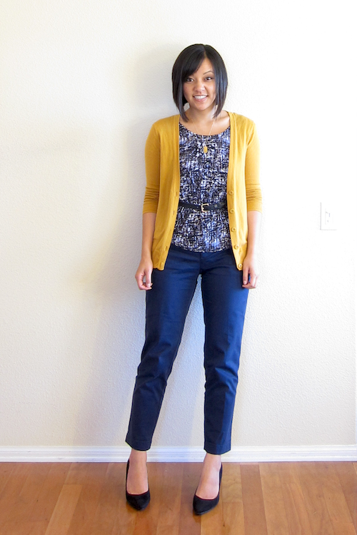
At home
To meet important business partners
Gym instructor
Interview
Working with kids/youth
Office job
Notes:
To meet important business partners and interview are underline because some interviews and business partners may require you to dress more business formal.

Slide 13
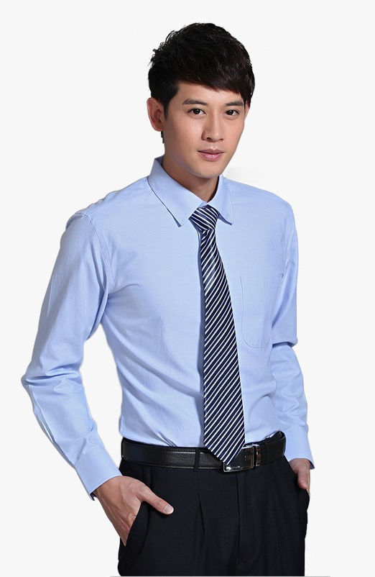
Corporate meeting
Outdoor work
Teaching Job
Interview
Selling cars
Food job
Notes:
Some foodjobs require you to dress nice like being a waitor/waitress and some do not, like McDonalds. In some schools, the dress code may be different. It is always important to check and see what is acceptable.

Slide 14

Interview
Office Job
Building objects
Gym instructor
At home

Slide 15

Office job
Building objects
Farming job
Party
Fashion design job
Notes:
Some organizations do not allow to show shoulders. Be sure to check and make sure this is acceptable.

Slide 16
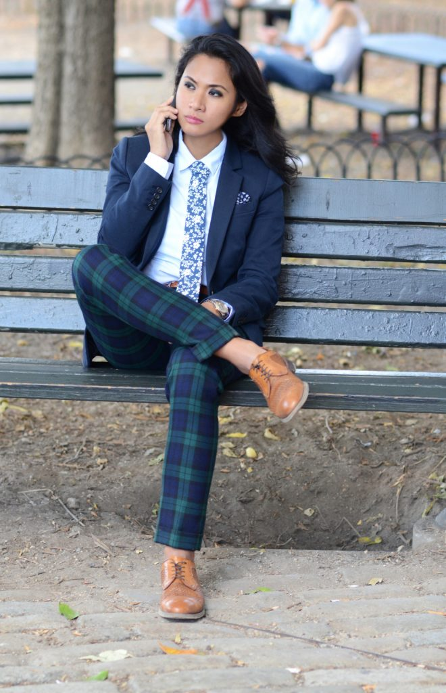
Working in the office
To meet important business partners
Outdoors work
To do a presentation
Social event

Slide 17
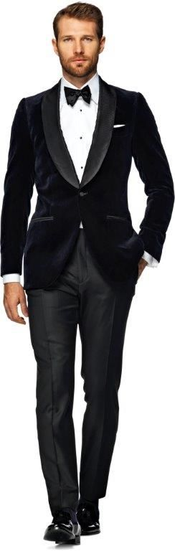
Corporate job
Interview
Party
Gym instructor
Working with youth
Notes:
If the suit was not velvet, this outfit could be worn to an interview or corporate job.

Slide 18

Office job
Social gathering
Interview
Photography job
Lunch with coworkers
To meet important business partners
Notes:
Same as slide 13.

Slide 19
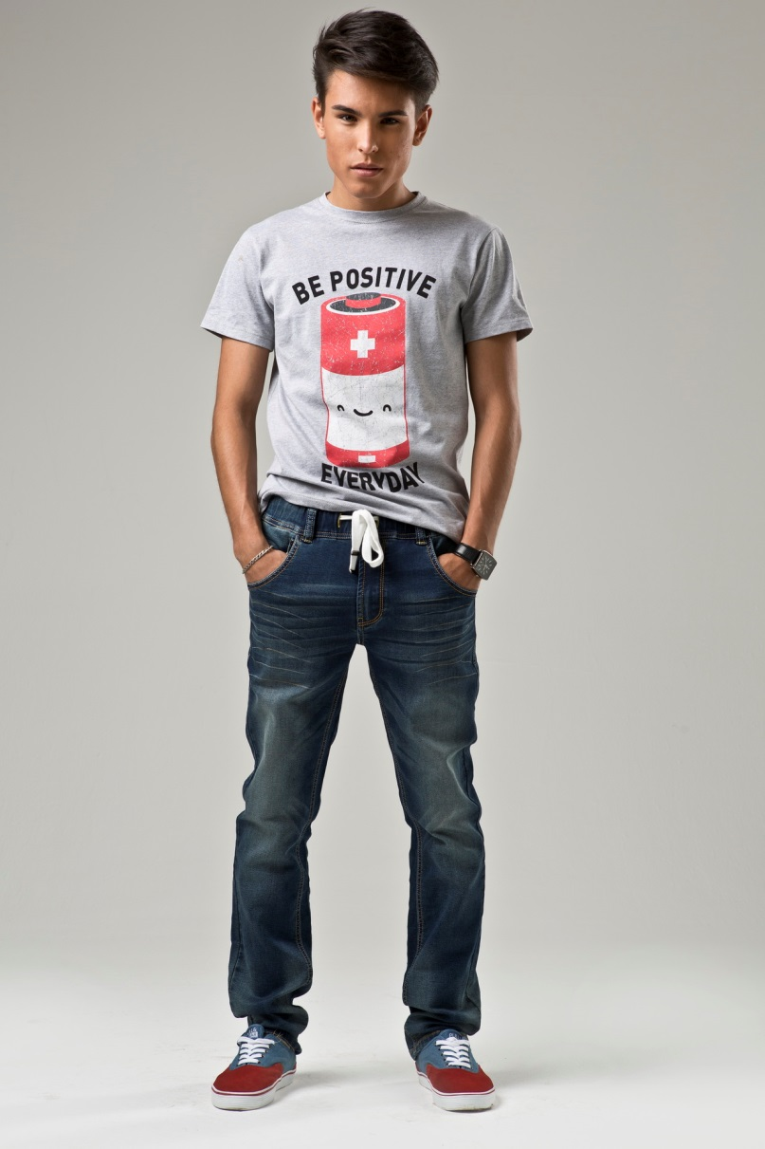
Outdoor job
Building objects
Office job
Working with kids

Slide 20

Social Gathering
To meet important business partners
Presentation
Corporate office
Outdoor event

Slide 21

For sure don’t
Ripped clothing
Sweats
Dirty clothes
Muscle shirts, Spaghetti strap tanks, Halter tops
Shorts/skirts that are more than 1 inch above your knee.
Strong cologne/perfume
Messy hair
Heavy makeup
Flip flops
Notes:
Presenter to youth: In what scenarios are these appropriate?

Slide 22
Reflect
What is your dream job?
How would you be dressed for that job?
Notes:
Presenter to youth: Take a few minutes to think about your dream job and what people in that job/industry wear to work. How would you be dressed for that job?

Slide 23

Strategies to Be Successful
Reasons why someone might not like their job?
Notes:
Presenter to youth: To yourself, list down a few reasons why someone might not like their job. Once you have your list, think about ways that you can overcome those barriers. For example, 1 reason why someone wouldn’t like their job is because it is boring. They can overcome this barrier by getting to know their coworkers or asking for more interesting tasks.

Slide 24

5 ways to counteract a bad job
Notes:
Presenter to youth: In most cases, there will always be something that makes every job less enjoyable. Instead of quitting or leaving work, it is important to learn how to problem solve those problems and see if they can be fixed. By being able to think positive and fix these problems, it can reduce your stress and improve your productivity at work. It also shows that you are reliable and can maintain a stable job for a long period of time.

Slide 25
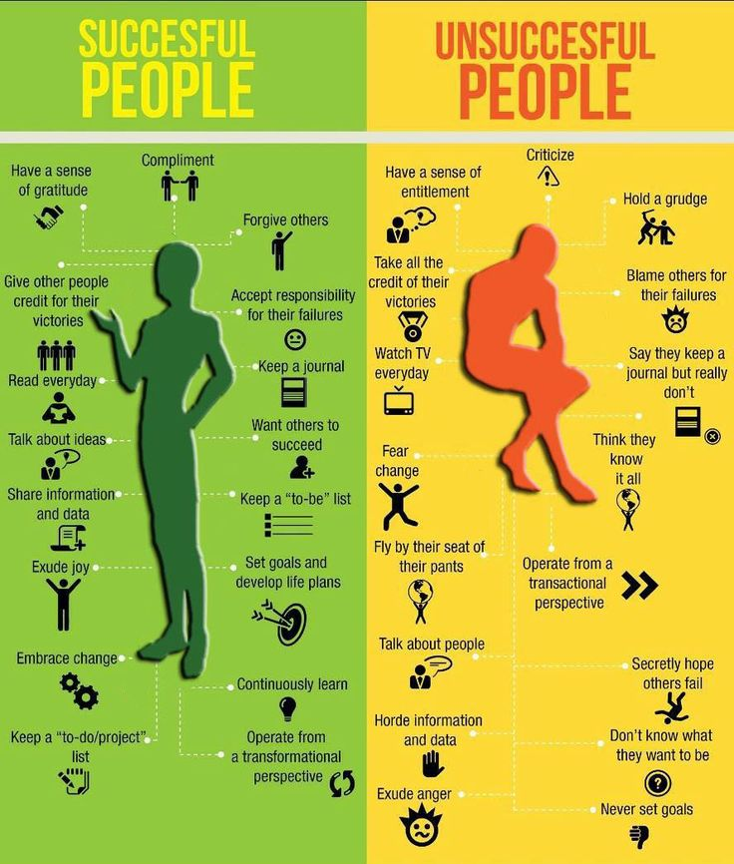
On a post – it note, write down any “Ground Rules” our group should follow.
i.e. listen when others are speaking, be present, speak your truth only, etc…
Notes:
Information for presenter: The poster shows the different attitude successful people have vs. unsuccessful people. This could be a time for a break. 10 Minutes = Quick Break + Grab Lunch!

Slide 26
Uncomfortable situations
What do you do during an uncomfortable situation?
Notes:
Presenter to youth: Whether we like it or not, uncomfortable situations are unavoidable at work. Although we can’t control what happens to us, we can control how we respond to it. Please use worksheet 2, located on our website for this activity. Worksheet contains some uncomfortable situations that you will read through. Think of ways in which you could professionally handle the situation. Once you are finished, talk through your answers with a trusted adult like a parent, mentor, teacher or supervisor.

Slide 27

Feedback
Receive!
Give!
Ask!
Take a look at the feedback article in your binder sometime in the next 2 weeks.
Notes:
Presenter to youth: Feedback is important for growth. Receiving feedback is not the same as receiving criticism. Feedback is meant to help us identify areas in which we can work on and become better. It is also important to give feedback to others and let them know how they are doing. Asking for feedback is good too. It shows that you care about your performance and want to work on it.

Slide 28
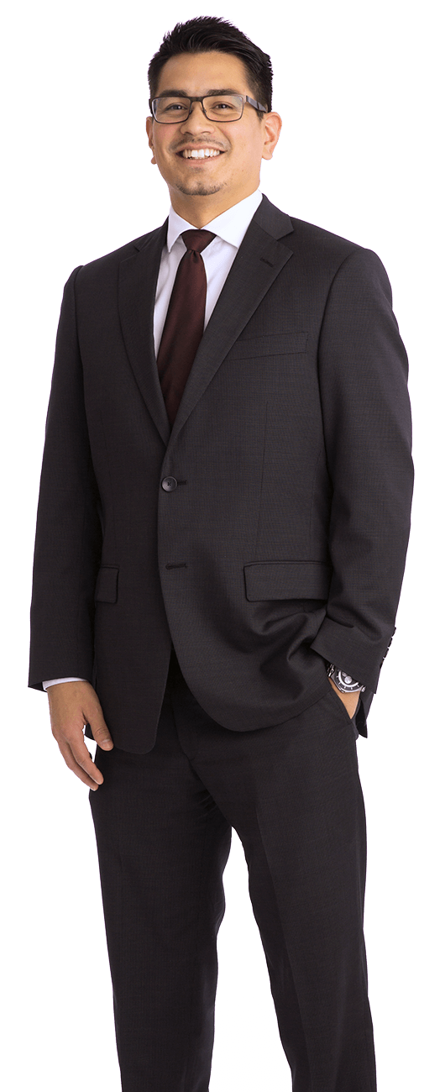

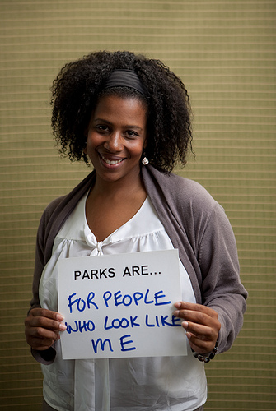
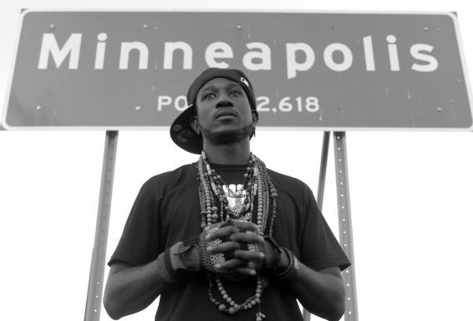
Characteristics of a Leader?
Notes:
Presenter to youth: Leadership is the action of leading a group of people or an organization. Leaders are largely responsible for building a sense of community within the workplace. Employees and people are more willing to follow an effective leader than a non effective leader.
Ask youth what they think makes a great leader. Ask what qualities they have within themselves that make a great leader.
Here are some leaders in our St. Paul community today, Forrest Tahdooahnippah. Kao Kalia Yang – Author. Toki Wright – Musician/producer, Professor, Activist, etc.. Rue Mapp – Founder of Outdoor Afro

Slide 29
Qualities of a Leader
Communication
Motivation
Delegating
Positivity
Trustworthiness
Creativity
Receiving and giving Feedback
Responsibility
Commitment
Flexibility
Notes:
Presenter to youth: These are top 10 leadership qualities, does this list match what the group identified/shared as characteristics of a leader?

Slide 30

How can you be a leader in your current role?
Notes:
Presenter to youth: Leadership doesn’t always have to be big changes or organizing hundreds of people like Martin Luther King, but can come in all different shapes and forms. Leading a game of Uno with kids, assigning task to members, giving advice to your supervisor and much more are all forms of leadership.
Conclusion: Summarize presentation main points and reinforce the importance of them. Ask youth if there are any major takeaways from the session that they would like to share- what they learned, how they now think of themselves as a potential leader, what qualities do they have to work on to be an effective leader, etc.

