Slide 1
Communication at Work
Notes:
Presenter to youth: Effective communication skills is a life and professional skill that helps us work, connect, and understand each other better. Ineffective and miscommunications are one of the main reasons why people can’t work together. Learning how to communicate at work can increase productivity with others, resolve differences, and much more. This PowerPoint will focus on professional culture with communication.
Information for Presenters: Feel free to use some extra handouts on our website to help you become even better at communication. https://righttrack.stpaul.gov/professional-development-training-material/

Slide 2
Ice Breaker
Please share 1 exciting thing that you accomplished at work or at school.
Notes:
Presenter to youth: Please share with the group an accomplishment from work or school this week!

Slide 3
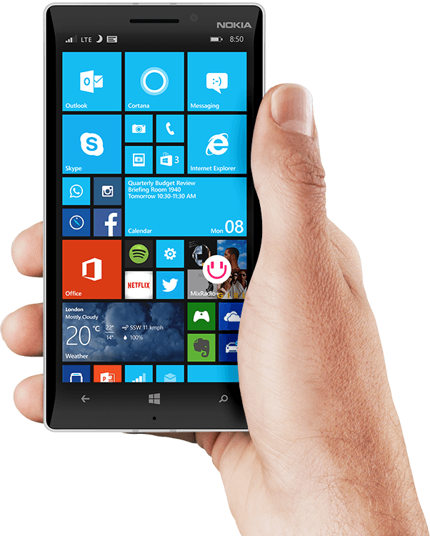
How should someone send an email or text message?
Notes:
Presenter to youth: Emails and text messages are one of the main uses of communications between people. In many cases, an email is the first form of communication between you and your future employer. Many people can judge your professional skills based on the emails/text messages you send.
Information for presenters: The next few slides will show the do’s and don'ts's of email etiquette

Slide 4
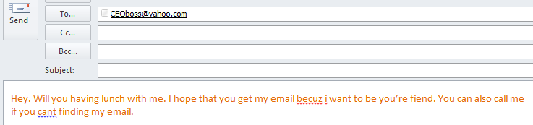
What’s bad about this email?
Nothing written in the subject box
No proper greeting. Also, does not address the person
“Hey” is not a good greeting
Incorrect punctuations
Incorrect spelling “fiend” should have been spelt “friend”
Becuz should be fully spelled, “because”
Capitalize “I”
No proper ending
No signature
Told them they could call but does not include phone number.
Grammar
Font Color
Notes:
Presenter to youth: Analyze the email above (in orange) and list what’s bad about the email. Make sure you use a professional email. Professional emails usually contain your first or last name. Avoid email names that contain slang or seem unprofessional. When writing an email make sure you always check for grammar and spelling mistakes. Errors like those can give off the impression that you don’t care. Make sure to always include your signature or let the reader know who you are. Email’s always contain a form of greeting and a line break afterwards. Don’t forget to include a brief subject header and make sure the font color is black.

Slide 5
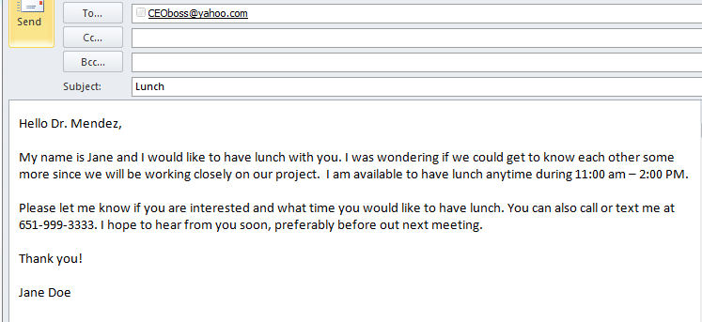
What’s good about this email?
Proper header
Sentences are more thoughtful
Introduces themselves
Offers a time
Gives phone number
Had proper ending and signature
Has a subject
No grammar mistakes
Notes:
Presenter to youth: This is the same email from the previous slide, written in a more professional manner. Notice how the sentences are more thoughtful, there is a proper header, they introduce themselves, give the needed context, has a subject and has no grammar mistakes.

Slide 6
Email Do’s and Don’t
https://leadergrow.com/articles/145-12-dos-and-donts-of-e-mail-communication-e-mail-communication-tip-sheet
Notes:
Information for presenters: Click on the link to learn more about the do’s and don’ts when writing a professional email.

Slide 7
Texting
Hi John. You messaged me?
Hi John. You messaged me?
Hey, OMG i m not gud 2day. i m @wrk right now and I’m working on a really cool group project :D I will be l8 to our meeting. Ill c u soon.
Hi! I’m pretty busy and working on an important group project right now. I apologize but I will be a little late at our meeting. I’ll see you soon.
Watch out for text language
Grammar
Watch out for smiley faces
Don’t text and drive
Notes:
Presenter to youth: Text messages are a great way to communicate with someone quickly and receive a response. However, there are some important texting etiquette that we should use when texting professional staff. Be aware that not everyone understands texting lingo like, “LOL” or “BRT”. It’s always safer to spell out the full words. When texting, check for grammar and spelling. Lastly, watch out for smiley faces, especially when texting new professional staff. Smiley faces can send off a less professional vibe.

Slide 8
Social Media
69% of employers admit to rejecting an applicant after checking them on Facebook or another social media site.
What did supervisors see?
Inappropriate or provocative photographs
Misrepresentation of background or abilities
Posts about negative information about a current or previous employer
Photos drugs or alcohol
Political posts
Things you post stay on FOREVER
Notes:
Presenter to youth: Social media is a fun platform that we use to keep in touch with others and let others keep in touch with us. However, it is important to remember that anyone can view things we post publically on the internet, including future employers. There have been real cases in which employers decline an applicant because of what they saw on their social media. When posting public things, be mindful of how future employers will perceive you.

Slide 9
Flipping the Switch
Flipping the switch between peers, supervisors and the general public.
Notes:
Presenter to youth: Do you speak differently with your friends vs. your teacher? How do you behave and speak differently in different situations. Being able to flip your switch during different situations is important for work. The way we act at work is different from the way we act at home. Fill in the worksheet and put how you would act differently if you were talking with your friends, professionally, and with strangers. Use worksheet called, “Flipping the switch”.

Slide 10
Potential Barriers – What to do
Notes:
Information for presenter: Go through the bullet points and discuss briefly what exactly these barriers entail and how to overcome them. Please open the floor to youth to share their thoughts/ideas on these barriers and perhaps how they have personally overcome them in the past.

Slide 11
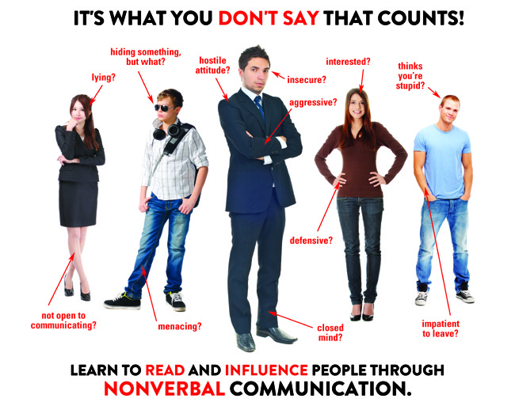
Notes:
Information for presenter: Possible break/lunch here. This slide will lead into the lesson on non verbal communication.
Presenter to youth: How do non verbal cues affect our communication with others?

Slide 12
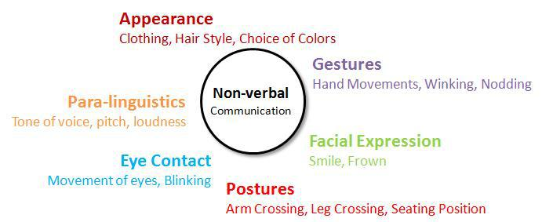
Non-Verbal Communication
Notes:
Presenter to youth: Did you know that only 7% or what you say is important in a conversation? 38% is on inflection and 55% is on how we look when we speak. Inflection and how we present ourselves when we talk is called “Non-verbal” communication. You should always reflect and think about how your body language affects how people perceive you.

Slide 13
Accepting a job
Accepting a Right Track job
Accepting a non Right Track job
Notes:
Presenter to youth: Before accepting a job that isn’t Right Track, make sure you ask the employer about salary and benefits. You can always negotiate a salary if you feel like you deserve more. Once you agree to accept the job, ask them for a written reference of your acceptance, that way you have a paper trail. Lastly, thank the employer for the opportunity.
If you are receiving a phone call about your acceptance, make sure you are in a quiet and calm place. This will help you focus and make sure that you don’t miss anything. If you are not in a quiet or appropriate place, politely ask the employer if you can call them back when you are available.

Slide 14
Leaving a job
What should you do and not do when you leave a job?
Notes:
Presenter to youth: When you leave a job, make sure to inform your boss at least two weeks before leaving. This gives them time to prepare for your leave. You should never leave a job by simply not showing up. This is a bad way to end your job and your boss may mention that to future employers. If you cannot give a two weeks notice, make sure you still address your leave to your boss. Indicate a brief reason for your leave and ask if there is anything you can do to help wrap up.

Slide 15
How to call in sick or late
What should you do/not do?
Notes:
Presenter to youth: When sick, make sure to let your boss know instead of not showing up to work. Let your boss know as soon as you can so that they can prepare for a day without you. However, if it is after 8 pm when you find out you’re sick, instead of calling, send an email and call your boss early in the morning.

Slide 16
Communicating as a team
What makes a group work hard?
What makes a good team?
When should you step up as a leader?
When should you not lead?
Notes:
Presenter to youth: Working with other people at work or on projects is almost inevitable. Learning how to effectively communicate with each other is a major part of how productive your team can be. Teamwork tends to fall apart when there are miscommunications, too much communication or not enough communication. Take a minute to answer the questions on the slide with a trusted professional to help learn more about effective teamwork.

Slide 17
Reflection
What is 1 thing you learned today about communication?
Notes:
Presenter to youth: Encourage everyone in the room to share at least one takeaway from today’s session.
Concluding remarks: Summary of main points.

