Slide 1
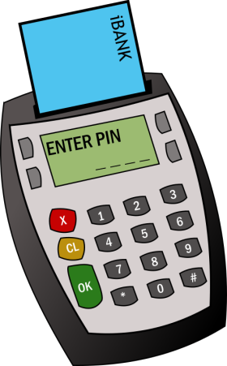

Financial Literacy
Notes:
This PowerPoint is focused on helping us learn the basics of banking terms, why it is important to save money, and how to manage a budget. Financial literacy is aimed at helping young adults learn how to make thoughtful and informed decisions with their money. Learning how to properly handle your money can save you from debt, avoid scams and make you less stress.

Slide 2
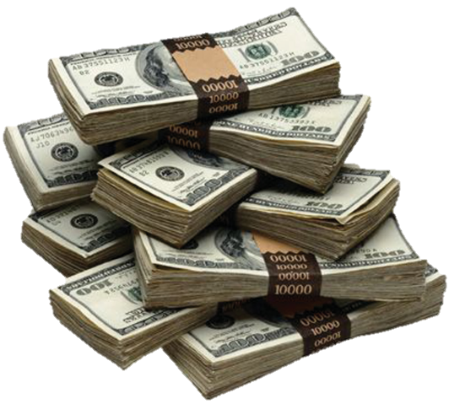
Important Terms to Remember
Withdraw
To take out money from your account
To put money in your account
How much money you have in your account, or how much you owe a third party.
A number that determines your financial credibility.
Borrow money now. Pay later. Usually with interest.
your balance history. It displays all the withdraws/deposit you made with your account.
Deposit
Balance
Credit Score
Loan
Bank Statement
Notes:
Here are basic banking terms to know. The definitions are written in black and the terms are bolded in green. These are banking terms that your accountant, banker, supervisor, and community will use when talking about money. Knowing these basic terms will prevent confusion and better help you follow a conversation about money.

Slide 3



Credit Union | For Profit
Examples: Hiway Federal Credit Union, Wings Financial | Examples: Wells Fargo, US Bank, Chase
Services: Savings and checking accounts, loans, mortgages, internet home banking, and more. | Services: Savings and checking accounts, loans, mortgages, internet home banking and more.
Membership: Usually based on family, geographic location, membership in another group. | Membership: Open to anyone
Pros: Members can vote and run for board. May have higher saving rates and lower loan rates. | Pros: Tends to have more products and services. ATM’s tend to be more accessible. Tends to have better credit card incentives and rewards. Does not have to be in affiliation with anything to join.
Cons: ATM’s are less accessible. Less products. Need an affiliation in order to join. | Cons: Tends to have more fees
Notes:
Bank are institutions built to help you store and mange your money in a safe place. Choosing a bank is an important money decision. There are usually two types of banks, a credit union bank and a for profit bank. Although each individual bank is unique, it is important to know the main differences between the two. Use the chart as a reference to understand the difference between a for profit bank and a credit union.

Slide 4
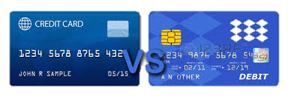
Credit | Debit
Ownership: The money does not belong to you. | Ownership: The money belongs to you. The card is connected to your account.
Pay later: When used, money is taken out from the bank for you to use. You will have to pay them back. | Pay now: When used, money is taken straight from your account.
Pros: Can build credit. Can pay later. May have better security feature. | Pros: Instant cash from ATMs and cash back options. You can only spend the money you have in your account.*
Cons: Paying back interest. Risk of late fees. If misused, can destroy credit. | Cons: Can’t build credit. Can’t spend money you don’t have.
Bank
You
Bank
You
Bank
You
Notes:
Plastic currency like credit cards and debit cards are two of the most commonly used tools for spending money around the world. But what is the difference between a credit card and a debit card and when should you use them? Take a look at the chart to learn more about the different functions they provide and how using them can affect your money. Both cards can be used to buy goods. However the main difference is that a debit card is using money straight from your bank account, while a credit card is borrowing money from the bank and having to pay it back later. Example: If I used a credit card to buy a jacket for $50 I will have to pay the bank $50 with interest because I used the banks money. If I used a debit card to buy the same jacket for $50, I am using my own money and do not have to pay the bank anything.
Why would you want to use a credit card if you have to pay the bank back? Simply because a credit card allows you build credit (a number that showcases how reliable you are at borrowing money) that you will need if you want to get a loan. Building credit is important because there will be times when you need to make big money purchases that you can’t pay in one transaction like a house, car, college, and much more. If you show the bank that you have good credit and are reliable for paying the money back, the bank will be more willing to loan you money. But if you have bad credit and show that you aren’t reliable, they will not trust you with the money.
There are more reasons why you would want to use a debit card over a credit card or vice versa. Make sure to look at the chart for more answers.

Slide 5
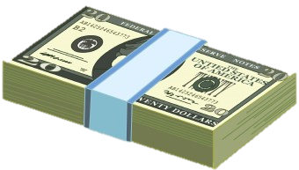
Checking Account | Savings Account
Easy access to your money | Allows you to accumulate interest on funds
Daily transactional needs | More for future/emergency needs
Notes:
When opening a new bank account, you will be asked if you want to open a checking account and a savings account. The difference between the two is that a checking account is more used for daily transitional needs and a savings account is used more to save money for future needs. Savings account can also accumulate interest, whereas checking accounts can’t. Example, if I put $100 into my savings account, my bank will put $5 for free into my savings account monthly. Checking accounts cannot do that. Make sure to check with your bank on how much interest you can accumulate.

Slide 6
Reasons to save
How much of your paycheck do you deposit into your savings?
Notes:
While obtaining your paycheck, it is wise to store some of into your savings account. They reasons are because 1: It can provide a safety net in case of emergencies 2: Savings account can earn interest over time.

Slide 7
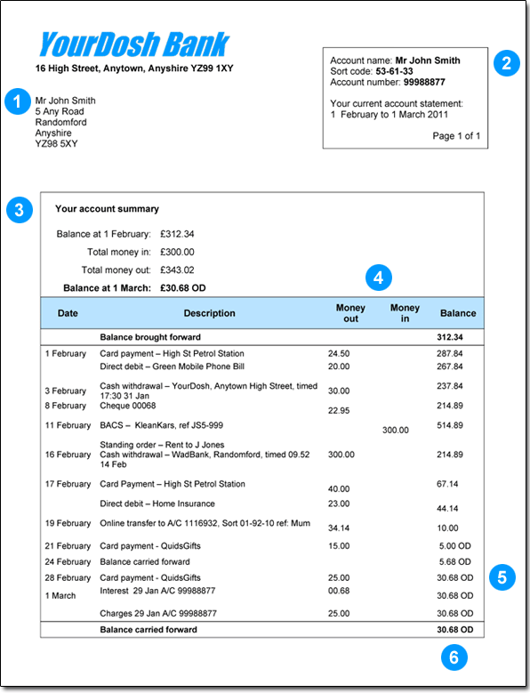
Bank Statement
Notes:
A bank statement is a form that keeps track and records all your transactions within a giving period (i.e month of February). It is like a money history that shows when, where, how much, and whether you deposited or withdrew your money. We recommended that you check your bank statement at least twice a week, tracking where your money is going and how much you have. Check and make sure there aren’t an suspicious or transactions you don’t know about. If you notice that your money is being spent at areas you didn’t commit, call your bank immediately and let them know.
1: Owners name and address. 2:Owners name, account number and provides the date of the bank statement. 3: Pertains the important account summary. Includes start balance and end balance. 4: Header 5: Shows the transactions and deposits of your bank activity over that time period. It shows where, when, and the amount of money spent/deposited. 6: Displays new balance.

Slide 8
Bank Statement Activity
Notes:
On our Right Track website, use the worksheet labeled, “Keeping a Running Balance” and “Balance Sheet” to see if you understand how to read and create your own bank statement. The worksheet and answers can be found here.
https://righttrack.stpaul.gov/professional-development-training-material/

Slide 9
What is APR and how does that affect you?
Annual Percentage Rate – the amount of interest on your total loan amount that you’ll pay annually.
Notes:
An annual percentage rate is a percentage that you have to pay on top of the original cost of a good. You pay this annually (once a year). Annual percentage rates can highly affect how much you are truly paying for a good. There are also monthly percentage rates.

Slide 10
How APR Affects your bill
Take a look at how three different APRs affect the total repayment amount on a $1,000 balance if only the minimum payment of $20 is paid monthly.
Rate | Length of Repayment | Total Interest Paid | Total Amount Paid
4% | 4.6 years | $96 | $1,096
14% | 6.3 years | $510 | $1,510
23% | 14 years | $2,348 | $3,348
Calculator soup
Notes:
Do your best to stay away from high percentage rates. You want to get the lowest percentage rate as you can, that way you have to pay less. The graph above shows how much extra money you are paying if you buy a $1,000 good at different rates (4%, 14%, 23%) and the length of repayments. As you can see, buying an item at $1,000 at a 23% rate in 14 years is really costing you $3,348. When dealing with rates, make sure you know the real cost of your good by calculating it.

Slide 11
Protect your $$ - avoid these scams
Work-at-home schemes, get-rich-quick schemes
Phone, mail and e-mail offers
Phone and internet fraud
Income tax scams & Advance refund loans, payday loans
Title loans
Pawnshops, rent-to-own stores
“Cash my check” scams
Notes:
There are people out there who create tricky scams to steal your money. To prevent yourself from becoming a victim of a scam, make sure to avoid the above list. It is important to prevent scams because they can greatly destroy you credit history and money that you worked hard to build. If you want to learn more about avoid scams, feel free to browse this useful website, https://www.consumer.ftc.gov/articles/0120-avoiding-scams-101.

Slide 12
The cost of Little Purchases
Cost of a Fast Food Meal for lunch = ~$5.00
Cost of (5) lunches for the work week = ~$25.00
Cost of (20) lunches for the month = ~$100.00
What’s a better deal?
Paying a bus fare everyday?
Or buying a bus pass?
Bus Fare = ($1.75 x 2) x 5 x 4 = 70
31 day buss pass = $59.00
Notes:
We often think that costs like $1 snacks won’t affect us. However, many little $1 purchases can accumulate over time and create a big dent into our pockets. For example, bus fare alone is 1.75 a ride. We may think it doesn’t cost much but if we add all the times a person has to take the bus to work and back home for a pay period, it equals to about $70. It is cheaper to buy $59.00 ticket now and save.

Slide 13

Save it up
Trick #1: Set Savings Goals!
  How much should you save each month? That depends what you’re saving for.
  If you saved $25 each month ($6.25 a week) , you could buy that bike in four months! And if you saved $50 each month, you could buy that bike in two months!
Trick #2: Save First, Not Last!
  What’s the FIRST thing you do when you get paid? You divide your money and put it in your SEPARATE ACCOUNTS.
    If you want that bike, you have to be sure that money goes into the SAVE bank FIRST.
  THIS IS A BIG RULE about money. YOU CAN SPEND IT ONLY ONCE.
    Let’s say you use your SPEND money go to a movie. You have all of your allowance in your pocket, and you spend $5.50 of your SAVE money on pizza and soda. That money is gone. You can’t use it for your bike. Your dream of a bike just got farther away.
Notes:
Saving is an essential skill someone should have if they want to learn how to budget their money wisely. Learning how to save money is important for future emergencies or goods that you want to spend (i.e car accident, smart phone). However saving can be hard to do because there are daily goods that we also desire. Use this slide to help you find ways on how to save.

Slide 14
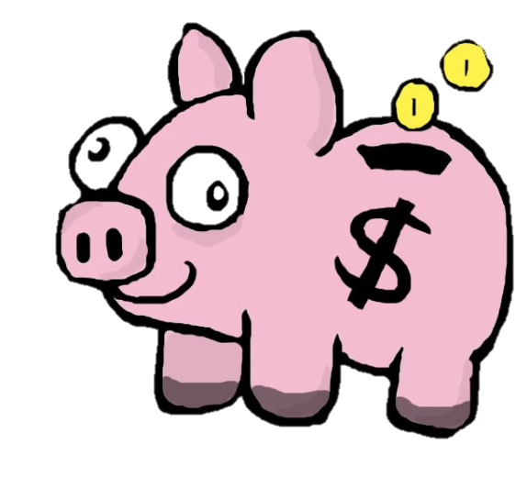
What’s in your piggy bank
Knowing what you know now, write down 1 (or more) changes you might make that will put more money into your piggy bank
Notes:
Reflections

Slide 15
Resources
http://mint.com
http://www.bettermoneyhabits.com/
http://www.interest.com/
http://www.accountabilitymn.org
Notes:
There are also links that can teach you how to keep track of your spending and learn where you spend money.

