Slide 1



Interviews
Notes:
Hello and welcome! You must be getting ready for an interview or want to know more about them. You are in luck because we have some tips and exercises you can try to help you be more prepared, relax, and ready for your future interview.

Slide 2
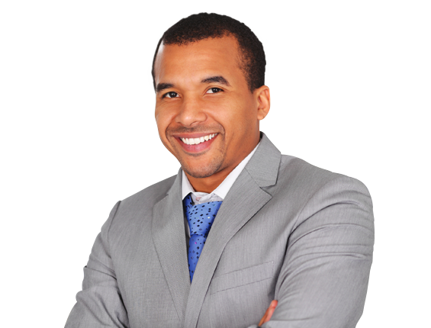

Who would you hire?
Notes:
If you were the person interviewing an applicant, who would you like to hire? What would they look like? What qualities, skills, mannerisms and experience would make you interested in hiring a person and what would make you not want to hire a person. Switching roles is a great way to get inside the head of an interviewer and help you understand what they would be looking for.

Slide 3
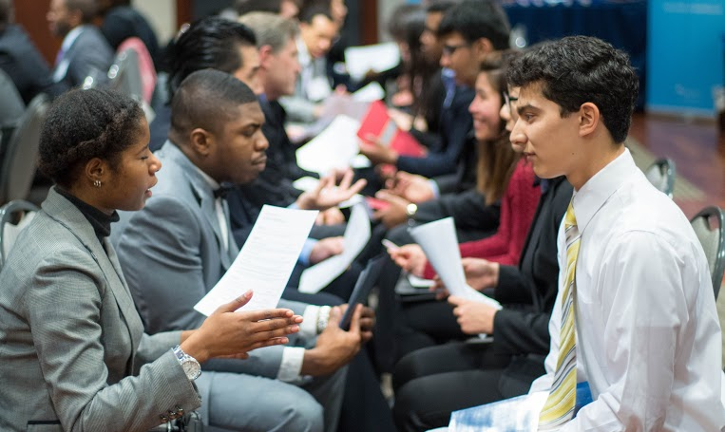
Speed Interviews
Notes:
Attending speed interviews is a great way for you to practice and get comfortable with presenting yourself to multiple new people. If you are shy or have a hard time getting to the point in your explanations, speed interviews can give you the practice to overcome those weaknesses. The more practice you have presenting and informing someone about your qualifications, the more confident you will be.

Slide 4
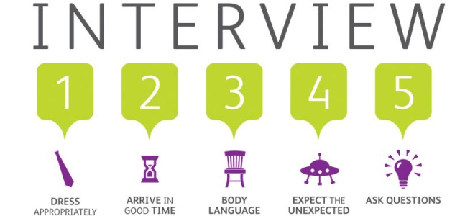
Notes:
Here are 5 things you should always do for an interview:
1: Dress for success. Before heading to the interview, do a little research to see how a person in that job position would dress. Not every job interview will require you to wear a suit or blazer. Ask trusted advisers or working family members to give you feedback on the outfit you are wearing. If you want more information on what to wear for an interview, check out our other lesson, “Attitude and enthusiasm” for more information.
2: Don’t be late for an interview. Arrive earlier than your interview time to show that you are serious and punctual. Arriving early also gives you time to adjust to the new environment, calm your nerves, mentally prepare you for the interview and fix any problems if they arise.
3: When you are doing the interview, always maintain positive and good body language. Do not slouch because it can give the impression that you are uninterested or lazy and to do not move too much because it can be distracting for the interviewer. For more information on body language, check out our “Communication” lesson to learn about nonverbal communication.
4: Be prepared for the unexpected. Many people are scared of interviews because anything can happen since they are out of our control. We don’t know what questions they are going to ask us, we don’t know the location space, and etc. Although you can’t control the interview, you can prepare yourself by thinking about the different scenarios that can happen and how you will respond.
5: At the end of an interview, an interview may ask if you have any questions for them. Do your best to always ask a question because it shows that you are interested and paying attention. You can always create a list of possible questions to ask before the interview.

Slide 5

Common Interview Questions
Notes:
You can expect that most interviewers will ask you these questions. Knowing what someone will ask you will before an interview can help you formulate your answer to be more thoughtful. Feel free to use our handout called, “Common Interview Questions” and practice answering these questions out loud with a trusted adviser.

Slide 6

Unwritten rules of Interviewing
Notes:
Before heading to an interview, make sure you take a look at our “Unwritten rules of interviewing” handout. Print the handout and take a minutes to answer each question. This will help you prepare for an interview and give you a better idea of what to expect.

Slide 7
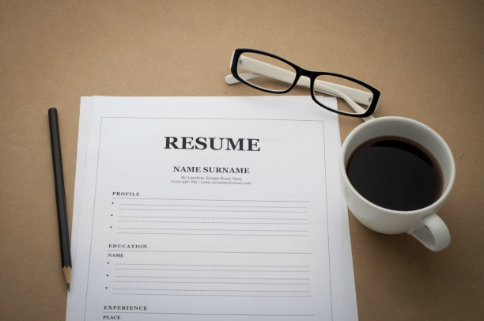
Conclusion
Evaluation
Thank you!
Notes:
We hope you learned a lot about interviewing and feel to explore on our website at https://righttrack.stpaul.gov/
Next session, we will be working on resumes
Bring iPad
Bring Resume

