Slide 1
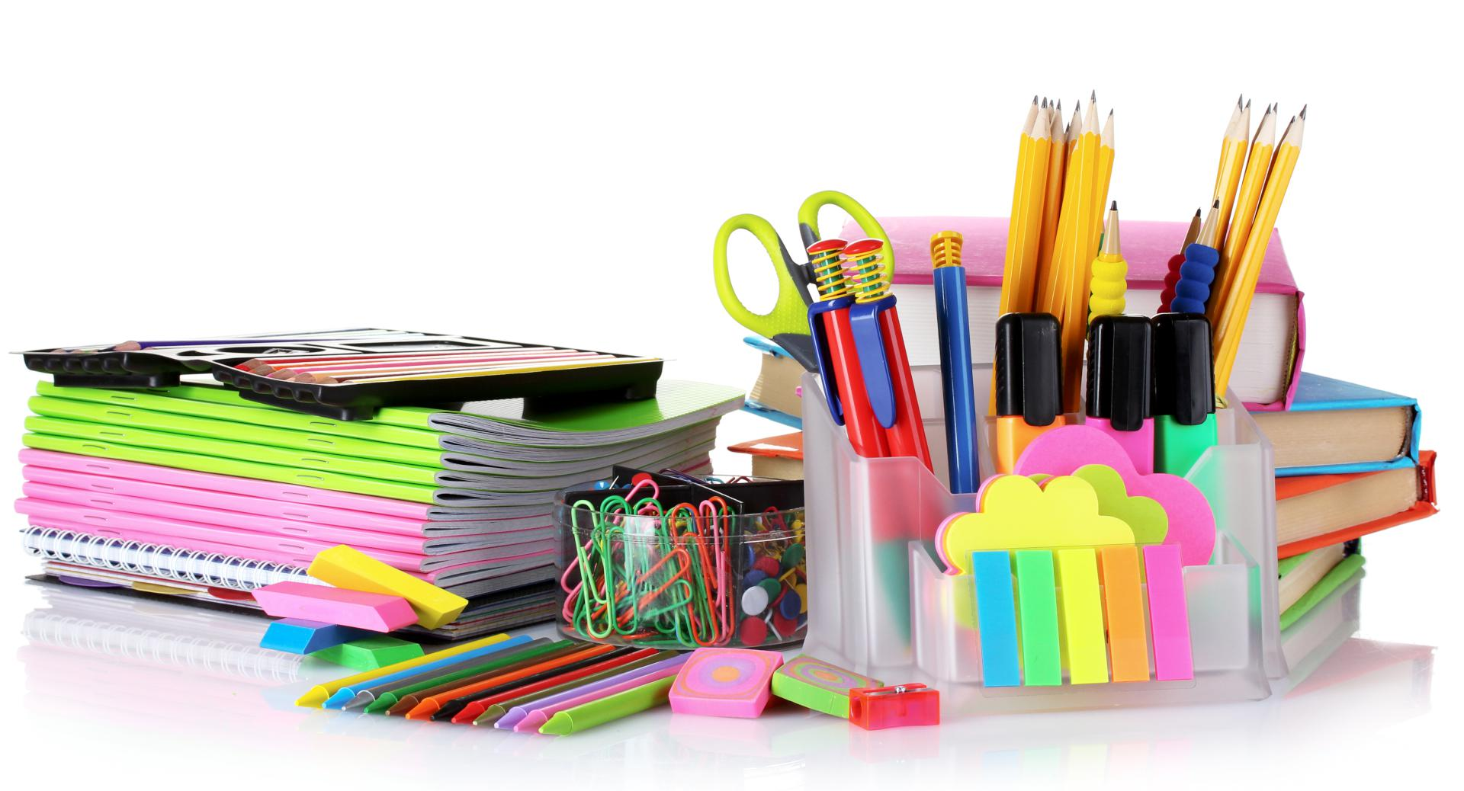
Planning and Organizing
Notes:
Presenter to youth: Hello! This PowerPoint will focus on how proper planning and organization can help you become more productive at work. Proper organization and planning can help complete task more efficiently and quickly.

Slide 2
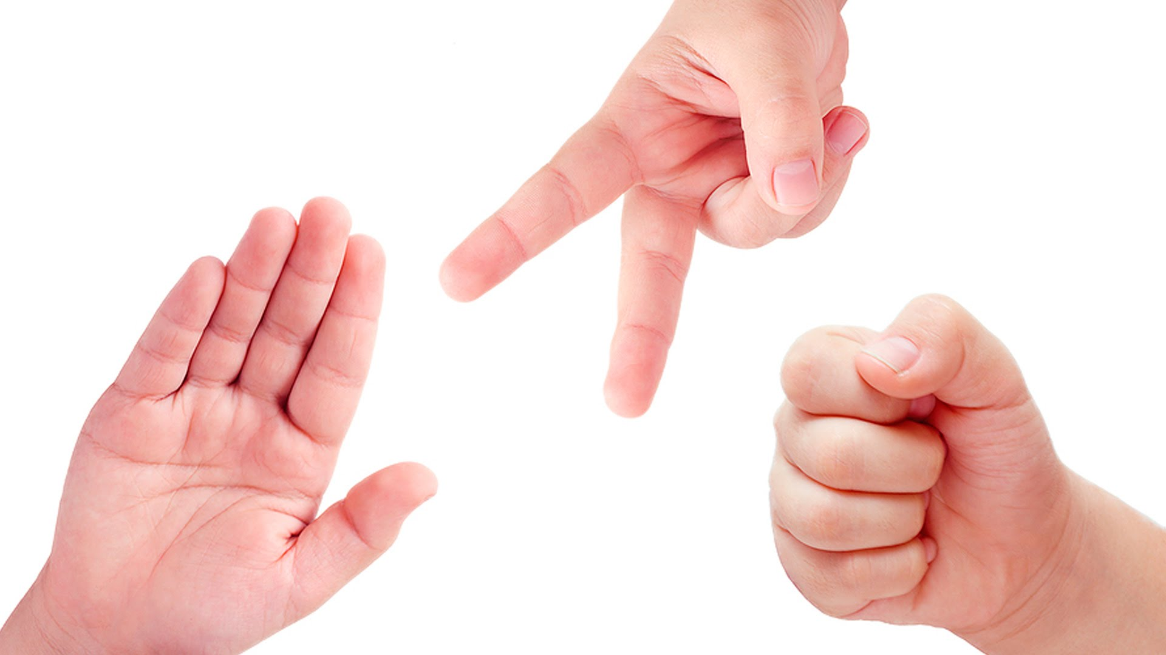
ICE BREAKER!
Notes:
Presenter to audience: share an accomplishment from work or school this week!

Slide 3
What is your Productivity Style?
Please take 5 minutes to complete this assessment
https://hbr.org/2015/01/assessment-whats-your-personal-productivity-style
It will help you learn more about who you are and identify ways that help you perform better
Notes:
Presenter to audience: Every human mind organizes and works differently, and that is okay. The sooner we learn about how our brain cognitively works, the better we can use it to our advantage and become more productive. Take 5 minutes to complete this assessment to find out which productivity style you are and how you can harness it to your advantage.

Slide 4
Which one are you?
1. A Prioritizer prefers logical, analytical, fact-based, critical, and realistic thinking.
2. A Planner prefers organized, sequential, planned, and detailed thinking.
3. An Arranger prefers supportive, expressive, and emotional thinking.
4. A Visualizer prefers holistic, intuitive, integrating, and synthesizing thinking.
Notes:
Presenter to audience: These are the 4 different types of productivity style you could of scored after completing the productivity assessment. What were your results? Read the slide and learn more about what your style does the best at.

Slide 5
What each style contributes
Strengths
Prioritizer
Pet Peeves
Prioritizing
Great analyzer and logical problem solver
Goal Oriented
Can make decisions easily
Consistent
Meaningless Chatter
Inaccurate or missing data
Inefficient use of time
Vague, approaches or instructions
Overt sharing of personal feelings
Things they love
Communication style
Critical analysis
Facts
Spending time wisely and efficiently
Prefers concise emails
“Give me the bottom line”
“I only want to hear the most relevant data”
Notes:
Presenter to audience: 47% of the population score as Prioritizer. Prioritizers are very goal oriented and straight to the point. They are logical and making decisions is easy because they are great analyzers. Aristotle, Kant, and Sir Isaac Newton are some of the famous Prioritizers. When thinking and making decisions, Prioritizers typically ask “What” questions, such as, “What does this product do?”, “What are the problems?” and “What are the results?”.

Slide 6
What each style contributes
Strengths
Planner
Pet Peeves
Action oriented, consistent and practical
Good a finding overlooked flaws in plans or processes
Organizing and maintaining data
Developing detailed processes and plans
If the agenda is not clear
Late or last minute work
Indecisiveness
Unclear instructions, language
Typos and errors
Things they love
Communication style
Prefers information presented in a detailed
Use complete sentences
Emails with bullet points or numbers
Typically ask, “how” questions
“Lets stick to something that we know will work”
A schedule and action plan
Scheduled appointments and timely arrivals
Getting to the point
Timely follow up
Notes:
Presenter to audience: 37% of the population are Planners. Planners prefer to be organized and detailed thinking. Planners are detailed oriented, making them great at finding errors or flaws. They tend to finish work before deadlines. You can count on a planner to be organized, keep track of important data, and provide stable leadership because they make firm decisions based on looking at the details. When thinking or making a decisions, Planners typically ask “how” questions, such as, “How frequently do problems occur?” and “How do you want to approach this project?”. Famous planners is Philosopher Plato, FBI director J. Edgar Hoover and British politician Margaret Thatcher.

Slide 7
What each style contributes
Strengths
Arranger
Pet Peeves
Expecting how people will feel
Understanding people’s emotions and finding hidden agendas
Trusting their gut
Persuading people
Teaching
Lack of eye contact
Only relying on data and facts.
Tone of demand
Undermining relationships
Things they love
Communication style
Interactive and conversation approaches
Time to process feelings and emotions
Acknowledgement and appreciation
Opportunity to discuss questions and concerns
Prefer if information is presented through an open, informal discussion.
Arrangers like to feel enthusiasm
Notes:
Presenter to audience: 19% of the population identify as Arrangers. Arrangers are typically the people person in the group. They prefer supportive, expressive and emotional thinking. Arrangers love to work with others. They are good at reading how others are feeling and following their intuition. Arrangers are great at recognizing interpersonal difficulties and therefor, make great teachers. When thinking or making decisions, Arrangers like to sense how others feel. They tend to ask “who” questions like, “Who is involved”, “Who will benefit most from this?”, and “Who are the primary stakeholders”. Famous Arrangers are Mother Teresa, Oprah Winfrey, Bono and Mohatma K. Gandhi.

Slide 8
What each style contributes
Strengths
Visualizer
Pet Peeves
Open minded
Ability to see the big picture
Recognizing new opportunities
Mixing ideas and concepts
Innovation
Willingness to challenge the status quo
Too many facts, numbers or details
Repetition, slow pace
Being told, “You can’t” or “We’ve always done it this way”
Things they love
Communication style
Metaphors and visual aids
Spending little time on details
Broad conceptual frameworks
Connecting with other approaches
Flexibility
Provide context
Make sure to always connect to the “Big Picture” or “Goal”
“Why are we doing things this way?”
Notes:
Only 18% of the population identify as Visualizers. Visualizers like to see the big picture and are usually good at connecting things support the big picture. They are intuitive, integrating, and holistic. They can work quickly and create off the wall projects that work. They tend to be open minded and challenge things that are already put in place. When thinking or making a decision, they like to imagine and invent new solutions to solve the problem. They tend to use the “why” statement like “Why is this process better?” and “Why do we do things this way?”.

Slide 9
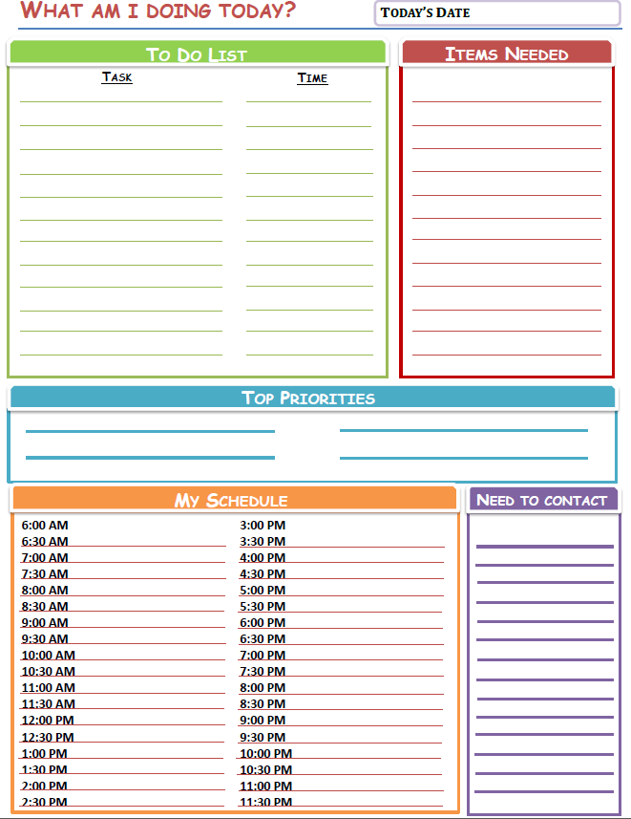
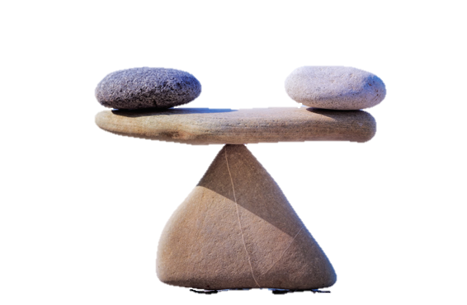
Balance your schedule
Notes:
Presenter to audience: The first step to becoming more organize is organizing your own daily schedule. Use the worksheet labeled “Planner” on our website to complete this exercise. https://righttrack.stpaul.gov/professional-development-training-material/
Take about 10 minutes to sit independently and list all the task you need and would like to complete on Saturday (ex. English Essay, tennis practice, babysit). Write down how long you think it will take. Jot down the items you believe you will need (ex. Gym Shorts, tennis racket). Write down two or three things that you believe are the most important things to accomplish on that day in the “Top Priorities” section. Everything else that is not in the “Top Priorities” section will not be actions that you are willing to let go, in order to complete your top priorities. In the “My Schedule” section, put down your timed schedule. The “Need to Contact” box is for all the people or places you need to contact on that day. For example, if you need to call in work for your pay stubs or contact a teacher for an extension.

Slide 10

Evening Routines
Save time and be more productive because of morning routines
Notes:
Presenter to audience: An evening routine is doing most of the task you do in the morning, the night before, such as deciding your outfit. Evening routines are a great way to save time in the morning and reduce the stress of getting ready. Setting an evening routine can help you start your next morning feeling ready, prepared, and calm instead of anxious, rushed, and hectic. You can also get more sleep because you reduced the amount of things you need to do. Here are some things you can do in your evenings to help your mornings,
1:Decide your outfit. For some people, deciding what to wear can take an hour because we like to mix and match and test what works. If your day tomorrow involves a more thoughtful appearance (like a job interview) or if you simply have a hard time deciding what to wear, choosing your outfit the night before can reduce a lot of time. This also includes finding that other matching sock and ironing your clothes.
2: Lunch. Deciding what to eat, cooking lunch and then packing it takes a large chunk of time. It’s hard to do especially if you have to work early in the morning. Plan your meal the night before, pack it and label your lunch to help keep you organized and ready to go. If you carry a water bottle, it wouldn’t hurt to fill it up as well.
3: Packing. Have you had one of those scary mornings when you’re scrambling to find your assignment or can’t find your gym clothes? Avoid unexpected surprises and anxiety by packing everything you need in your evening and placing it near the door. This includes extra clothes you might need, homework/assignments, business cards, etc.
4: If you need coffee to function in the morning, invest in a coffee machine that has a timer. You can set a timer the night before, 5 minutes before your alarm so that the coffee machine will brew your coffee automatically. Save time and wake up to the fresh smell of coffee.

Slide 11
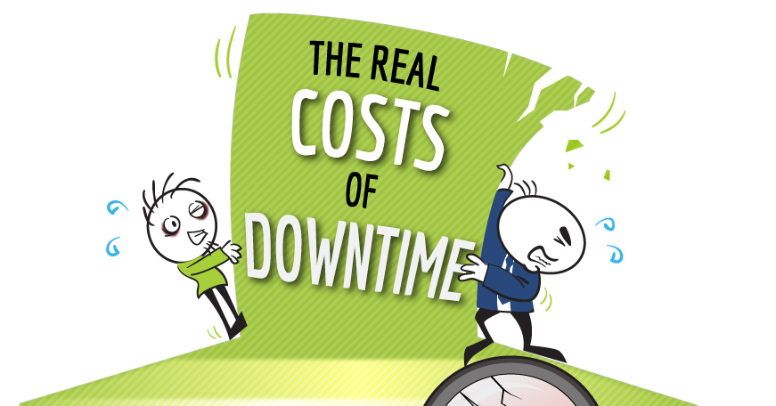
Make your downtime productive
Notes:
Presenter to audience: The average bus ride is 30 minutes, a total of 10, 950 minutes a year if the bus was taken everyday (not two way trips). This is a huge chunk or time that we like to call “Downtime”. Downtime can be a great time to unwind and reset yourself for your next activity, however you can also turn downtime into powerful productivity. For example, during a 30 minute bus ride, you can use that time to teach yourself valuable skills like a new language, reading a self coaching book, practicing for a future presentation, etc. Downtime can also include 5 minutes before the bell rings, and waiting for your ride.
If you would like to do something productive during your downtime, feel free to check out http://mooc.org/.

Slide 12
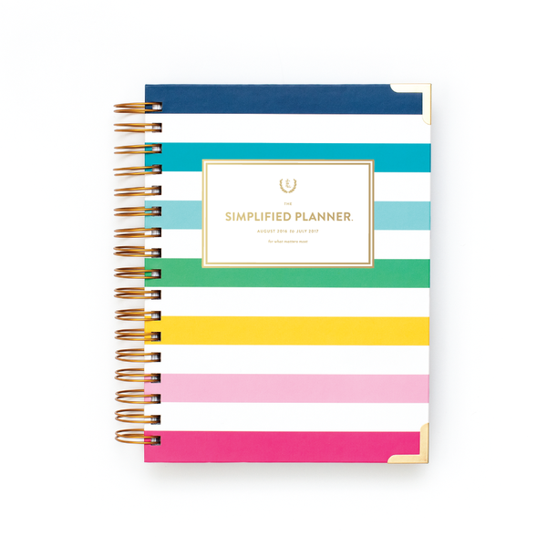
Organizing tools
Google Calendar
  Online Planner
  Can connect with your friends/coworkers calendar
  Can send text/email reminders
  Color coded
  Can set item reminders and descriptions for events, location
Notes:
Presenter to audience: Google calendar is a great tool you can use to help you keep track of your schedule and get reminders about important events like deadlines, appointments, social gatherings, and even updates. Google calendar also allows you to share your calendar with your friends/family/coworkers. Sharing calendars is a good way to keep others in the loop about what is going on. If you want to know what classes your friends are in or know when your coworkers are available to collaborate, sharing calendars can help make it easier.

Slide 13
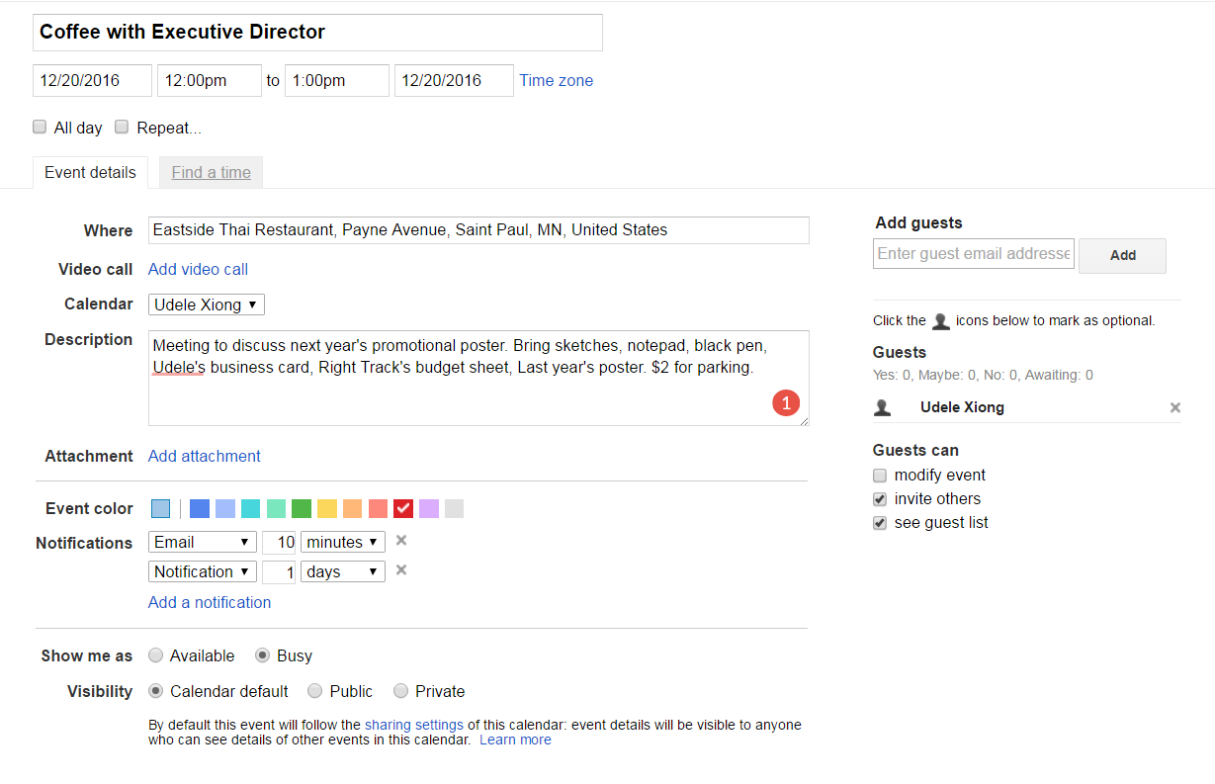
Notes:
Presenter to audience: Google calendar is colorful and can show you your schedule in the next day, week, month, and year. You can invite other people with their emails and set descriptions to help remind you what your meetings are about or if you need to bring anything extra. Google is also useful in that it can send you reminders via email and text. You can set a location for where the event is held and decide if you want this event to repeat.This is a great tool for high schoolers, college students, and working members.

Slide 14
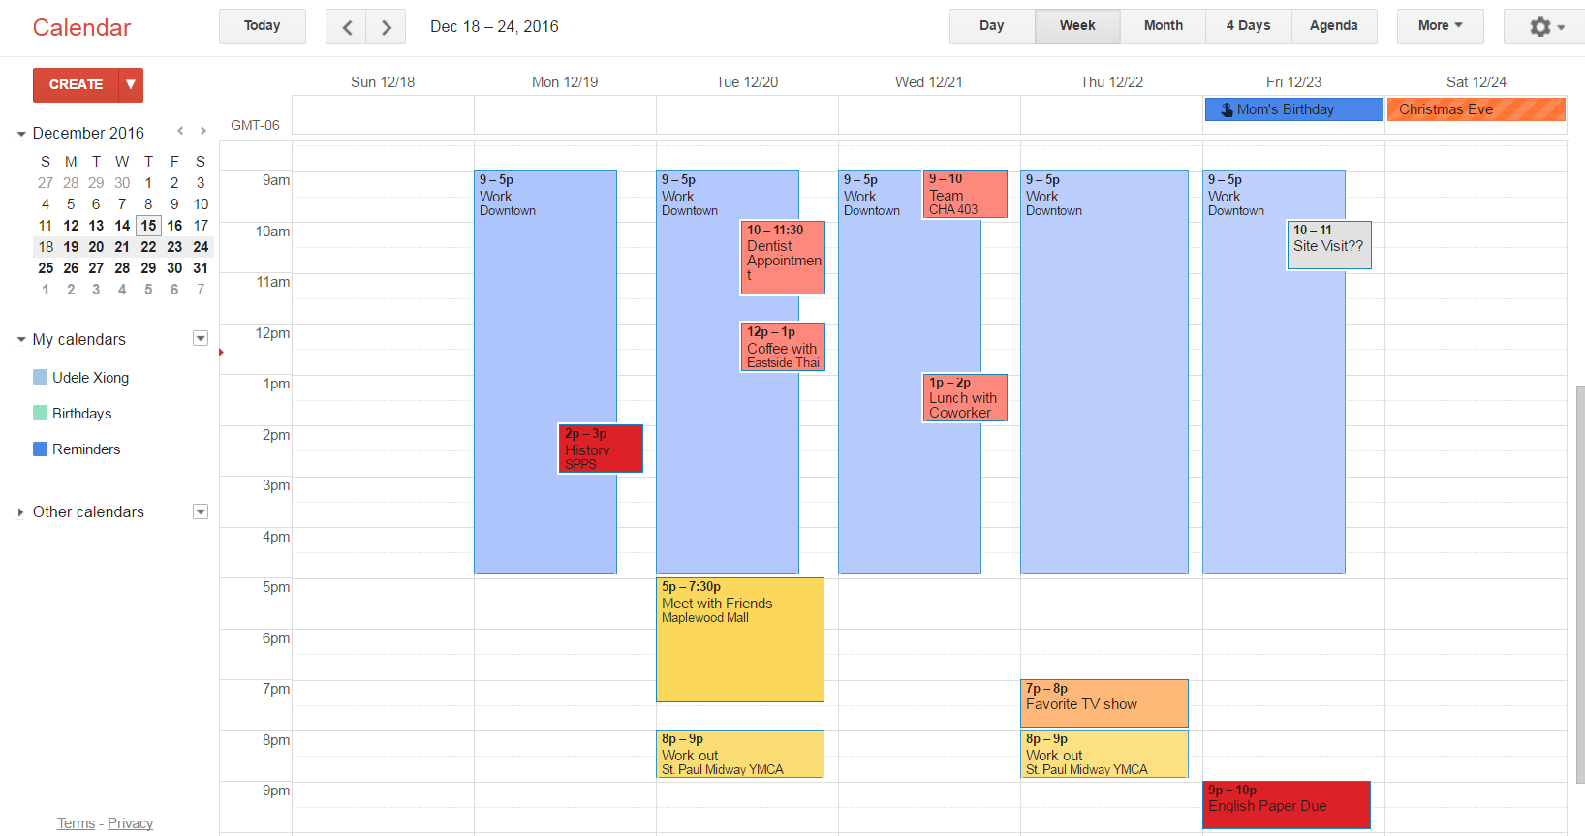
Notes:
Presenter to audience: Here is how Google calender looks out when viewing weekly task. I organized my calender with colors. Events in yellow are optional, and flexible. Events in pink are appointments. Events in red are deadlines and priority. Events in grey are tentative or a possibility of happening. Events in blue is work. You can create your own color scheme. If someone was sharing their calendar with me, I can also have to option to view their events.

Slide 15
Other Cool Tools You Can Use to Keep Yourself Organized
Trello
Post it notes
Mind Maps/white board apps
Wunderlist
Evernote
Notes:
Presenter to audience: Here are some other tools you can use to keep yourself organized. Trello is an online website that is to meant to help teams share and communicate with each other. It allows you to create check list for one another, share documents, and keep each other up to date.
Post it notes can be effective for all productivity types. They can be used as reminders, marking things, and create color coded notes.
Mind maps can help you visually organize and see your ideas. You can download the white board app to help you keep track of how your thoughts connect and flow.
Wunderlist is an app that helps you create checklists. You can share this checklist with anyone. If you need a teammate to buy something for your presentation, you can create a checklist for them and the will automatically receive it.
Evernote is another app that you can use to keep your notes. If having thousands of paper notes is disorganizing to you and stresses you out, try evernote. You can write notes with your tablet like you would in a journal.

Slide 16
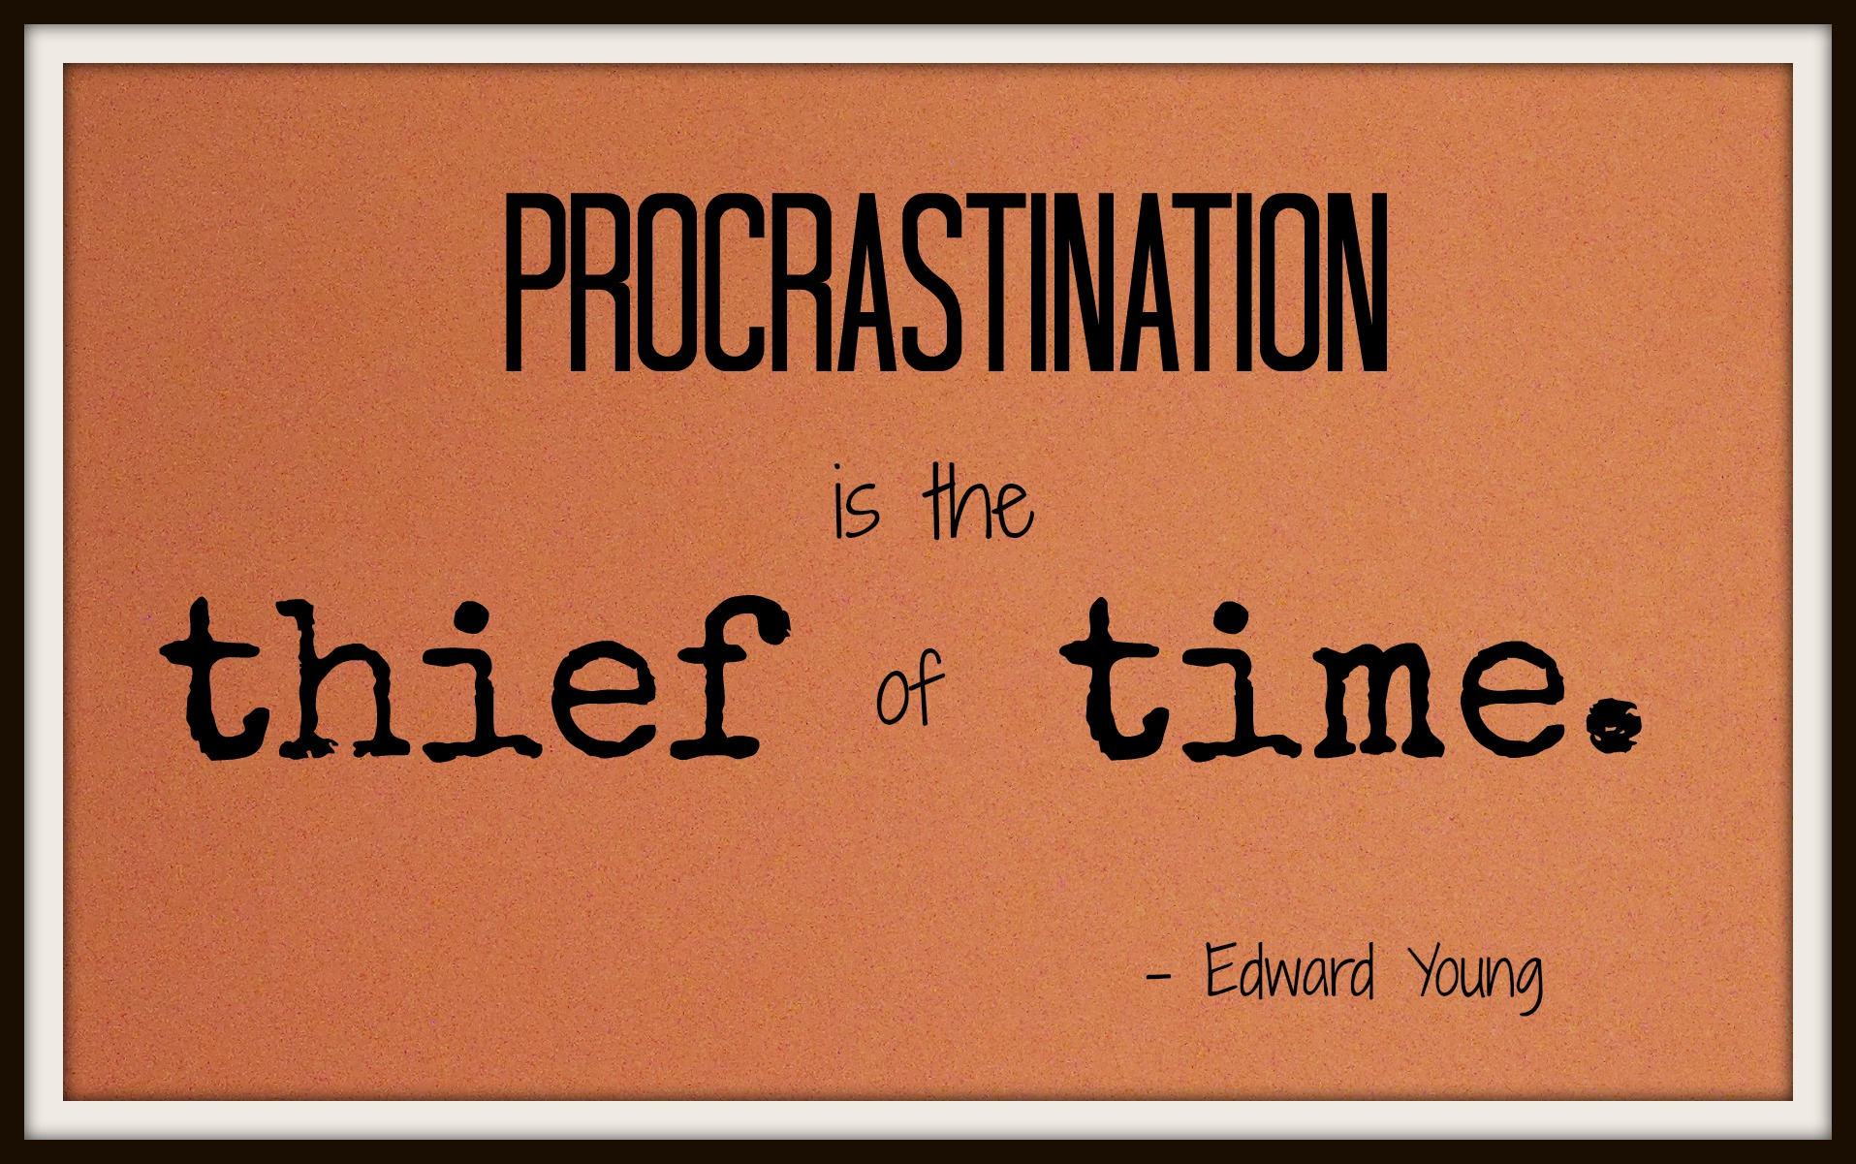
Notes:
Presenter to audience: Everyone has probably procrastinated at least once in their life. However, for some, procrastination is chronic and we do it all the time. Procrastination is the act of putting off or delaying a task like an assignment, and finishing it right before its deadline. There are a few different reasons for why people procrastinate: no motivation, don’t know how to do the task, fear of failure, fear of success, distraction and lack of interest. Procrastination can be a bad habit because it can increase anxiety, increase stress, generate lower quality work, and can actually take up more of your time.

Slide 17

Notes:
Link to video – Presenter to audience:
Take a look at this 1 minute video and see how this man justifies procrastination.

Slide 18
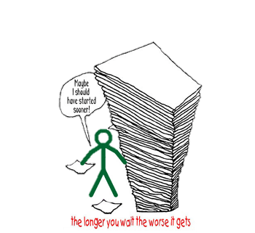
Question time!
What did you think about the video?
Is this close to how you procrastinate?
Notes:
Presenter to audience: Take a minute to reflect on the video and ask yourself the questions on the slide.

Slide 19
Notes:
Presenter to audience: Link to video - https://youtu.be/Qvcx7Y4caQE
Watch this video to learn new ways to defeat procrastination.

Slide 20
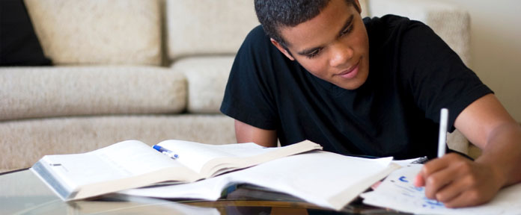
Question time #2!
What did you think about the video?
What do you do to prevent procrastination?
Notes:
Presenter to audience: Take a minute to reflect on the video and ask yourself the questions on the slide.
Do you think you will try the advice? Let us know if it helped you and if there is anything else you do to prevent procrastination.

Slide 21
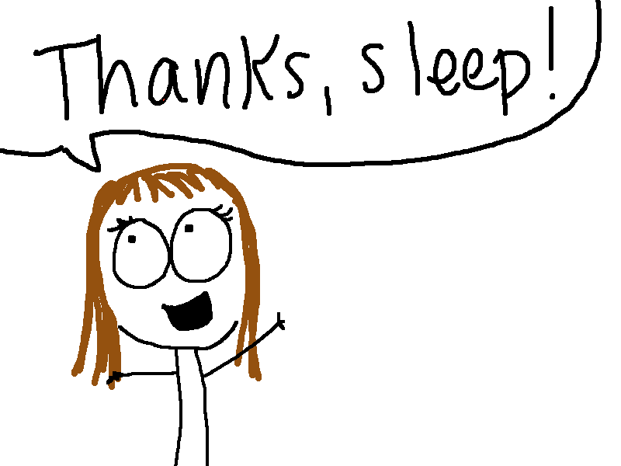
Did you know?!
That one of the most important things that affect our productivity is sleep?
Sleep improves your productivity by 4% and your memory improves.
If you are sleep deprived, your reaction time and accuracy goes down by 50%. Meaning more mistakes, and slower work.
Your naps should only be 10-20 min. If you go past 40 min. you enter REM sleep. Waking up during REM sleep is what causes people to be cranky.
  If your naps last long, it’s a sign that you are sleep deprived.
Notes:
Presenter to audience: It’s break time! However, during your break, feel free to learn some cool and interesting facts about how sleep affects your productivity.

Slide 22

Event Planning
Notes:
Presenter to audience: Event planning is a skill that many different fields encounter. Event planning can be something as big as a wedding, to a simple team meeting. Many times, event planning is something that we won’t be able to avoid.

Slide 23
Considerations
Who will be there?
What will happen?
Where will we be?
What time is the event?
Why are we having a celebration?
What is our budget?
What will we eat?
What materials/supplies are needed?
Notes:
Presenter to audience: Here are some important things to consider first when planning an event. Answering these questions can help set the foundation for future decisions.

Slide 24
Fixed/Non-Negotiables
Our budget is $600, which includes any kind of Right Track swag (i.e. jackets, backpacks, etc).
  We already have plates, napkins and utensils, so you don’t need to take those into consideration of cost.
The majority of participants will need 30 - 45 minutes to fill out the Right Track application.
  A few folks are not reapplying for Right Track – what should they be doing during this time?
The event will take place at Arlington Hills Community Center on Saturday, February 11th from 11am – 1pm.
There are X number of participants in our training cohort.
Notes:
Presenter to audience: Non-negotiables are ideas or things that cannot be negotiated. Once they are set, they are concrete and cannot be changed in the future. When planning an event, like our last celebration, list down your non-negotiables. This gives you something to build off and help you make future decisions. Non-negotiables are typically things like: The cost or budget of the event, the location, the amount of people that can attend, theme, and the time.

Slide 25
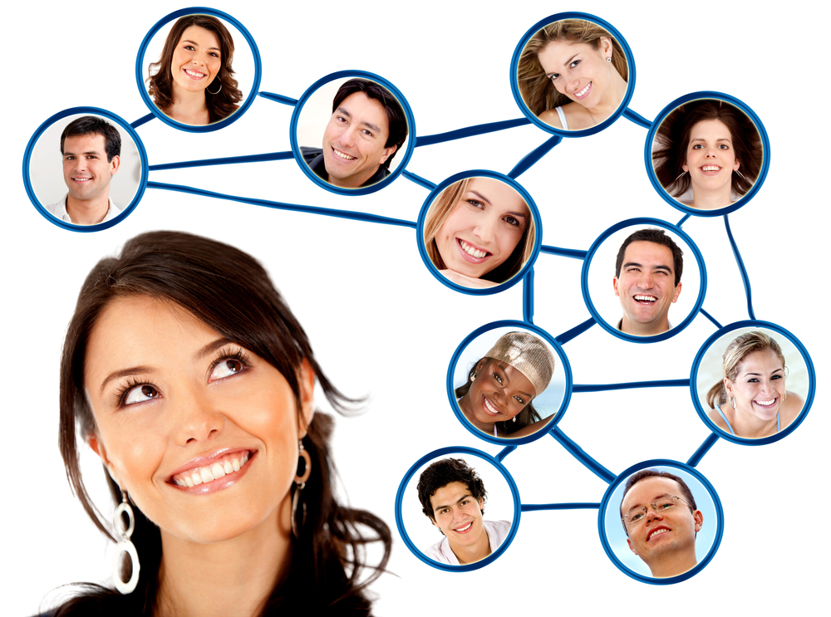
Conclusion
Complete our evaluation
Stay safe and warm
Thank you!
Notes:
Presenter to audience: We hope you learned some new things about planning and organization. Proper planning and organizing can greatly improve a persons ability to focus, be more productive and save time.

