Slide 1
Resume Building 101
Right Track Training
Notes:
Presenter to youth: Welcome and quick breakdown on what the session will be about.

Slide 2
Ice Breaker
Resume Adjective Activity
Notes:
Presenter to youth: Youth will share an example of how they exemplified an adjective they listed on their resume in the past. Remember, if it’s on your resume as skill or adjective- be prepared for employers to ask you explain them!

Slide 3
What can be on a Resume?
Experience
Volunteering
Special Skills
Notes:
Presenter to youth: Relevant experience is when you highlight skills from previous positions that pertain to the job you are applying for. You can use experience from volunteer positions too. Special skills include languages, technological skills, etc.

Slide 4
What is it and why do I need it?
A written document, typically one page, that you give employers as a first impression and summary of your work experience, accomplishments, education background, and skills.
A strong, well written resume will make the employer want to move forward with your job application.
Notes:
Presenter to youth: A written document, typically one page, that you give employers as a first impression and summary of your work experience, accomplishments, education background, and skills. A strong, well written resume will make the employer want to move forward with your job application.

Slide 5
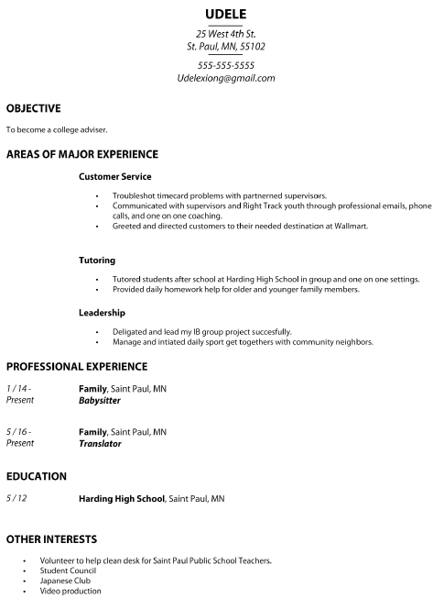
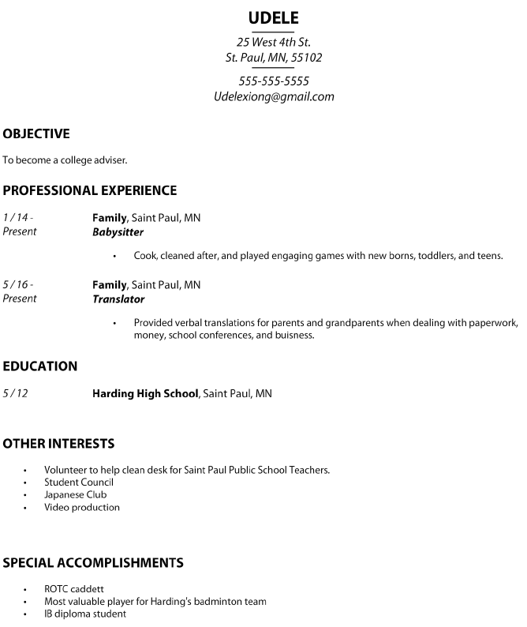
Functional
Chronological
Notes:
Information for presenter: Explain the difference between the two resumes in the slide and what each is most appropriate for.

Slide 6
Dissecting a Resume
Your personal information
*Optional – What is your goal?
Your work experience
Your school
Other things you are involved in or interested in
Awards, accomplishments
Notes:
Information for presenter: A brief breakdown of general resume components.

Slide 7
Bad Resumes
Notes:
Presenter to youth: What are the flaws in this resume?

Slide 8
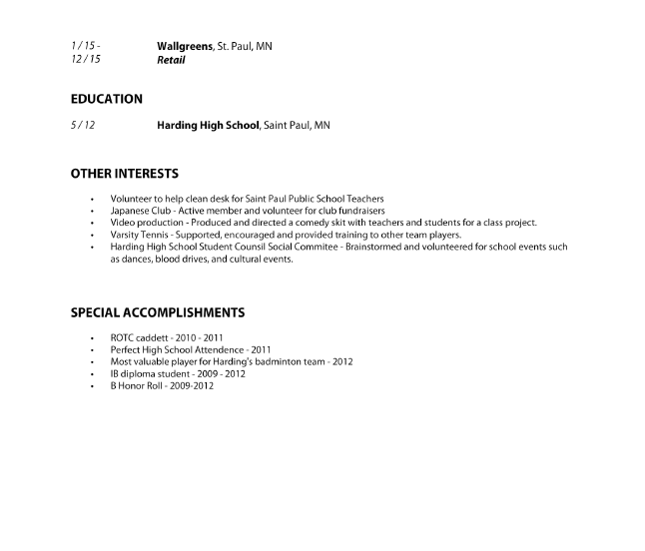
Notes:
Presenter to youth: What makes this resume readable?

Slide 9
Strong Resumes
Don’t just say it, show it
Include dates of accomplishment
Be specific
i.e Babysitting. Did you babysit a newborn, toddlers, or teenagers? Where did you babysit? What did you do when you were babysitting?
Showcase your strengths by emphasizing contributions and results
Strong resumes start with strong action verbs
i.e Facilitated, managed, produced, etc.
Notes:
Presenter to youth: Emphasize the importance of dates, specificity, highlighting results (when possible, quantify your contributions so that employers understand exactly what you accomplished). Explain the importance of action verbs.

Slide 10
Target Audience
Maybe not for Right Track
For future positions, tailor your resume to the job qualifications/requirements for the position you want
Research the job you want
Notes:
Presenter to youth: Understanding your audience (i.e who will be reading your resume) is important because it shapes how you go about tailoring your resume. Make strong connections between the content of your resume and the job you are applying to.

Slide 11
Behind the Scenes
76% of resumes are discarded for an unprofessional email address.
68% of employers will find you on Facebook.
Notes:
Facts grabbed from: http://www.business2community.com/human-resources/25-fun-facts-resumes-interviews-social-recruitment-0975676#gePiqBOHBLaK3l6K.99

Slide 12
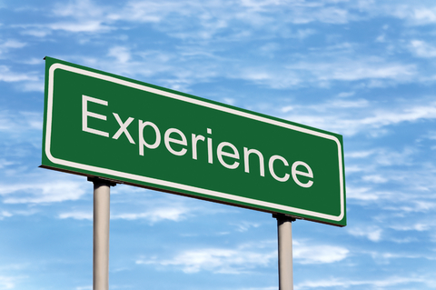
My Resume Ideas
Notes:
Presenter to youth: Think about past work, volunteer, internship, and leadership positions. How can you highlight them through 3-4 bullet points? What strong and effective language can you use?

Slide 13
Resume Builder
https://www.thebalance.com/easy-steps-to-build-a-resume-4122296
Notes:
An article on resume building.

Slide 14
Reflection
Was there anything you learned about yourself as you worked on your resume?
Notes:
Presenter to youth: encourage everyone to share at least one take away from today’s session.

