Slide 1


Right Track Training

Slide 2
Welcome
Think of 3 shinning moments in your work lives.
  Awards, compliments, an impossible task achieved promotion, etc.
  Come up with 3 as a group to present
Notes:
One of the best ways to identify which careers fit you is to analyze shinning moments in job related experiences. Shinning moments are moments in which you received awards, compliments, or were able to accomplish task that seemed impossible. While thinking about these shinning moments, try and remember how it made you feel. Shinning moments can help us understand what is important to us in a job and help us identify what job fits us best.

Slide 3
Thinking about Careers…
https://www.careeronestop.org/ExploreCareers/explore-careers.aspx
Notes:
If you are wondering what careers are out there and which ones might match you, feel free to take this free career assessment.
https://www.careerinfonet.org/occ_rep.asp?next=occ_rep&Level=&optstatus=111111111&jobfam=27&id=1&nodeid=2&soccode=272011&menuMode=&stfips=27&x=6&y=3
This career assessment will ask you questions about your likes and dislikes, and find careers that match your interests. You can also click on the job title and learn more about it. It will explain how much the job makes, what kind of degree you will need to accomplish, what skills you will need to master to be successful in that job and much more.
There is a worksheet on our website that goes with the career assessment. https://righttrack.stpaul.gov/professional-development-training-material/
Feel free to use it to help keep track of all the important information. The worksheet is called “Career Assessment”.

Slide 4

Right Track Application
Notes:
Doing internships and getting a summer job is another great way to learn more about what you enjoy doing and what career you might be interested in. Right Track offers amazing work opportunities for youth with or without past experience. If you are interested in getting a job or internship in the summer 2017, make sure to apply for our summer program. The application is open during February 1 – 28th. You can learn more about Right Track jobs by visiting our website: https://righttrack.stpaul.gov/overview/

Slide 5

Group Discussion
Notes:
Do you have any ideas on how the City of Saint Paul can support youth better? If you do and want to share them with us, please email Righttrack@ci.stpaul.mn.us

Slide 6
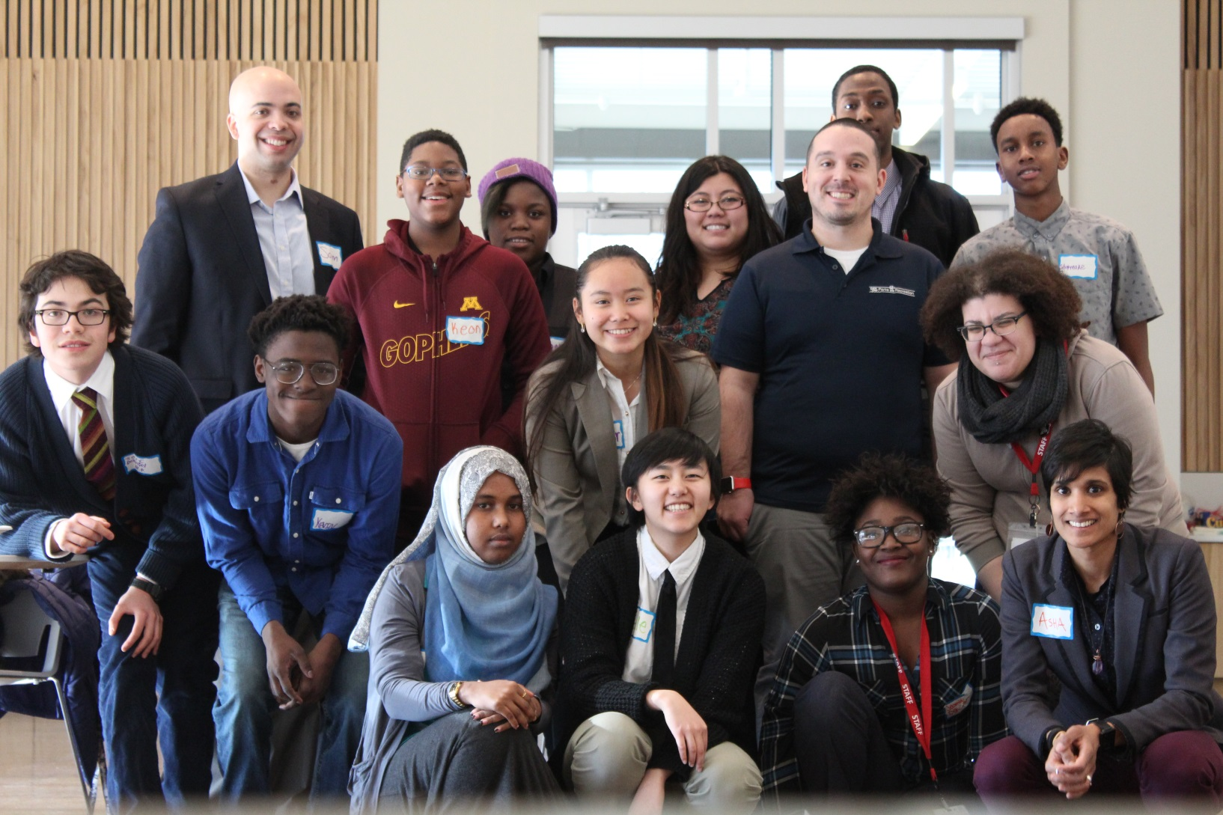
Thank you!
Notes:
We hope you learned about the different careers that are out there and which ones fit your interests. The best way to learn if a career is right for you is to experience different jobs and

