Slide 1



CITY OF SAINT PAUL
2026 Neighborhood STAR Awardee Workshop

Slide 2
Congratulations from the STAR Staff!
Erin Lewis, Neighborhood STAR Program Coordinator
Melissa Doerscher, Management Assistant
Nya Hardaman, Project Manager
Nancy Vang, Project Manager
Grace Bubel, Project Manager
Jessica Larson Johnston, Cultural STAR Program Coordinator
Notes:
Introductions of staff on call

Slide 3
Introductions – STAR staff and additional staff as we go.
Awardees, please introduce yourselves in the chat!

Slide 4
Agenda
Tips and reminders
Working with a Project Manager
Getting Under Contract
Compliance & Insurance Requirements
Contractors/Subcontractors
Closing Fee & Registering with PaymentWorks
Draw Requests & Reporting
We want to hear from you!
Contact Information
Meeting will be recorded and posted to our website for those unable to attend today

Slide 5
Neighborhood STAR
Tips & Reminders

Slide 6
Timeline
Working with the City of Saint Paul Neighborhood STAR Program
Timing: Awardees for the 2026 Round have until the end of 2027 to get under contract. At least one draw must be made by the end of 2028. Contracts are for two years. Please note that if you do not get under contract by the deadline, your grant funds will be withdrawn.
Compliance: Your project is subject to compliance requirements depending on the total amount of your award, total project amount, and/or type of project. We will cover these areas in more detail today. Keep these requirements in mind before beginning work on your project.
Eligible Expenses: You will only be reimbursed for expenses that are eligible for funding per STAR guidelines. If your project includes include activities that are not STAR-eligible, those must be paid by other sources of funds. STAR-eligible expenses must be for capital improvements – physical improvements that are permanently affixed, with a lifespan of 7+ years.
Keep good records: The Neighborhood STAR program is a reimbursement or disbursement program, and proof of payment for all grant-funded work is required. Be sure to keep track of all invoices, receipts, and proof of payment, including those you will be using for match, if applicable.
Plan ahead: The PED team is managing hundreds of projects at any given time. Processes for reimbursement can be slow – in some cases, 4+ weeks. Please plan ahead and have your receipts and other documentation ready to go if you are on a tight deadline.

Slide 7
Working with a Project Manager

Slide 8
Project Management
Each awarded project will be assigned a Project Manager from the Planning and Economic Development (PED) team.
Your Project Manager will be your main point of contact for getting under contract, maintaining contract compliance, disbursing funds, navigating city systems, and providing support and assistance as needed throughout the life of your project.
Your Project Manager will be in touch with you in the next few weeks to get started on the steps needed to get your project under contract.

Slide 9
Getting Under Contract

Slide 10
Getting Under Contract
Your contract is your first step in formalizing your agreement with the City of Saint Paul.
Your contract will include the dates of your agreement with the city, the scope of your project, insurance and compliance requirements, and all the terms and conditions of the STAR program.
Please review your contract and ensure you have met all applicable requirements. For example, you must ensure that your project is properly zoned and obtain any needed licenses or permits as a condition of your STAR contract.
You have until the end of 2027 to get under contract for your award.
Your business or organization must be in good standing with the MN Secretary of State.
A sample contract, statement of work, insurance requirements, and other resource documents can be found online at stpaul.gov/nstar-recipients.

Slide 11
Compliance

Slide 12
Compliance
Entities that do business with the City of Saint Paul must meet compliance requirements that are set by the city to ensure that local, state, federal, and funder requirements are met. This is sometimes simply referred to as "compliance."
Whether compliance applies to your project depends on the sources of funding you have, total project cost, and/or project type.
We will review insurance and the most common compliance requirements today.
Your Project Manager will contact you to schedule a pre-construction meeting with our compliance team before you begin your project.
We strongly advise that you wait to begin your project until you fully understand the compliance requirements as they may impact the cost and timing of your project.

Slide 13
A Summary of Common Areas of Compliance
Awardees may not discriminate against protected classes
Awardees must comply with city insurance requirements
Employees must receive all pay due for their work, as well as Earned Sick and Safe Time (ESST) and at least the minimum wage for your size business for St. Paul
If you receive $20,000 or more, you must solicit two written bids for construction per the city's Two Bid Policy and proceed with the "lowest responsible bidder" for the work
If your project is for construction work and/or you receive a grant of $25,000 or more, Prevailing Wage requirements, a minimum wage for construction workers, will apply. This can increase the cost of your project.
If you receive $25,000 or more in grant funds, you must have a defined public purpose and set goals for job creation and wages per Business Subsidy Law.

Slide 14
Summary, continued
Awardees receiving $50,000 or more must have an Affirmative Action Plan certified by the City, including goals and documentation for hiring and recruiting ($75 fee for certification)
If the total cost of your project is over $50,000, you must satisfy Vendor Outreach Program (VOP) compliance, meeting goals around soliciting bids from small, minority- and/or woman-owned firms that are CERT certified with the City of St. Paul
If you receive an award of $100,000 or more, you must follow the St. Paul Living Wage Ordinance, which guarantees a living wage to employees, with wages determined each year by the City.
If you receive more than $200,000 in public funds, the Sustainable Building Ordinance will apply, including certification of your building through an eligible green building standard.

Slide 15
What Compliance May Apply to your Project? | $5,000- $24,999 | $25,000- $49,999 | $50,000 | $50,001- $99,999 | $100,000- $199,999 | $200,000 ≤
Discrimination, minimum wage, ESST, and wage theft laws | X | X | X | X | X | X
Two Bid Policy | X | X | X | X | X | X
Prevailing Wage |  | X | X | X | X | X
MN Business Subsidy Law |  | X | X | X | X | X
Affirmative Action/ Equal Employment Opportunity |  |  | X | X | X | X
$1 : $1 Match |  |  |  | X | X | X
Vendor Outreach Program |  |  |  | X | X | X
Living Wage Ordinance |  |  |  |  | X | X
Sustainable Building Ordinance |  |  |  |  |  | X

Slide 16
Insurance Requirements
Certificate of Insurance with at least $1.5 million coverage for each occurrence and each applicable coverage type is needed before the contract can be approved. An umbrella policy may be helpful if securing a $1.5 million policy is a challenge.
If you have personal and/or commercial vehicles, you may need to submit copies of your individual insurance policy.
You must provide proof of Worker's Compensation insurance or complete documentation stating why you don't need it in the State of Minnesota.
Your Project Manager will work with you on insurance requirements and/or any applicable waivers.
If you have questions about the City's insurance requirements, contact Michael Cowell at Michael.Cowell@ci.stpaul.mn.us or 651-266-6501

Slide 17
Human Rights &
Equal Economic Opportunity (HREEO)

Slide 18

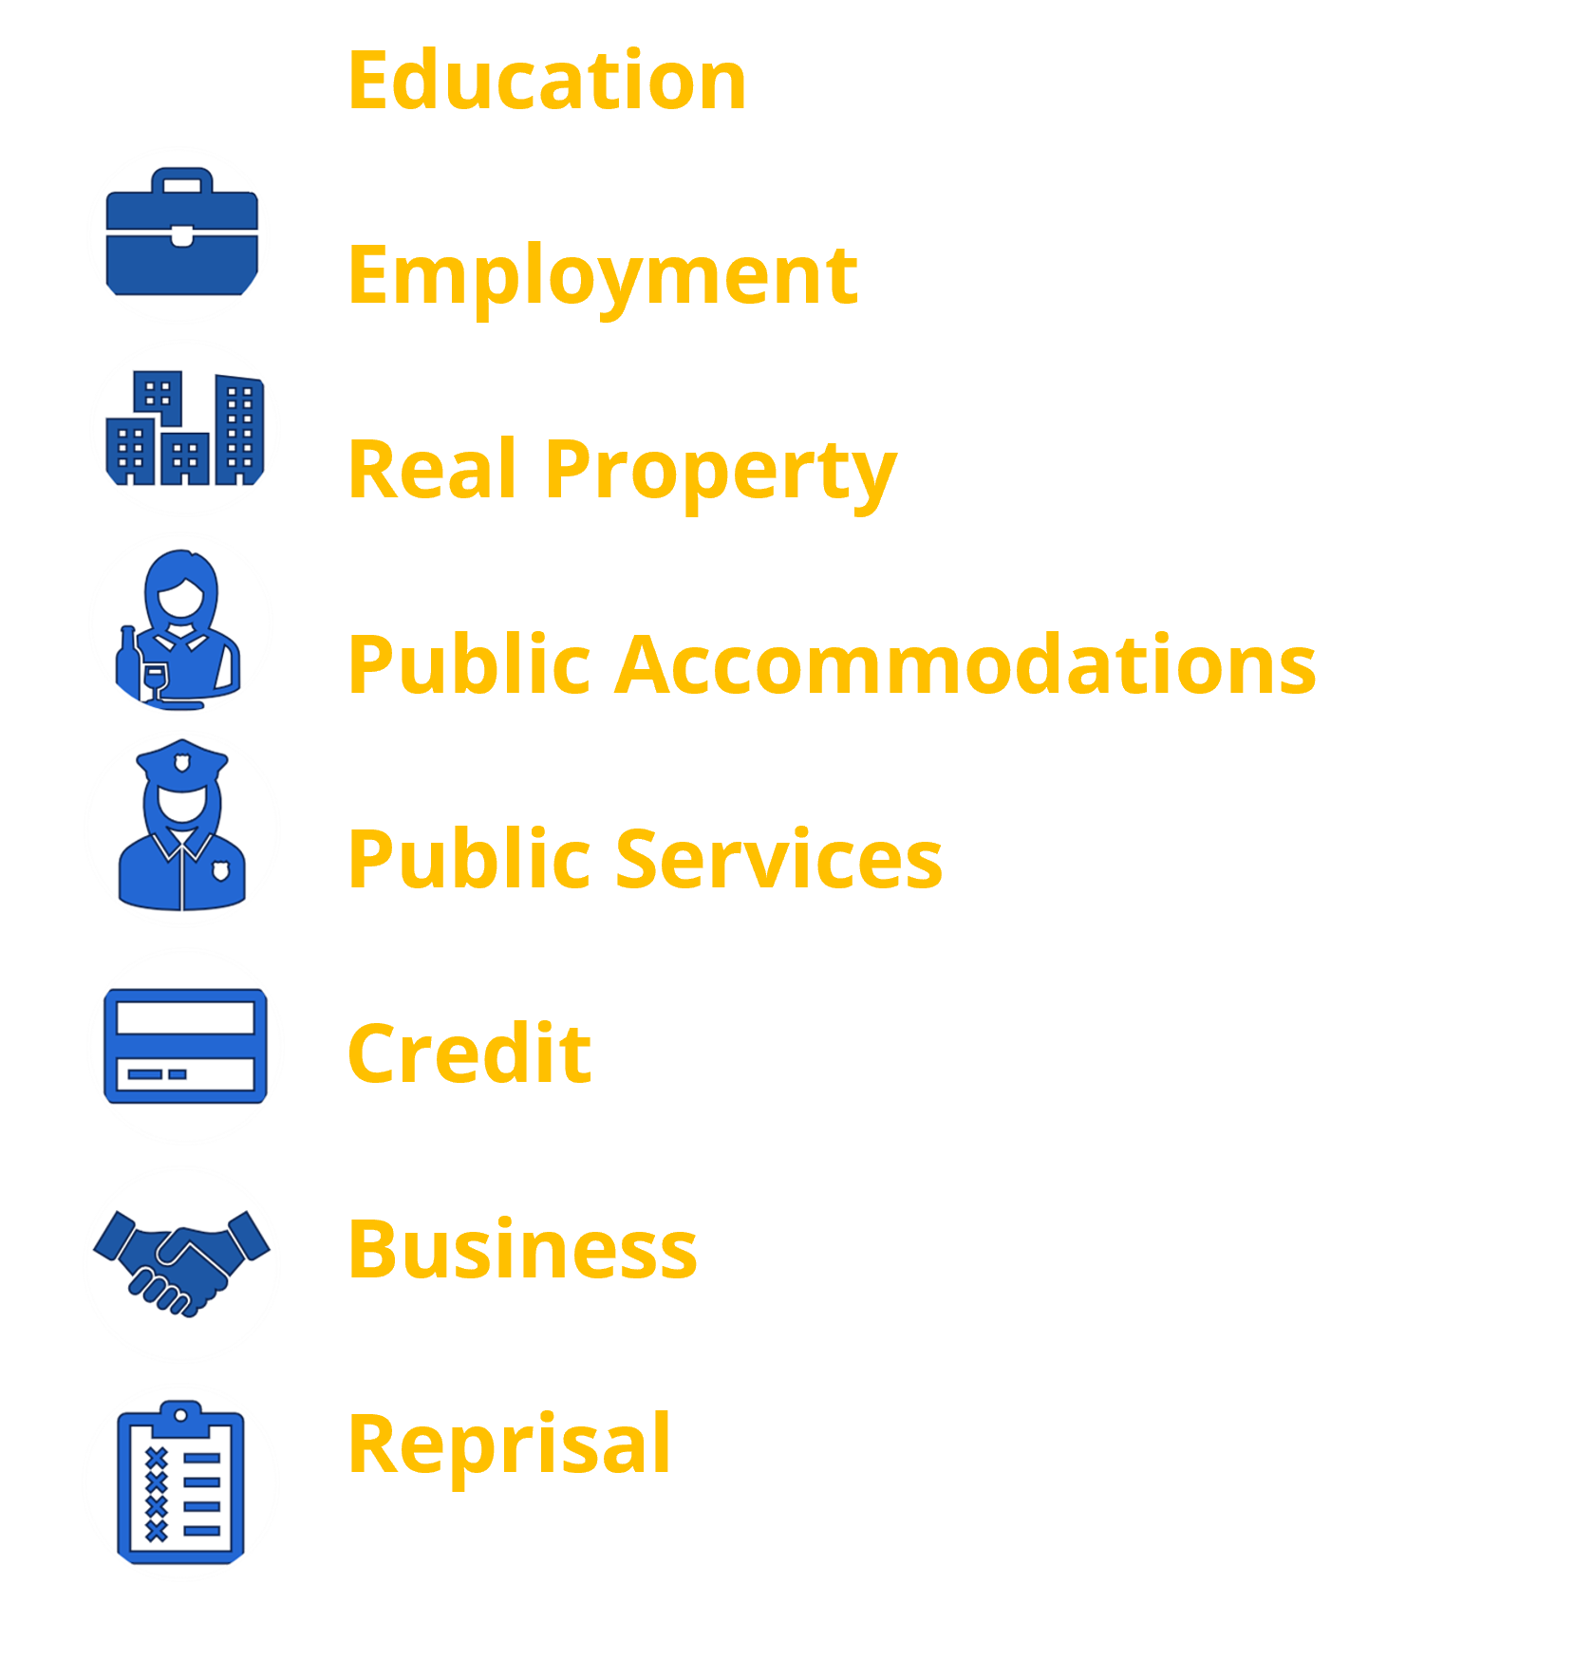
We investigate allegations of discrimination in these areas*
Discrimination against members of these classes is illegal in Saint Paul: Chapter 183
Race
Color
Disability
Religion
Creed
Age (18+)
Marital Status
Familial Status
Sex and Gender Identity
Sexual or Affectional Orientation
National Origin
Ancestry
Status with Regard to Public Assistance
*One year statute of limitations period to file a charge of discrimination
Notes:
The City has a Human Rights law! The Saint Paul Human Rights Ordinance chapter 183 gives the Human Rights division the power to Investigate allegations of discrimination that take place within the City of Saint Paul.
You are protected from discrimination as a member of these classes
-Race-discrimination on someone from a certain race or because of personal characteristics associated (hir texture, skin color, facial features)
-Color-Skin color/complexion
-Disability-any condition or characteristic that renders a person a disabled person. A disabled person is any person who:
(a)
Has a physical, sensory, or mental impairment which materially limits one (1) or more of such person's major life activities;
(b)
Has a record of such an impairment; or
(c)
Is regarded as having such an impairment.
-Religion-not only those who belong to traditional, organized religions but also those who have sincerely held religious, ethical or moral beliefs.
-Creed-Moral, ethical, deeply held beliefs. Includes/incorporates belief systems that may not be expressed by an organized religious group.
-Age-limited to people 18 and older. It is not illegal for an employer (for ex.) to favor an older worker over a younger one, even if both workers are age 18 or older.
-Marital status whether a person is single, married, remarried, divorced, separated or a surviving spouse and, in employment cases, including protection against discrimination on the basis of the identity, situation, actions or beliefs of a spouse or former spouse.
-Familial status the condition of one (1) or more minors being domiciled with their parent or parents or legal guardian or the designee of the parent or parents or guardian. The protection afforded against discrimination on the basis of familial status applies to any person who is pregnant or is in the process of securing legal custody of an individual who has not attained the age of majority.
-Sex includes but is not limited to gender identity, pregnancy, childbirth, disabilities related to pregnancy or childbirth, and sexual harassment.-includes unwelcome sexual advances, requests for sexual favors, sexually motivated physical contact or other verbal or physical contact or other verbal or physical conduct or communication of a sexual nature
-Gender Identity: a person's actual or perceived self-image or identity as expressed through dress, appearance, behavior, speech or similar characteristics, whether or not traditionally associated with the person's physical anatomy, chromosomal sex, or sex at birth.
-Sexual or affectional orientation: having or being perceived as having an emotional or physical attachment to another consenting adult person, or having or being perceived as having an orientation for such attachment.
-National Origin, from a particular country or part of the world, because of ethnicity or accent, or appear to be of a certain ethnic background (even if they are not) this includes a prohibition on discrimination against individuals with limited English proficiency.
-Ancestry-country, nation, tribe or other identifiable group of people from which a person is descended
-Status with Regard to receiving public assistance-does not include section 8, means the condition of being a recipient of federal, state or local assistance, including medical assistance, or of being a tenant receiving federal, state or local subsidies including rental assistance or rent supplements.
Examples:
A landlord charges more rent to a family after they have another child (familial status discrimination in real property) or refuses to rent to a person receiving Social Security disability (discrimination based on disability and receiving public assistance in real property)
An employer won’t accept an accommodation request for a person with disabilities (disability discrimination in employment), or an employer pays people who identify as men more than those identifying as women for comparable work/experience (sex discrimination in employment)
A school disproportionately suspending/giving harsher penalties to students of color vs. students who are white (race discrimination in education)
A restaurant refusing to serve persons based on their perceived religion (religion discrimination in public accommodations)
An employer firing an employee after they reported discrimination to HR or firing an employee for acting as a witness in a discrimination investigation (reprisal in employment)
18

Slide 19



Your Saint Paul Labor Standards Rights
Wage Theft
Employees in Saint Paul receive all pay they are due for their work
Chapter 224A
Wage Theft
Employees in Saint Paul receive all pay they are due for their work
Chapter 224A
Earned Sick & Safe Time (ESST)
Creates access to paid time off from work for employees who perform work in Saint Paul
Chapter 233
Earned Sick & Safe Time (ESST)
Creates access to paid time off from work for employees who perform work in Saint Paul
Chapter 233
Minimum Wage
Local hourly minimum wage rate for employees who perform work in the city of Saint Paul
Chapter 224
Minimum Wage
Local hourly minimum wage rate for employees who perform work in the city of Saint Paul
Chapter 224
Jan 1
Jan 1
2y
2y
Notes:
The City of Saint Paul currently has two labor standards ordinances
The Labor Standards division strives to be a resource for workers and business owners alike.
The Division takes complaints regarding violations of these ordinances and works with businesses to correct issues with the application of these laws
Our website has a wealth of resources, FAQs, and administrative rules with additional information. Employees and employers are encouraged to reach out to the Labor Standards team with questions at any time
19
The City of Saint Paul currently has two labor standards ordinances
The Labor Standards division strives to be a resource for workers and business owners alike.
The Division takes complaints regarding violations of these ordinances and works with businesses to correct issues with the application of these laws
Our website has a wealth of resources, FAQs, and administrative rules with additional information. Employees and employers are encouraged to reach out to the Labor Standards team with questions at any time
19

Slide 20
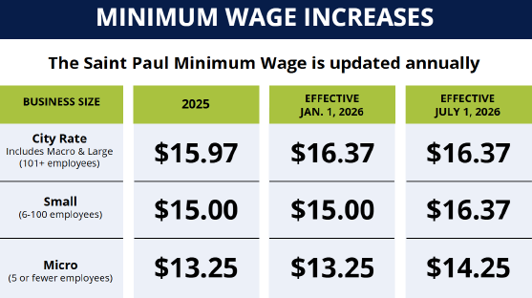
Workers have a right to earn a higher Minimum Wage for work done within the city of Saint Paul.
Notes:
The Saint Paul Minimum Wage increases annually!
The City rate is increased based on calculations from the MN Commissioner of Labor and Industry and is tied to inflation
20
The Saint Paul Minimum Wage increases annually!
The City rate is increased based on calculations from the MN Commissioner of Labor and Industry and is tied to inflation
20

Slide 21
Contact us for more information!
PCIARC Coordinator:
CivilianReview@stpaul.gov
651-266-8970
Contract Compliance & Business Development:
ContractCompliance@stpaul.gov
651-266-8904
CERT & Procurement:
Procurement@stpaul.gov
651-266-8966
Human Rights Investigations:
HRightsComplaints@stpaul.gov
651-266-8966
Accessibility/LEP Coordinator:
ADACoordinator@stpaul.gov
651-266-8902
Labor Standards:
LaborStandards@stpaul.gov
651-266-8966
Stpaul.gov/HREEO · 651-266-8966
Notes:
Walk ins are welcome Monday-Thursday 8 am-4:30 pm at City Hall 15 W Kellogg Blvd # 280, St Paul, MN 55102
21

Slide 22
Affirmative Action

Slide 23
Affirmative Action/Equal Employment Opportunity
        Vendors and Developers that have a contract with the city for $50,000 and over are required to have an Affirmative Action Plan (AAP) certified.
      Affirmative Action Plan and workforce participation goals apply to construction projects.
        Project Managers must ensure vendor AAP certification before routing contracts for signature. Check AAP Open Data Portal or contact Yia Thao.
        $75 (check only) fee applies to certify AAP – AAP certified for 2 years.
      There are no AA exemptions for nonprofits, vendors without employees, LLCs, etc.

Slide 24
Prevailing Wage

Slide 25
Prevailing Wage
Prevailing Wage will apply to your project if:
It involves any kind of construction work;
You are receiving any amount of public money, and;
The total cost of your project meets or exceeds $25,000 (if your project has federal money in it the project cost threshold is $2,000).
WHAT IS PREVAILING WAGE?
Prevailing wage is like a minimum wage for construction workers. Your contract with the city will contain a list of hourly rates of pay for various types of construction workers. If prevailing wage is triggered on your project, your contractors will need to ensure they’re paying their workers at the minimal rates provided in the contract.
Prevailing wage may increase the cost of your project.

Slide 26
What do you have to do?
When you’re looking for contractors make sure to tell them as soon as you can that your project is a prevailing wage project; most contractors are familiar with prevailing wage. Some contractors do not like working on prevailing wage projects because it can involve more work on their end.
Make sure to include the prevailing wage paperwork the city provides to you in your contracts with your contractors.
During the project, your contractors will be required to submit their workers’ payroll to the city.
If they don’t pay the required rates to their workers, or fail to submit their payroll to the city, it can delay payment from the city to you.
Any work occurring at the same time and place as your STAR work may become subject to prevailing wage. Contact staff for more information.
All of this will be discussed in more detail later on. If you have any immediate questions please email us at ContractCompliance@ci.stpaul.mn.us.

Slide 27
Vendor Outreach Program
Department of Human Rights and Equal Economic Opportunity Contract Compliance Division

Slide 28
Vendor Outreach Program (VOP)
Contract Compliance
Applies to projects with a STAR award of over $50,000
Establishes a goal of 25% of the sub-contracting opportunity be awarded to certified small, local businesses.
Businesses must be CERT certified to count toward VOP goals
Reporting requirements will be discussed further at a pre-bid or
pre-construction meeting
Notes:
Vendor Outreach Program is a business inclusion program – if you receive city funds, ‘share the wealth’ by reaching out to include other small & local businesses
There is a 25% overall business inclusion goal, subgoals: 5% MBE, 10% WBE, 10% SBE
Businesses must be CERT certified to count toward VOP goals.
Reporting requirements will be discussed at pre-bid or pre-construction meeting.

Slide 29
VOP responsibilities
Access the CERT directory https://cert.smwbe.com/
Reach out to CERT certified businesses for each scope of work, supply, service
Keep records of vendors solicited for bids and responses received
Include VOP specs with subcontracts
Payment reporting
https://stpaul.diversitycompliance.com/
Notes:
Access CERT directory
Reach out to CERT certified businesses
Keep records of who you reach out to, when, what the responses are, and what business you chose for each scope of work, supply, or any other vendors paid.
Include the VOP contract specifications with your subcontracts

Slide 30
Can use the CERT list/directory to find small local vendors, even if VOP is not a requirement on your project
Encourage small local businesses to become CERT certified
Certification is free and lasts for 3 years
Contact the CERT program directly
Notes:
Even if VOP is not required on your project, you can still use the CERT directory to find small & local vendors
If you own a small business and would like to become certified, contact CERT directly. CERT certification is free, and lasts for 3 years

Slide 31
Vender Outreach Program
Primary Contacts:
Priscilla Yang, Contract Compliance
priscilla.yang@ci.stpaul.mn.us
General Compliance Inbox
contractcompliance@ci.stpaul.mn.us
CERT
https://cert.smwbe.com/
Cert@strongandstarlike.com
651-288-4041

Slide 32
Minnesota Business
Subsidy Law

Slide 33
Minnesota Business Subsidy Law
Compliance During Project Operation
Minnesota Statute Sections 116J.993-.995 and
City Council Resolution #99-742
Require that a business receiving state or local government assistance must have a defined public purpose and recipients must set goals for job creation, wages and benefits to be achieved within 2 years of receiving assistance

Slide 34
Minnesota Business Subsidy Law
Compliance During Project Operation
Applies to recipients* receiving a business subsidy of $25,000 or more of grant funds, unless the project or recipient falls within an exemption;
If the award is $150,000 or more, the following will apply:
  Requires a notice and public hearing on the subsidy;
  Specific wage and job goals to be attained within 2 years and a 5-year commitment to continue operations at its business location in Saint Paul;
Annual reporting is required each year for the prior calendar year
* All for-profit entities qualify as a business subsidy recipient; however, only non-profit entities with at least 100 Full-Time Equivalent (FTE) employees and with a ratio of highest to lowest paid employee that exceeds ten to one qualify as a business subsidy recipient.

Slide 35
Saint Paul Living Wage Ordinance

Slide 36
Saint Paul Living Wage Ordinance
Compliance During Project Operation
Chapter 98 of Saint Paul Administrative Code;
Applies to recipients receiving $100,000 or more in a City Business Subsidy unless the recipient qualifies for an exemption*;
Recipients and Qualifying Tenant(s) must pay a living wage to each employee (and in the case of a Tenant to an independent contractor as well) who is employed in the location for which the subsidy was provided for the longer of, 3 years or the term of the STAR Grant Agreement.
*The following entities are exempt from paying a living wage: for-profit or non-profit entity that qualifies as a small business under MN Statutes 645.445, which includes, in part, businesses that are not an affiliate, and with 20 or fewer full-time employees or with annual gross revenues less than $1 million.

Slide 37
Saint Paul Living Wage Ordinance
Compliance During Project Operation
A Living Wage is:
  130% of the federal poverty level for a family of four OR
    $20.63 per hour for 2026
  110% of the federal poverty level for a family of four if health benefits are provided
    $17.45 per hour for 2026
Wage rates change annually (in January of each year);
An annual certification demonstrating compliance will be required by all recipients for the duration of its obligation to pay living wages.

Slide 38
Sustainable Building Ordinance

Slide 39
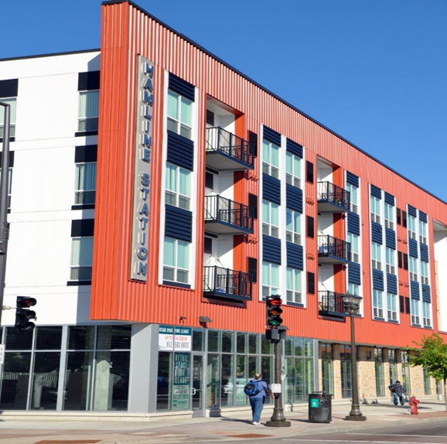
Sustainable Building Ordinance
Applies to projects receiving more than $200,000 in public assistance
Applies to new construction & rehab
Projects must be certified through an eligible green building standard
Projects must comply with the Saint Paul Overlay
Contact Kurt Schultz about any project that may receive more than $200,000 from all sources of public money

Slide 40
Working with Contractors/Subcontractors

Slide 41
Contractors/Subcontractors
For STAR projects, the city's relationship is solely with the grantee, who then has contractual obligations to the city to ensure that any contractors or subcontractors also abide by all applicable laws and ordinances in the STAR contract.
In other words, we work with you, and you work with your contractors and subcontractors!
The City DOES:
The City DOES NOT:
The City does require and attend a Preconstruction Meeting/Compliance Conference with the Grantee and City Compliance staff (HREEO) to review compliance requirements for each project. Contractors and subcontractors are welcome and encouraged to attend this conference.
The City does provide ongoing technical assistance related to compliance for the Grantee and associated contractors as needed.
The City does require that contractors and subcontractors are in compliance with City ordinance before releasing STAR funds to the Grantee.
The City does require Grantees to comply with the HRA two-bid policy.
The City does not pay contractors or subcontractors directly.
The City does not arbitrate or mediate between contractors/subcontractors/vendors and grantees.
The City cannot compel grantees to use specific contractors, subcontractors, or vendors.
The City does not make recommendations for subcontractors/vendors to STAR Grantees. In cases where Vendor Outreach Project requirements apply, Grantees are referred to the City CERT list of small, minority-, and woman-owned businesses as a resource.

Slide 42
Closing Fee & PaymentWorks Registration

Slide 43
Closing Fee
A closing fee equal to 1% of your grant award is due before payment can be released to you. For example, a grant of $50,000 would have a closing fee of $500.
Closing fee must be paid before any awarded funds can be released.
An invoice will be emailed to you with payment instructions. Online payments not accepted (sorry!)

Slide 44
PaymentWorks
PaymentWorks is a third-party service provider contracted to manage and verify vendor information for the City.
Grantees who are new to contracting with the City or still need to complete their PaymentWorks registration will receive an email from STAR staff in the coming days.
If you have already completed the PaymentWorks registration for the City, please log in to your account and make sure all your information is up-to-date.
Important to note when registering:
Your email may only be used once to set up a PaymentWorks account.
The information you provide to PaymentWorks must match throughout all forms and documents, including any STAR forms.
You can now opt in for ACH payments! Be sure to respond to PaymentWorks when they call to verify your banking information.
Save your login information so you can log back in to make updates.
The City does not have any oversight of their process.
Notes:
The City has partnered with PaymentWorks, a third-party service provider, to validate and manage vendor information. Grantees are required to complete the registration to get set up as a vendor and receive payments from the City. Those new to contracting with the City - OR - haven't started their registration with PaymentWorks will receive an email from STAR staff to complete the registration. Important things to keep in mind as you register:
You'll want to save your PaymentWorks login information so you can log back in to make any requested corrections or updates to your account.
PaymentWorks accounts are designed to represent a single tax entity, meaning if you manage multiple entities that need to register with PaymentWorks, you will need to create a separate account for each entity using a different email every time.
Your information must match throughout all forms and documents, including the information you provide to your project manager for your contract and payment request forms.
You can now opt in for ACH payments! If you do choose ACH as your preferred method of payment, PaymentWorks may reach out to you by phone to verify your banking information. It is important that you return their call if they leave a message.
Because this is a third party service provider, the City does not have any oversight of their process and cannot provide technical assistance.

Slide 45
PaymentWorks Resources & Technical Assistance
To learn more about the City's partnership with PaymentWorks, visit the City's website: https://www.stpaul.gov/departments/financial-services/paymentworks
To learn more about PaymentWorks visit: https://www.paymentworks.com/get-paid/
PaymentWorks Help Center: https://help.paymentworks.com/knowledge-base/payee-knowledge-base
Reach out to PaymentWorks directly for technical assistance by filling out their customer support form: https://help.paymentworks.com/contactsupport
If you have issues contacting PaymentWorks or have other concerns, please contact The Office of Financial Services (OFS) at OFS-Treasury@ci.stpaul.mn.us or call 651-266-8800.

Slide 46
Draw Requests & Reporting

Slide 47
Draw Requests & Reporting
Draw Requests
Work with your PM to request funds. All requests must include proof of work performed or costs incurred (payment, invoices, etc.)
Reporting
A final report will be required of all grantees
Payments must be approved by Compliance and PED Leadership – please allow 2-4 weeks
Proof of payment of all STAR funds must be submitted within 15 days of fund disbursement.
5% of constructions costs retained until proof of project completion (lien waiver, inspection report, etc.)
A link to an online reporting form will be emailed to you at the close of your project, prior to disbursing all funds
Reporting questions are about length of project, goals, before and after pics, and other comments about your experience.

Slide 48
We want to hear from you!
Please share pictures, stories, and updates throughout your project. We love opportunities to highlight the impact of the STAR program through videos, press releases, our website, reports, and other communications throughout the year.
You can share updates with your Project Manager or any STAR staff.
We may periodically be in touch with opportunities to be included in our communications, such as press releases or newsletters.

Slide 49
Contact Information

Slide 50
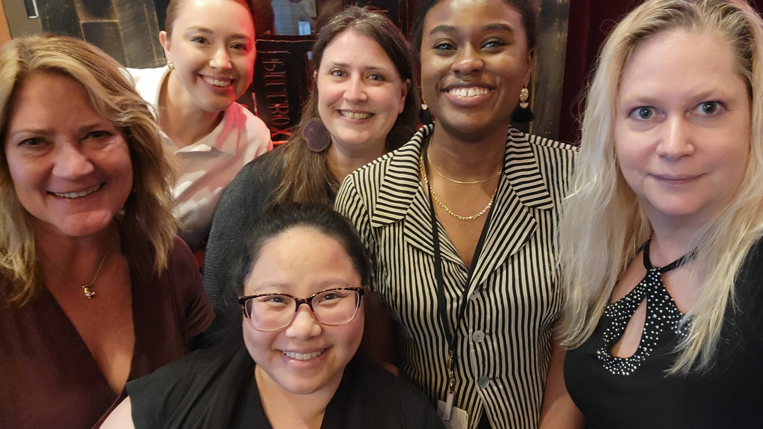
Neighborhood STAR Staff
Neighborhood STAR Coordinator:
Erin Lewis
651-266-6634
erin.lewis@ci.stpaul.mn.us
ped-neighborhoodstar@ci.stpaul.mn.us
Project Managers:
Nya Hardaman
651-266-6703
nya.hardaman@ci.stpaul.mn.us
Grace Bubel
651-266-6433
grace.bubel@ci.stpaul.mn.us
Nancy Vang
651-266-6474
nancy.vang@ci.stpaul.mn.us
Management Assistant:
Melissa Doerscher
melissa.doerscher@ci.stpaul.mn.us
651-266-6615
Cultural STAR Coordinator:
Jessica Larson-Johnston
jessica.Larson.johnston@ci.stpaul.mn.us
651-266-8654

Slide 51
HREEO Contract Compliance Contacts
HREEO: Stpaul.gov/HREEO
651-266-8966
contractcompliance@ci.stpaul.mn.us
Shared compliance inbox to reach all compliance contacts
AA/EEO & Workforce Inclusion
Yia Thao
affirmativeaction@ci.stpaul.mn.us
651-266-8928
City Labor Standards
Ethan Hansing
ethan.hansing@ci.stpaul.mn.us
651-266-8921
Vendor Outreach Program (VOP)
Priscilla Yang
priscilla.yang@ci.stpaul.mn.us
651-266-8966
CERT LIST:
https://cert.smwbe.com/cert@ci.stpaul.mn.us
651-266-8966 – Choose the option for “CERT”

Slide 52
Business Subsidy Law, Living Wage Ordinance, and Sustainability Building Ordinance Contacts
Business Subsidy and Living Wage Ordinance Contact:
Jenny Wolfe
jenny.wolfe@ci.stpaul.mn.us
651-266-6680
Sustainability Building Ordinance Contact:
Kurt Schultz
Kurt.Schultz@ci.stpaul.mn.us
651-266-6590

Slide 53
Questions?

Slide 54
Thank you!
We look forward to working with you on your STAR projects

