Slide 1



CITY OF SAINT PAUL
2026 Cultural STAR Awardee Workshop

Slide 2
Congratulations from the STAR STAFF!
Jessica Larson Johnston, Cultural STAR Program Coordinator
Grace Bubel, Project Manager
Nancy Vang, Project Manager
Nya Hardaman, Project Manager
Melissa Doerscher, Management Assistant
Erin Lewis, Neighborhood STAR Program Coordinator

Slide 3
Introductions – STAR staff
Awardees, please introduce yourselves in the chat!

Slide 4
AGENDA
Introductions
Types of Projects
Working with a project manager
Getting under contract
Registering as a vendor – PaymentWorks
Closing out your project
Tips + Reminders
Contact Information
Q & A

Slide 5
Project Types

Slide 6
Three Project Types – TWO Contract types
City of Saint Paul
SPECIAL PROJECTS
Quality arts activities, in any discipline
Capacity Building Projects
Activities to strengthen, grow and develop an organization
CAPITAL PROJECTS
Physical improvements, permanently installed equipment,
public art
This orientation session focuses on the contract and payment process for Special Projects and Capacity Building projects ONLY
*If you have a capital project, your project manager will reach out to you separately to go over contracting.
Notes:
Two contract types –
Special Projects/Organizational Development
Advance payment of 80%
The rest and close-out at the end
2. Capital
Disbursement
Track match as you go

Slide 7
Working with a
Project Manager

Slide 8
Project Management
Each awarded project will be assigned a Project Manager.
Your Project Manager will be your main point of contact for getting under contract, receiving your 80% advance, closing out your project, receiving your final payment, and providing support and assistance as needed throughout the life of your project.
Your Project Manager will be in touch with you soon to get started on the steps needed to get your project under contract.

Slide 9
Contracting

Slide 10
Getting Under Contract - receiving your 80% advance
Your contract is your first step in formalizing your agreement with the City of Saint Paul.
Your contract will include the dates of your agreement with the city, the statement of work for your project, insurance requirements, and all the terms and conditions of the STAR program.
You have until January 8th, 2027, to get under contract.
If your project is happening soon, your Project Manager will work to get you under contract as quickly as possible so that your 80% advance can be in play.
Projects in early August may not be under contract by the time the project takes place, and in those cases:
  Your Project Manager will work with you to get you under contract and then closeout your project (one after the other), to receive 100% of your grant all at once.
A sample contract, statement of work, insurance requirements, and other resource documents can be found online at stpaul.gov/nstar-recipients.

Slide 11
Contracting / 80% Advance Payment
Step 1: Getting under contract
  Statement of Work (SOW) – Complete and email to Project Manager
  Funding is specific to the project type, geographic location (In/Out of Cultural District), and project scope as proposed in your 2026 Cultural STAR application.
  Project and eligible expenses must be within the effective contract period (8/1/26-7/31/27)
  Only expenses from budgeted categories indicated in the statement of work will be eligible for reimbursement. New budget categories/budget lines cannot be added later. Documentation will be required for disbursement.
  Certificate of Insurance (COI) - Complete and email to Project Manager
  The City of St. Paul requires liability insurance coverage for all projects.
*Sample documents can be found here, under 2026 Cultural STAR Recipients:
Sample SOW + COI documents
Notes:
Statement of Work – reminders:
1:1 match required only for projects awarded over $50k
Timeline – event must be between 08/01/24 – 07/31/25
All expenses charged to grant to be charged within the approved budget categories and contract dates
Document all STAR expenditures – amounts can change between lines, but no NEW categories added later
Big ticket items usually easiest
Cannot fund food or beverage
City will not reimburse expenses related to insurance coverage
Matching funds documentation

Slide 12
Contracting / 80% Advance Payment
Did you apply with a Fiscal Sponsor?
Fiscal Sponsor
    Contract will be between the Fiscal Sponsor and the City
    Provide a copy of the Fiscal Sponsor Agreement to your Project Manager
    Documentation is usually completed and submitted by the grantee
    Fiscal Sponsor fee can be included in the budget as an expense charged to STAR
MN Secretary of State business status must be active and in good standing
Notes:
VOP packet – stay later to hear from Yia/staff
LOOK AT MY LIST FOR VOP / Sec of State

Slide 13
Contracting / 80% Advance Payment
Step 2: Review and sign contract and payment form
Contract prepped by City Project Manager
  Statement of Work completed and approved
  Certificate of Insurance submitted and approved
Payment Request Form prepped by City staff
E-Sign both Contract and Payment Request Form
City of Saint Paul signs and processes contract and payment request
Conflict of Interest Statement
PaymentWorks

Slide 14
Implement Project
Step 3: Be prepared for final requirements
Keep documentation of expenses to be charged to STAR
  Invoices, receipts, copies of payment method, artist/venue contracts, etc.
Give proper credit to STAR funding in your promotions – logo, acknowledgement statement
  Website, Facebook events, Programs, Promotional materials, etc.

Slide 15
PaymentWorks

Slide 16
PaymentWorks
PaymentWorks is a third-party service provider contracted to manage and verify vendor information for the City.
Grantees who are new to contracting with the City or still need to complete their PaymentWorks registration will receive an email from STAR staff in the coming days.
If you have already completed the PaymentWorks registration for the City, please log in to your account and make sure all your information is up-to-date.
Important to note when registering:
Your email may only be used once to set up a PaymentWorks account.
The information you provide to PaymentWorks must match throughout all forms and documents, including any STAR forms.
You can now opt in for ACH payments! Be sure to respond to PaymentWorks when they call to verify your banking information.
Save your login information so you can log back in to make updates.
The City does not have any oversight of their process.
Notes:
The City has partnered with PaymentWorks, a third-party service provider, to validate and manage vendor information. Grantees are required to complete the registration to get set up as a vendor and receive payments from the City. Those new to contracting with the City - OR - haven't started their registration with PaymentWorks will receive an email from STAR staff to complete the registration. Important things to keep in mind as you register:
You'll want to save your PaymentWorks login information so you can log back in to make any requested corrections or updates to your account.
PaymentWorks accounts are designed to represent a single tax entity, meaning if you manage multiple entities that need to register with PaymentWorks, you will need to create a separate account for each entity using a different email every time.
Your information must match throughout all forms and documents, including the information you provide to your project manager for your contract and payment request forms.
You can now opt in for ACH payments! If you do choose ACH as your preferred method of payment, PaymentWorks may reach out to you by phone to verify your banking information. It is important that you return their call if they leave a message.
Because this is a third party service provider, the City does not have any oversight of their process and cannot provide technical assistance.

Slide 17
PaymentWorks Resources & Technical Assistance
To learn more about the City's partnership with PaymentWorks, visit the City's website: https://www.stpaul.gov/departments/financial-services/paymentworks
To learn more about PaymentWorks visit: https://www.paymentworks.com/get-paid/
PaymentWorks Help Center: https://help.paymentworks.com/knowledge-base/payee-knowledge-base
Reach out to PaymentWorks directly for technical assistance by filling out their customer support form: https://help.paymentworks.com/contactsupport
If you have issues contacting PaymentWorks or have other concerns, please contact The Office of Financial Services (OFS) at OFS-Treasury@ci.stpaul.mn.us or call 651-266-8800.

Slide 18
Closing Out your Project

Slide 19
Closing out your project / 20% remaining payment
Your project is complete and you're ready to closeout!
STEP 1: Submit final Payment Request and Documentation via ZoomGrants.
  Project must have taken place
  Fill out and sign Final Payment Request Form
  Grantee must provide documentation of the following:
    All expenses charged to Cultural STAR grant funds, must demonstrate:
      What the expense was for, that it was related to the project, and within the approved budget categories from the Statement of Work, such as:
        Invoices, receipts contracts, etc.
      How it was paid, such as:
        Copy of check used to pay expense, bank/credit card statement, etc.
      Date expense incurred
        Must be between 8/1/26-7/31/27

Slide 20
CLOSE-OUT / 20% Remaining Payment
Required documentation, continued:
  Credit given to Cultural STAR funding, such as:
    Website print-out, program, promotional materials
  Completion of Final Report in ZoomGrants
  The STAR Grant shall be fully disbursed within ninety (90) days from the end of the Effective Dates of this Grant Agreement (7/31/2027): 10/29/2027

Slide 21
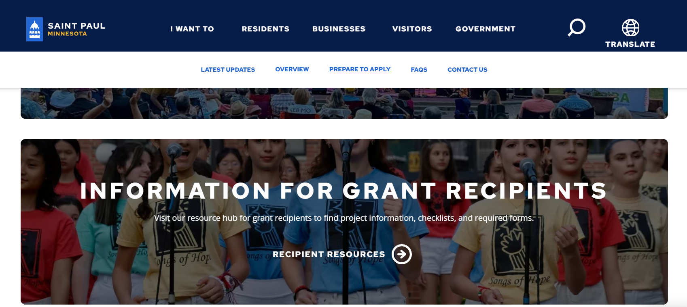
Website has documents, logos, and other resources: www.stpaul.gov/cultural-star

Slide 22
CLOSE-OUT / 20% Remaining Payment
Step by Step:
Log in to your ZoomGrants account
Find your 2026 Cultural STAR application
Access the Final Report Tab
Complete the Report (your responses will automatically save as you move to the next question)
Upload close-out and expense documentation
Submit
For more information on how to submit the final report, please refer to ZoomGrant’s help guide here:
  https://help.zoomgrants.com/index.php/zgu/approved-applicants-submitting-reports-invoices-and-adjustment-requests/

Slide 23
EXPENSE DOCUMENTATION
What we look for at Closeout – Expense Documentation
Do the expenses fall into the budget categories that were allocated in the contract? (Found in Exhibit A, Statement of Work).
  Note that the $ amounts can differ from what's in the contract, but no new budget categories can be added upon closing out.
Does each expense document list a date within the contract period? (Found on the first page of the official contract, "Effective Dates") 8/1/26 - 7/31/27
Does each expense document have a corresponding document showing proof of payment?
Is proof of payment clear? (e.g., if you send a bank statement, are the relevant payments noted/highlighted?)
When combined, do all expenses total at least the grant amount?

Slide 24
Tips & Reminders

Slide 25
Tips for closing out
  Where possible, charge larger expenses to the grant. This results in fewer documents to send your PM and less time for your PM to review everything.
    e.g., charging a facility expense to the grant, then submitting the invoice and proof of payment. This can save time in comparison to gathering and submitted numerous documents for small expenses.
  If your project is over, we encourage you to close out and not wait until the 10/29/27 deadline to submit your closeout documentation. STAR staff manages hundreds of projects and reviewing closeouts can be time consuming. If you are eager for your remaining grant funds, close out as soon as you can.

Slide 26
RESOURCES!
A sample contract, statement of work, insurance requirements, and other resource documents can be found online!
2026 Cultural STAR Recipients

Slide 27
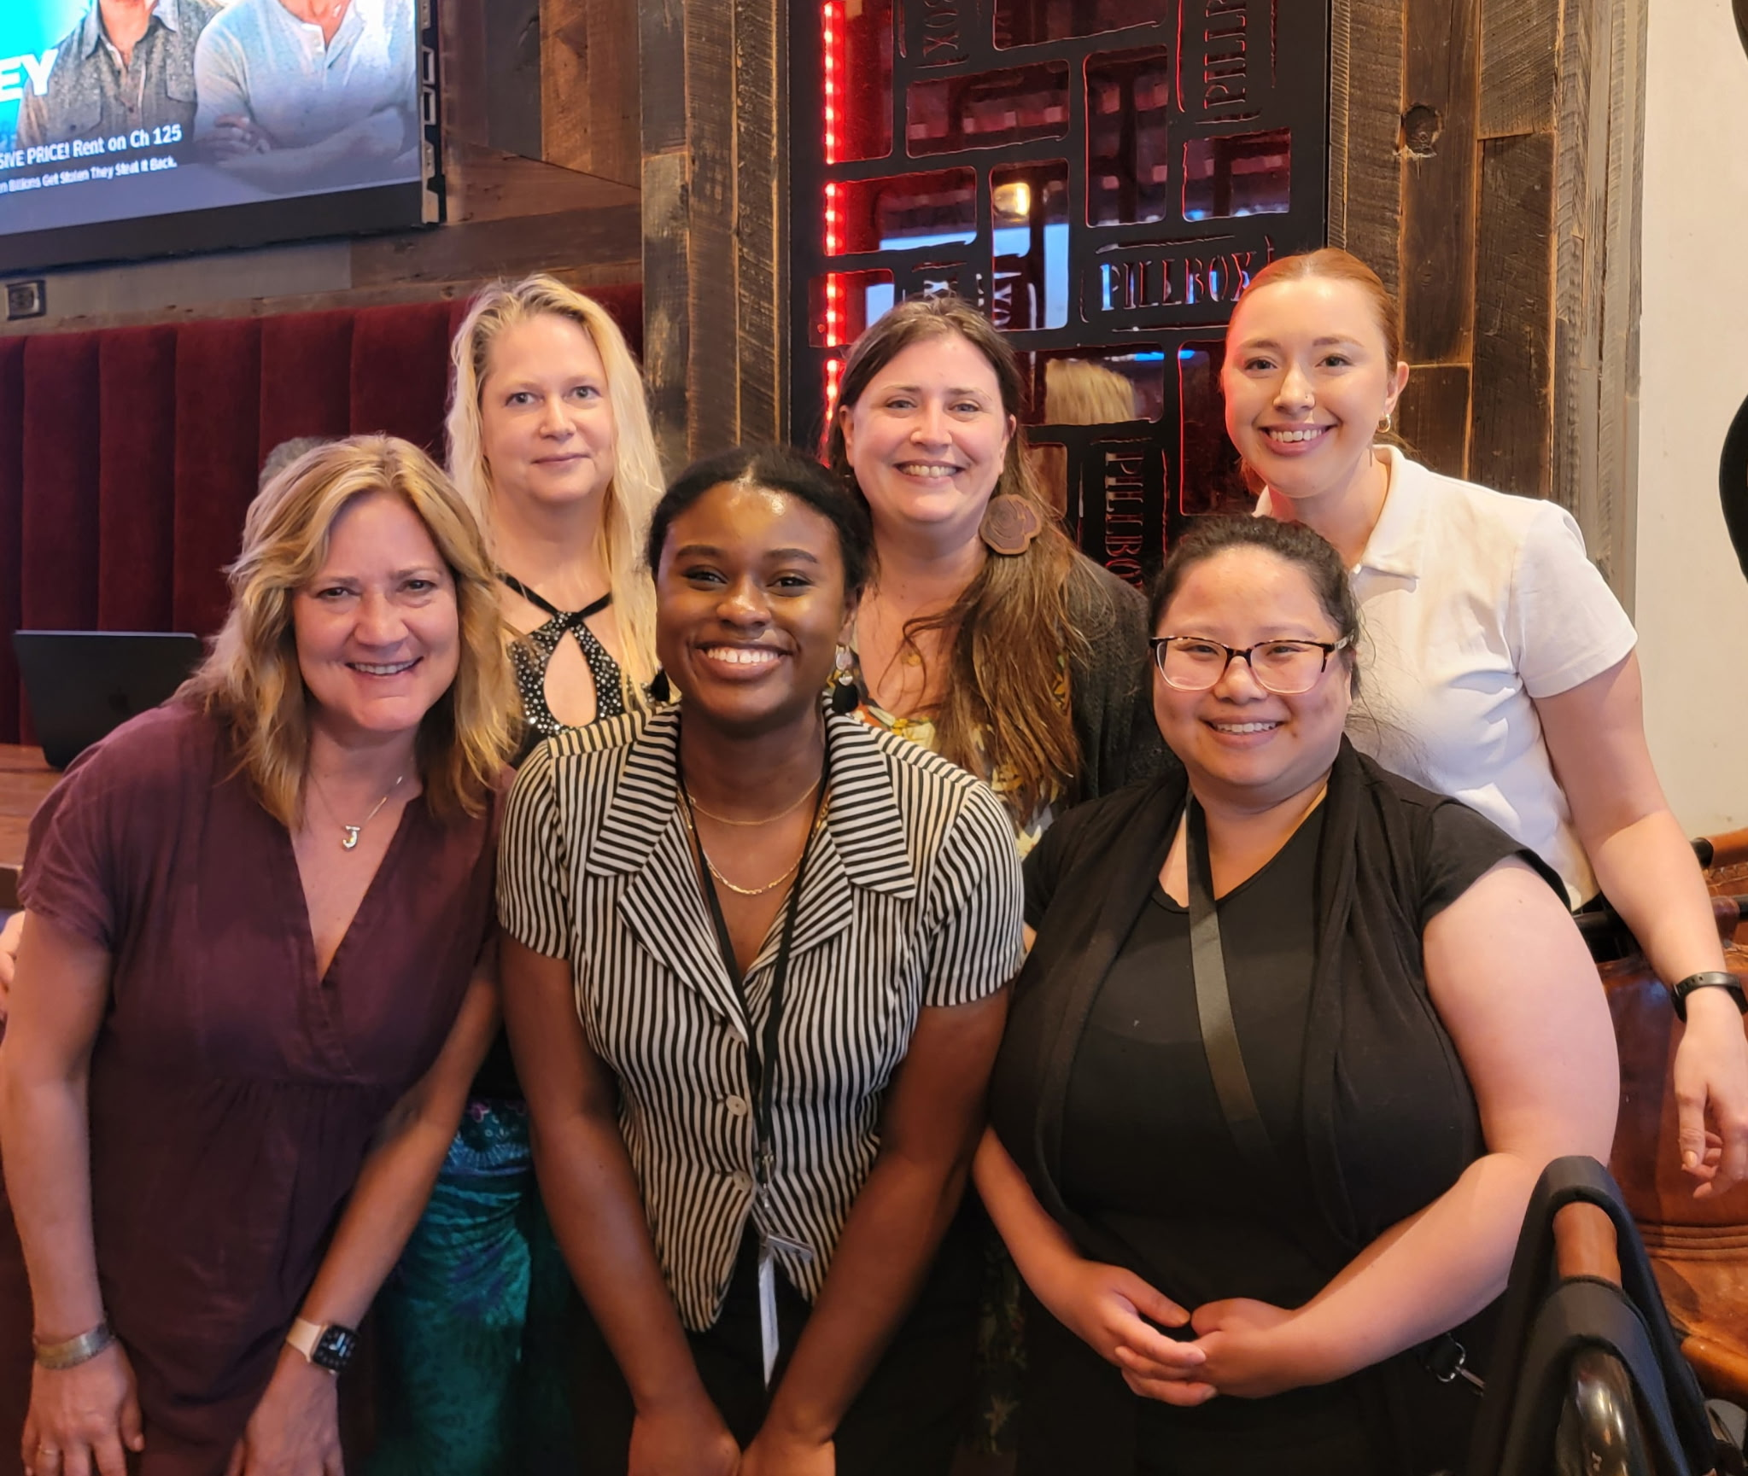
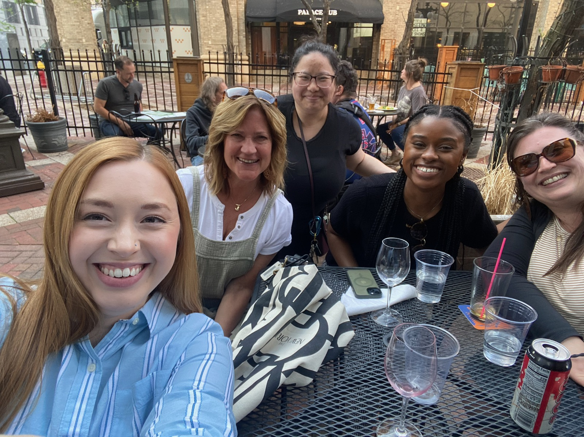
Cultural STAR Staff
Cultural STAR Coordinator:
Jessica Larson Johnston
651-266-8654
jessica.larson.johnston@ci.stpaul.mn.us
ped-culturalstar@ci.stpaul.mn.us
Project Managers:
Nya Hardaman
651-266-6703
nya.hardaman@ci.stpaul.mn.us
Grace Bubel
651-266-6433
grace.bubel@ci.stpaul.mn.us
Nancy Vang
651-266-6474
nancy.vang@ci.stpaul.mn.us
Neighborhood STAR Coordinator:
Erin Lewis
651-266-6634
erin.lewis@ci.stpaul.mn.us
Management Assistant
Melissa Doerscher
651-266-6615
Melissa.Doerscher@ci.stpaul.mn.us

Slide 28
Questions?

Slide 29
Thank you!
We look forward to working with you on your STAR projects

