Slide 1


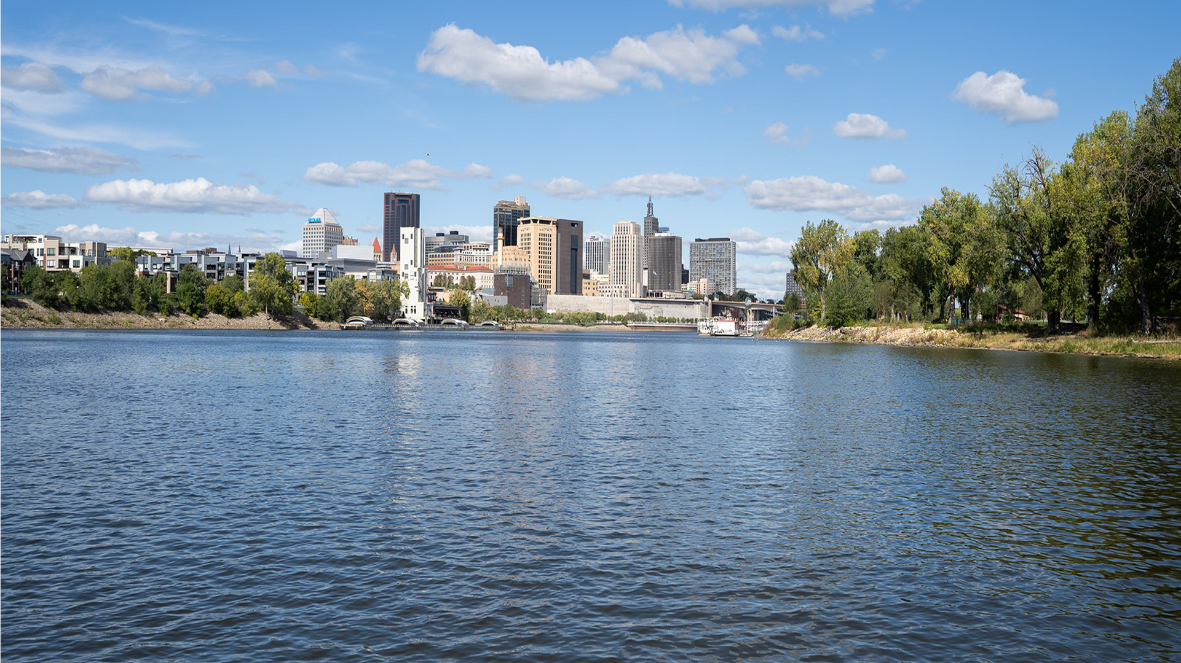
CITY OF SAINT PAUL
University Avenue Reconstruction Project

Slide 2
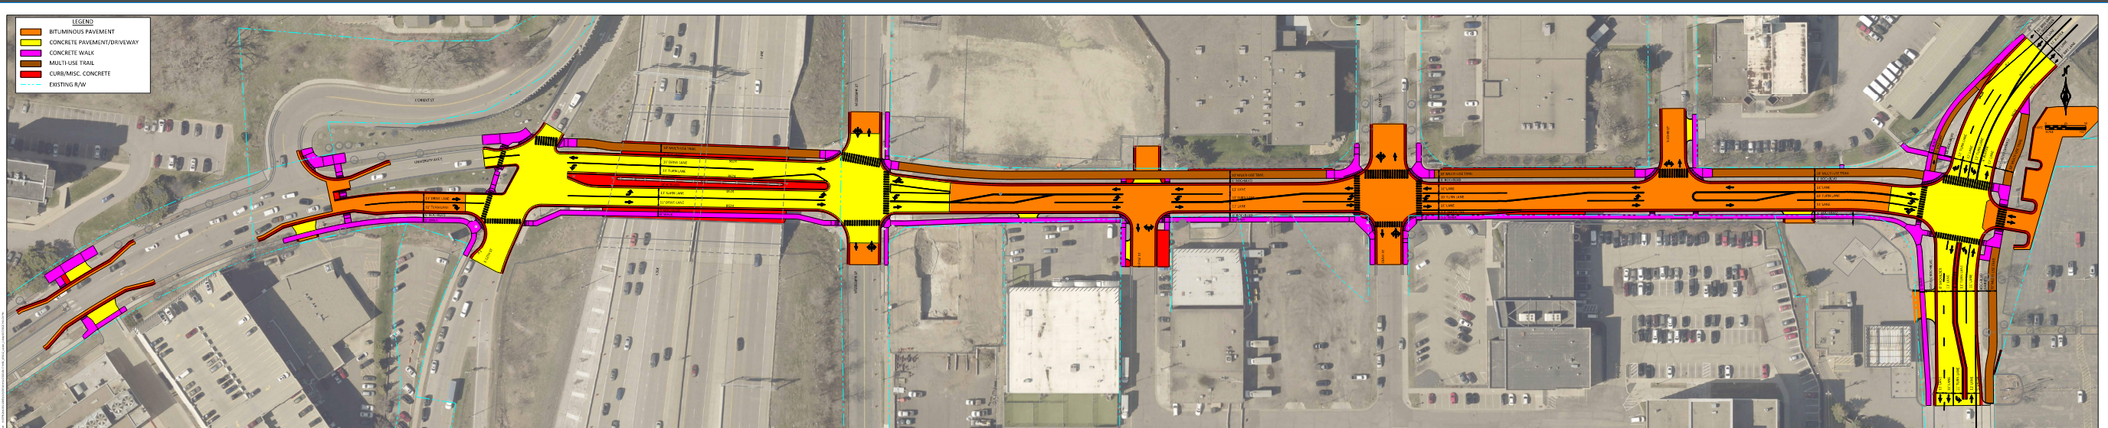
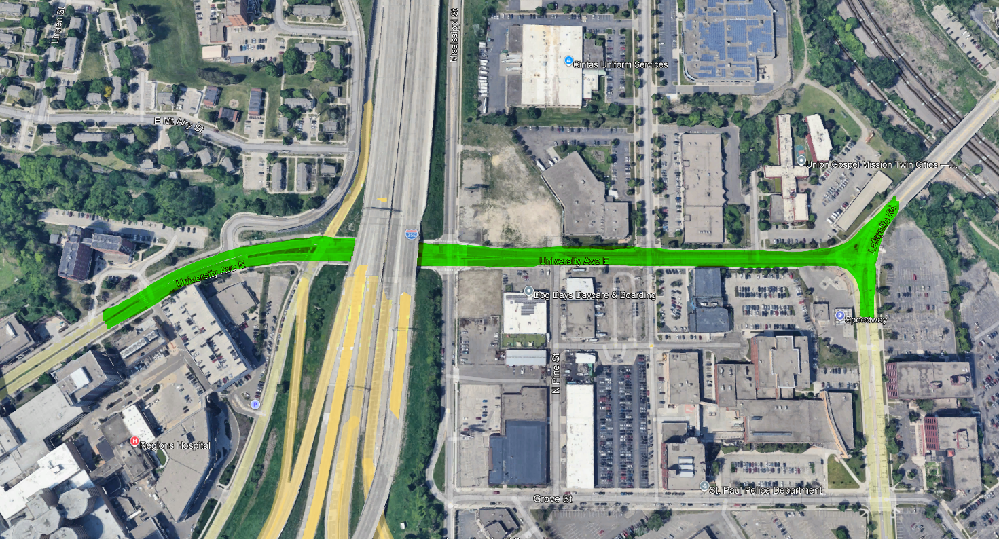
Reconstructing University Avenue
Project Information
From the west side of L’Orient Street to Lafayette Road
New watermain and storm sewer below ground
New road layout with additional street crossings, traffic signals and lighting

Slide 3
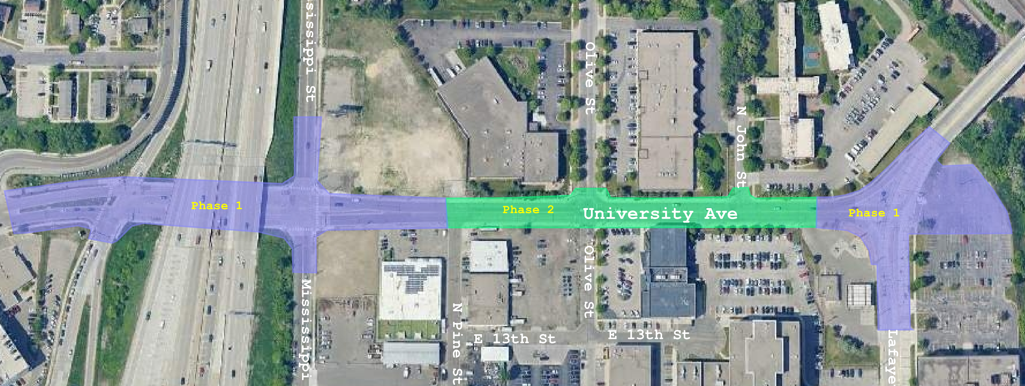
Overall Phasing Plan
Project Information

Slide 4
Project Timeline
Project Information
Phase 1: 6/1/26 – Mid-Summer
Phase 2: Mid-Summer – End of Autumn

Slide 5
Phase 1: L’Orient to N. Pine Street;
Lafayette Road intersection
Project Information

Slide 6
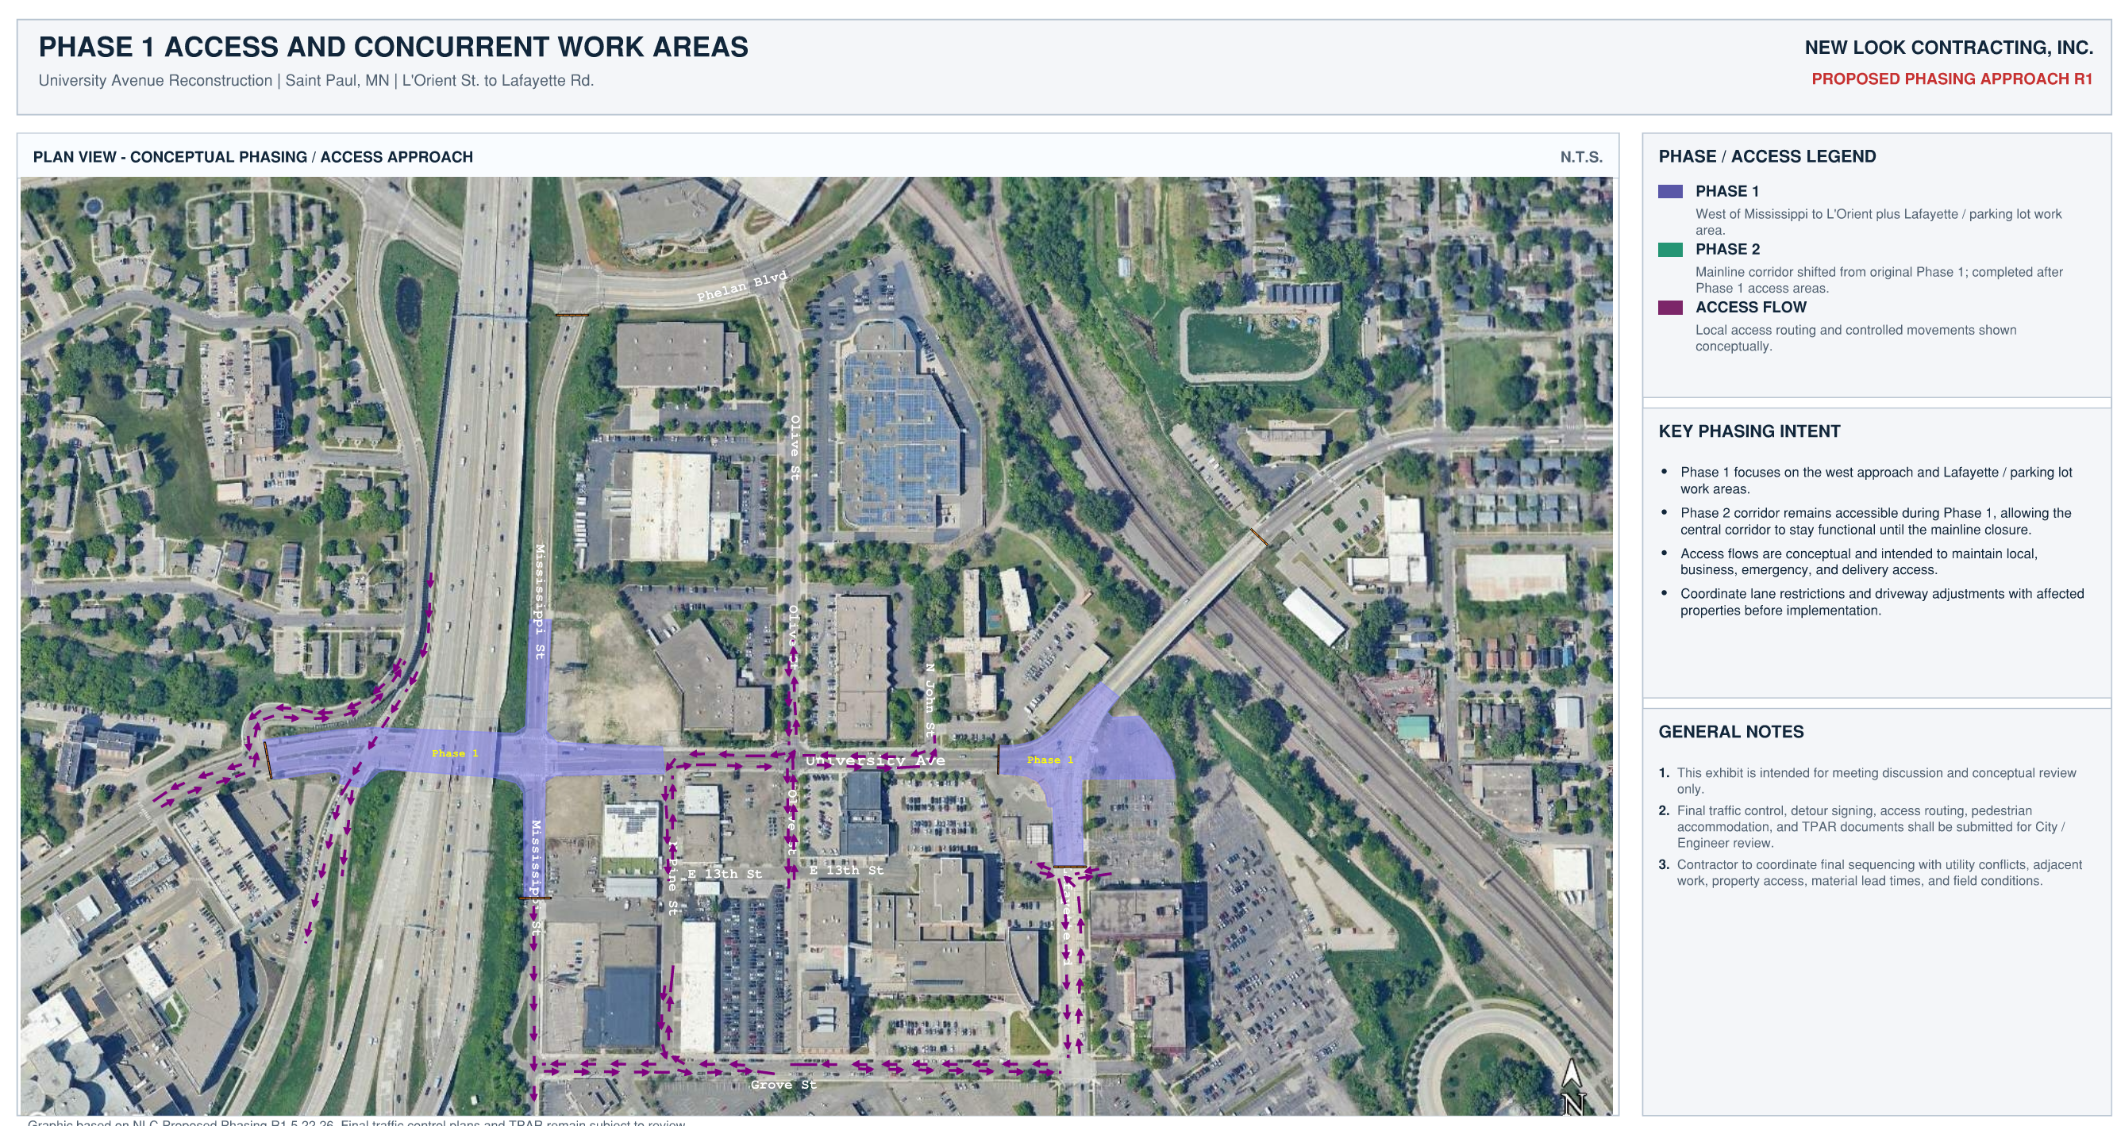
Project Information

Slide 7
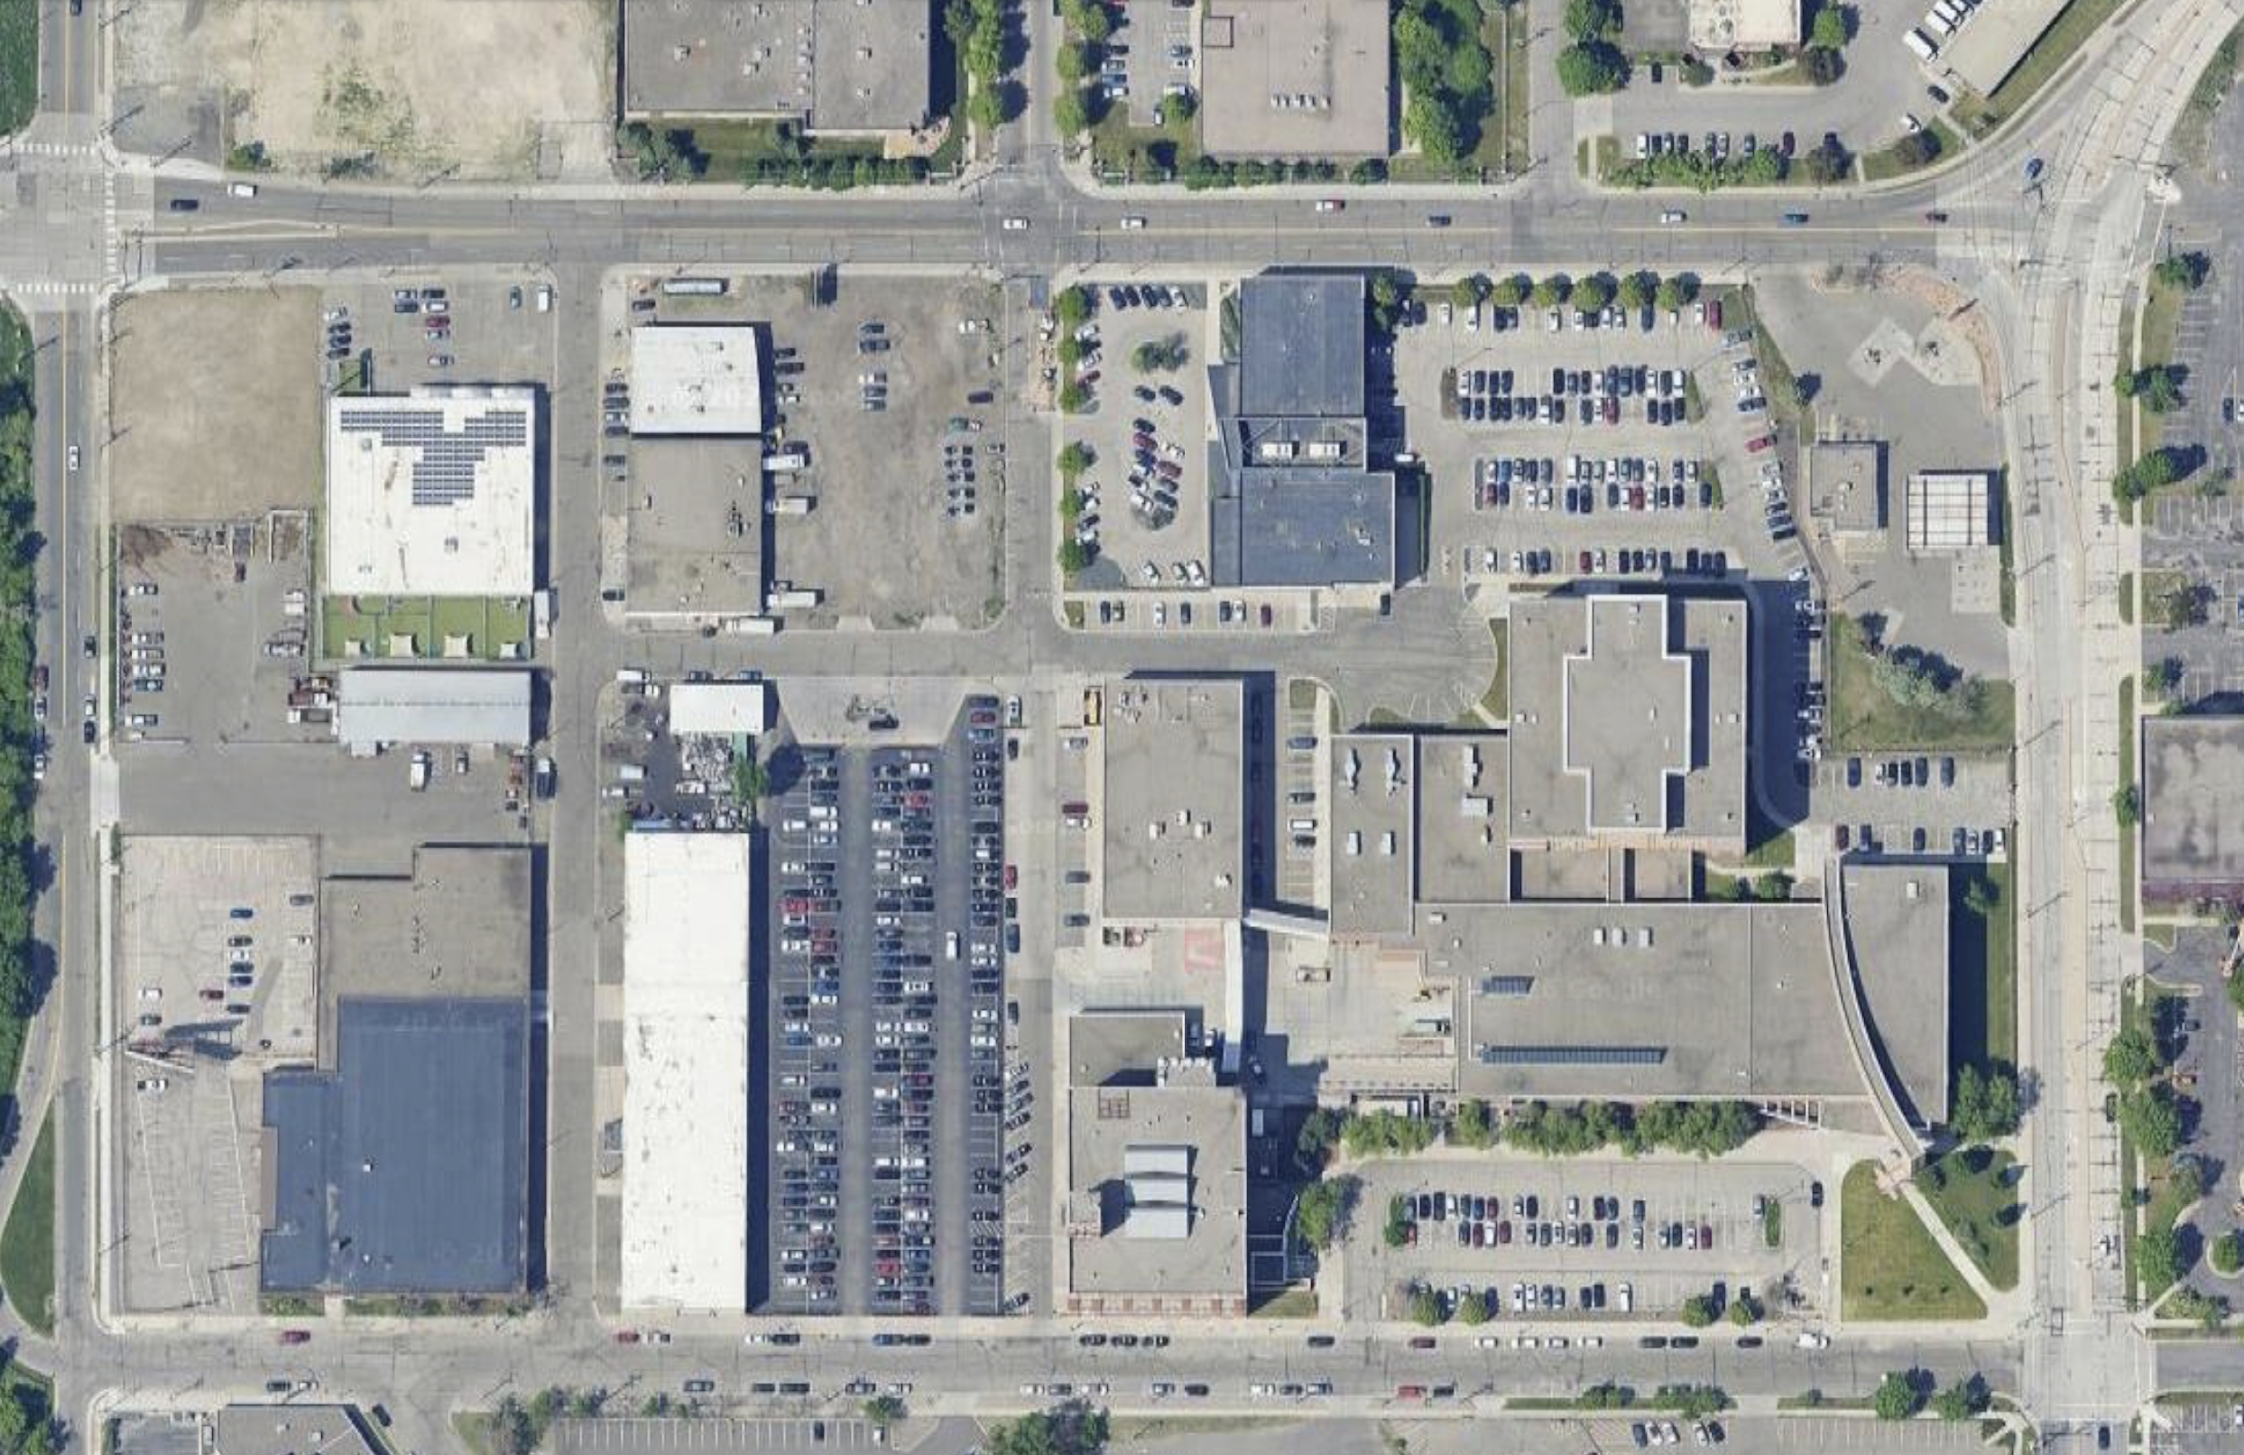
Access during Phase 1: L’Orient to N. Pine Street; Lafayette Road intersection
Project Information
N. JOHN STREET
AVAILABLE ACCESS
UNIVERSITY AVENUE – PHASE 2 RECONSTRUCTION
AVAILABLE ACCESS AT
UNIVERSITY DURING THIS
PHASE
OLIVE STREET
E. 13TH STREET
N. PINE STREET
LAFAYETTE ROAD
MISSISSIPPI STREET
GROVE STREET

Slide 8
Phase 2: University Avenue between N. Pine Street and west of Lafayette Road
Project Information

Slide 9
Access during Phase 2: University Avenue
Project Information
OLIVE STREET
N. JOHN STREET
AVAILABLE ACCESS
E. 13TH STREET
N. PINE STREET
LAFAYETTE ROAD
MISSISSIPPI STREET
OLIVE STREET
GROVE STREET

Slide 10

For more information:
City of Saint Paul
Project website: University Avenue Reconstruction | Saint Paul Minnesota
Sign-up for University Avenue Reconstruction Project Updates, for weekly updates in your inbox!
Questions?:
  Jack Connelly, Public Works Street Design and Construction, 651.266.5417, Jack.Connelly@ci.stpaul.mn.us
  Brandon Mensing, Bolton and Menk Construction Manager, 612.289.0313, Brandon.Mensing@Bolton-Menk.com

Slide 11
Investing in Saint Paul Streets: Common Cent:
City of Saint Paul
A portion of this street reconstruction project will be paid for by a 1% local option sales tax, called Common Cent. This sales tax was approved by Saint Paul voters in November 2023. A portion of the project will also be funded through assessments to property owners adjacent to the project. The estimated assessment rate is based on a third-party special benefit analysis of the property values in the project area. Property owners will receive a notice of the estimated rate and date for a public hearing when estimated rates are available. More information on assessments can be found at www.stpaul.gov/specialassessments.

Slide 12
Thank You

